Slide 1
Ch 11
Market Equilibrium

Slide 2
Learning Objectives:
1st Part:
Understand the Equilibrium price and quantity and how they are determined.
Understand the causes of changes in equilibrium price and quantity as a result of shifts in demand and supply curves.
2nd Part:
Understand the operations of market forces to eliminate excess demand and excess supply.
Understand the distinction between consumer and producer surplus.
Understand the effect of changes in demand and supply on consumer and producer surplus.

Slide 3
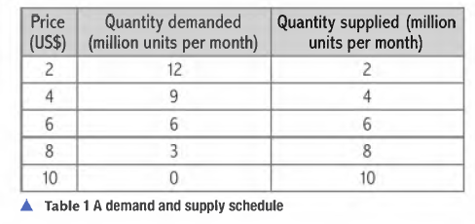
Equilibrium Price
Excess Demand - Shortage
At price US $2,
Quantity demanded > Quantity Supplied
Excess Supply – Surplus
At price US $ 10,
Quantity supplied > Quantity Demanded
Equilibrium price – Market cleared
At price US $6,
Quantity demanded = Quantity supplied
Equilibrium price
Definition: The price where demand of the buyers equals the supply of the seller in the market.

Slide 4
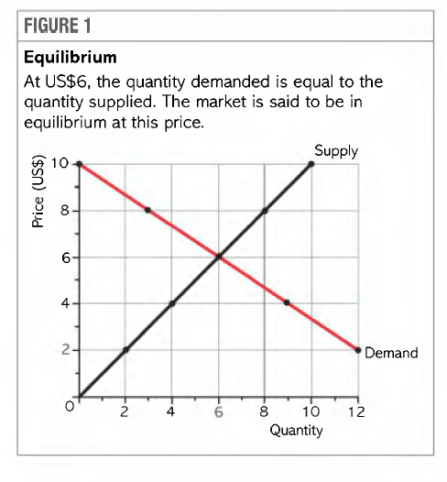
Equilibrium price is shown where two curves cross each other at the same price (US $6) and quantity which is bought and sold at equilibrium price is equilibrium quantity (6 million units).

Slide 5
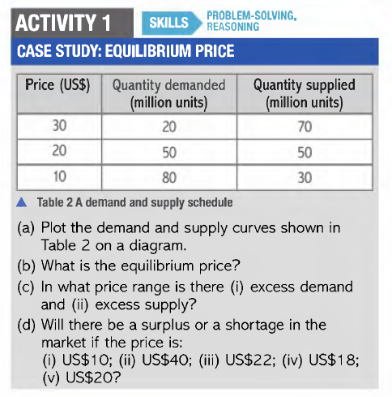

Slide 6
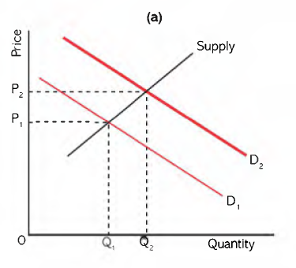
Changes in Demand and supply
Effects of changes in demand and supply on equilibrium price and quantity.
Increase in consumer’s income leads to an increase in both prices and quantity of a product sold.

Slide 7

Increase in demand for flat screen televisions leads to fall in demand for bulky television sets.
Demand curve for bulky TV sets shift left from D1 to D2

Slide 8
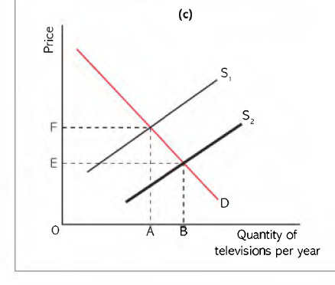
Fall in price of television sets
Increase in supply at given prices.
Supply curve shifts right from S1 to S2

Slide 9

Simultaneously,
Demand curve shifts right from D1 to D2
Supply curve shifts right from S1 to S2
Increase in price, decrease in price or no change in price will depend on the extent of the shift in supply and demand curve.

Slide 10
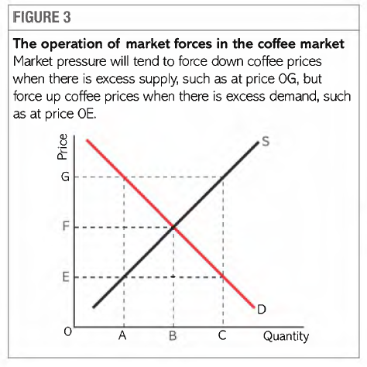
Do markets clear?
Argument by neo-classical economists – Markets do tend to clear.
Excess Demand for coffee:
Higher prices and higher production level
Excess supply for coffee:
Lower Prices and lower production level
The pressure which forces the market towards an equilibrium point are called free market forces.
Excess Supply
Excess Demand

Slide 11
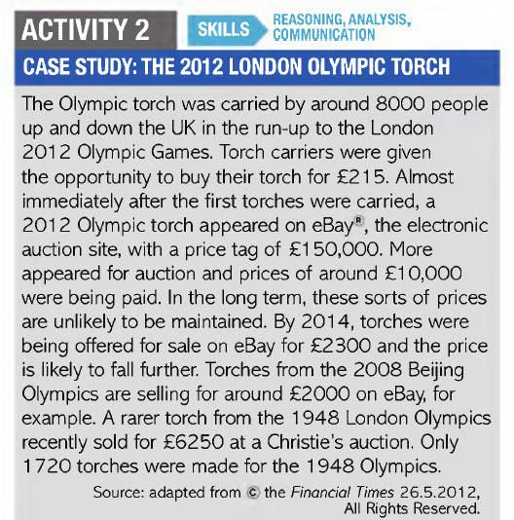
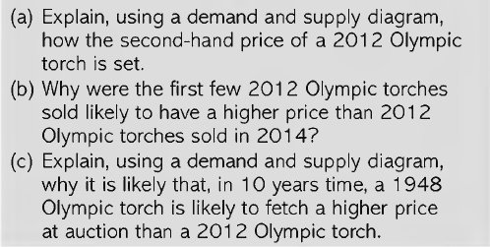

Slide 12
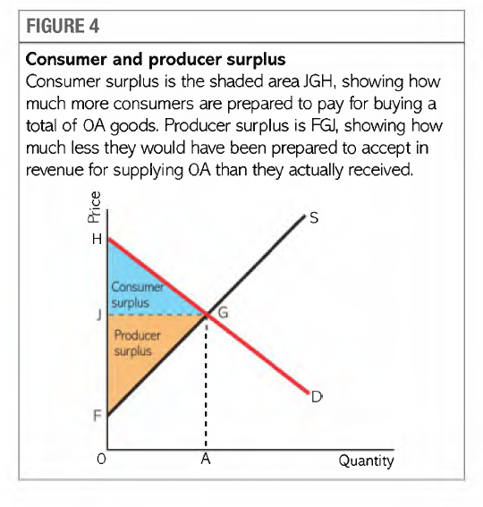
Consumer and Producer Surplus

Slide 13
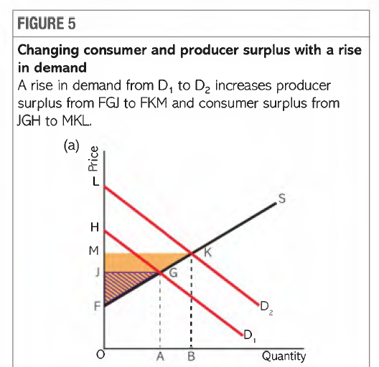
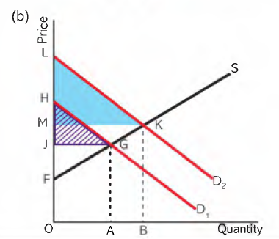
Change in Demand: Increase or decrease
Rise in demand leads to increase in producer and consumer surplus.
Fall in demand leads to decrease in consumer and producer surplus

Slide 14
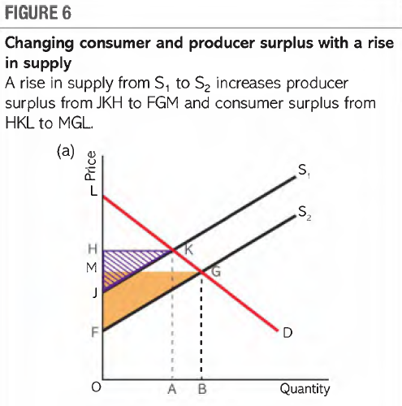
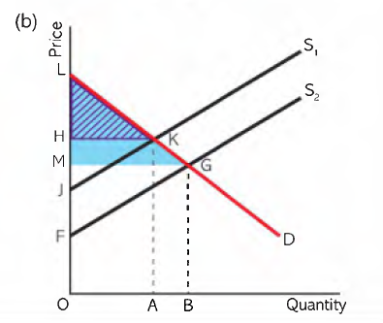
Change in Supply: Increase or decrease
Rise in Supply leads to increase in producer and consumer surplus
Fall in supply leads to decrease in producer and consumer surplus

