Slide 1
Ch 12
Functions of
Price Mechanism

Slide 2
Learning objectives:
Understanding the rationing, incentive and signalling functions of the price mechanism for allocating scarce resources.

Slide 3
The Price Mechanism
The Price Mechanism in a market economy allocates resources between conflicting uses.
Price has three important functions:
  Rationing function
  Signalling function
  Incentive function

Slide 4
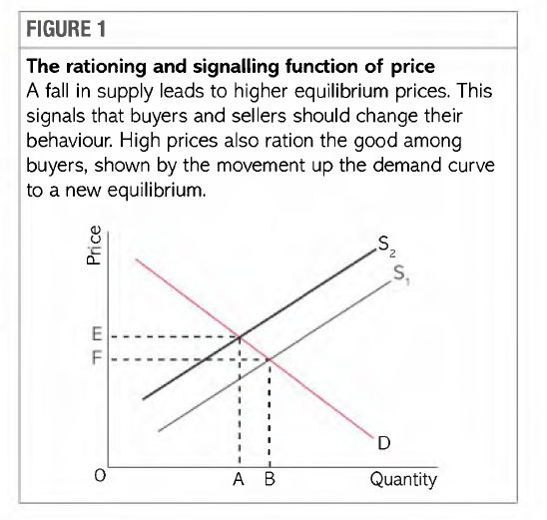
Rationing Function
The rationing function of price is associated with contraction of demand along the demand curve.
Higher prices leads to rationing of the good over time.

Slide 5
Signalling function
Price act as a signal for buyers and sellers
Decision of buyers and sellers are based on these signals.
Rise in price and fall in price gives signals to the consumers and producers.

Slide 6
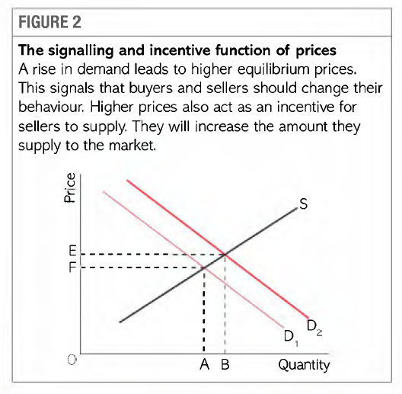
Incentive function
The incentive function of price rise is associated with an extension of supply along the existing supply curve.
Higher prices are incentive for firms to increase supply.

