Slide 1
Ch 13
Indirect Taxes and Subsidies

Slide 2
Learning Objectives:
Part 1
Understand the impact of indirect taxes on consumers, producers and government.
Understand the incidence of taxes on consumers and producers.
Part 2
Understand the impact of subsidies on consumers, producers and the government.
Understand the incidence of subsidies on consumers and producers.

Slide 3
Indirect Taxes
Indirect tax is a tax on expenditure.
Types of Indirect Tax
Value added Tax
Excise Duties

Slide 4
Value Added Tax | Excise Duty
Ad Valorem Tax | Specific or Unit Tax
Tax charged increases in proportion to the value of the tax base | Amount of tax charged does not change with the value of the good but with the quantity or volume of the good.

Slide 5
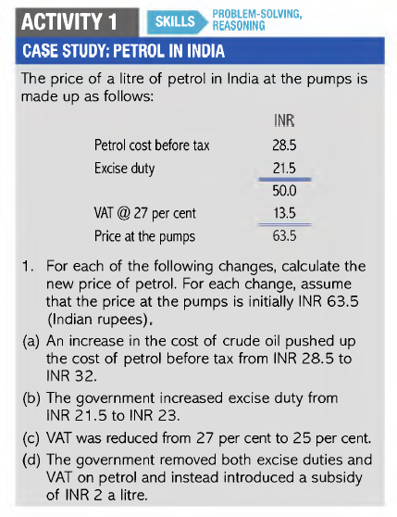

Slide 6
The Incidence of Tax
Measures the burden of tax upon the tax payer
Impact of imposing an indirect tax on a good – Decrease in supply
Price (US$)
S2
TAX REVENUE:
Tax revenue is the income that is gained by government through taxation.
Total Tax revenue :
Tax per unit X Quantity sold
= $1 X 40 million units
= $ 40 million
Consumers Paid:
= $0.70 X 40 million units
= $28 million
Producers paid:
= $0.30 X 40 million units
= $12 million
S1
8
Consumer Burden
7.30
7
Producer Burden
D
Quantity
(Millions of units
O
40
60

Slide 7
Ad valorem Tax
Ad valorem means – according to value.
An ad valorem tax imposes a tax on a good depending on its value.
This tax is usually expressed as percentage tax.
Price
S2
S1
F
E
Consumer Burden
G
K
C
Producer Burden
H
J
D
O
Quantity
A
B

Slide 8
TAX and ELASTCITIES
Price Elasticity of Demand = Price Elasticity of Supply
Tax Incidence on Consumer = Tax incidence on producer
Price
S1 + Tax
S1
E1
P1
Consumer Burden
E
P
Producer Burden
P0
F
D
Quantity
O
Q1
Q

Slide 9
Incidence of tax falls entirely on consumers
When Supply is perfectly Elastic, producer shifts the whole tax burden on consumer.
When Demand is perfectly Inelastic, producer shifts the whole tax burden on consumer.
Price
Price
D
S1 +Tax
S1
P1
P1
S1 +Tax
All tax burden on consumer
All tax burden on consumer
P
S1
P
D
Quantity
Quantity
O
Q1
Q
O
Q

Slide 10
Incidence of tax falls entirely on producers
When Demand is perfectly Elastic, producers have to bear the burden of the tax.
When Supply is perfectly Inelastic, producers have to bear the burden of the tax.
Price
Price
S1 +Tax
S1
S1
P
All tax burden on producer
P
D
All tax burden on producer
D
Quantity
Quantity
O
Q1
Q
O

Slide 11
Subsidies
A subsidy is a grant given by the government to encourage the production or consumption of a particular good or service.
Price
S
S+ subsidy
P1
Producer subsidy
Total cost of subsidy
P
Consumer Subsidy
P0
D
O
Q
Q0
Quantity

Slide 12
SUBSIDIES and ELASTICITY
When Demand is Inelastic
When Demand is Elastic
Price
Price
S
S
P1
Total Cost of subsidy
Producers subsidy
S+ subsidy
S+ subsidy
P1
Total Cost of subsidy
P
Producer’s Subsidy
Consumer’s Subsidy
P
Consumer’s subsidy
P0
D
P0
D
O
Q
Quantity
O
Q
Q0
Q0
Quantity

