Slide 1
Ch 16
Supply of Labour

Slide 2
Supply of labour to an occupation
Supply of labour – number of workers willing and able to work in a particular job or occupation for a given wage.
Factors that affect supply of labour:
  Wages/ salaries
  Job satisfaction
Greater job satisfaction – workers ready to accept lower wages
Higher pay – higher job satisfaction
  Higher paid jobs – workers have more control over their working environment

Slide 3
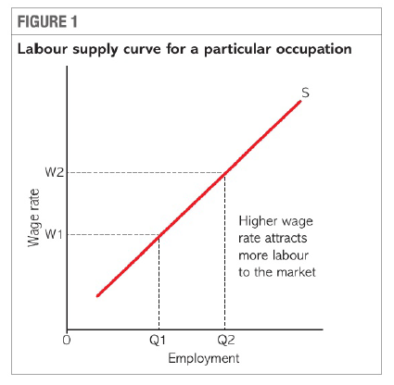
Two ways of increasing the number of hours worked:
  Existing labour
  Recruit new workers
Rise in wage rates – attracts new workers
  New workers may be from other occupations, house persons or unemployed
  Supply of labour curve – upward sloping
  Higher the wage rate – more workers want to enter that occupation

Slide 4
Shifts in supply of labour curve
Size of population
  Working population – number of people who are of working age, between school leaving age and retirement age and willing and able to work.
    Higher working population – more people enter the occupation – increase the supply of labour
    Increase in school leaving age – fall in working population – fall in supply of labour
    Increase in retirement age – increase in working population – increase in supply of labour
  Economically active – number of workers in workforce who are in job or are unemployed.
    Few people part of workforce – supply of labour is lower
    Activity or participation rate is an important factor that influence supply of labour
      E.g. increase in women participation – population remain same – increase in supply of labour
    Age structure of population
      Increase in total population due to aging population – supply of labour may not increase

Slide 5
Net migration
  Positive net migration – more people entering the country than leaving – increase in supply of labour
    To prevent shortage of skilled labour – doctors, teachers
  Negative net migration – decrease in supply of labour
    Leads to skill shortages
Income tax rates
  increase in income tax rates – reduce disposable income – work becomes less attractive – fall in supply of labour to low paid jobs
  Progressive income tax – disincentive for workers to gain promotions – fall in supply of labour to high paid jobs
  Progressive income tax – high marginal rate of tax – not worth working additional hours – workers discouraged from working long hours – fall in supply of labour
  No income tax for low paid workers – higher incentive to supply labour
  Fiscal drag
    Rise in wages – rise in inflation – but tax free allowance not raised – low paid workers wages rise but also have to pay tax – disincentive to effort – reduce supply of labour

Slide 6
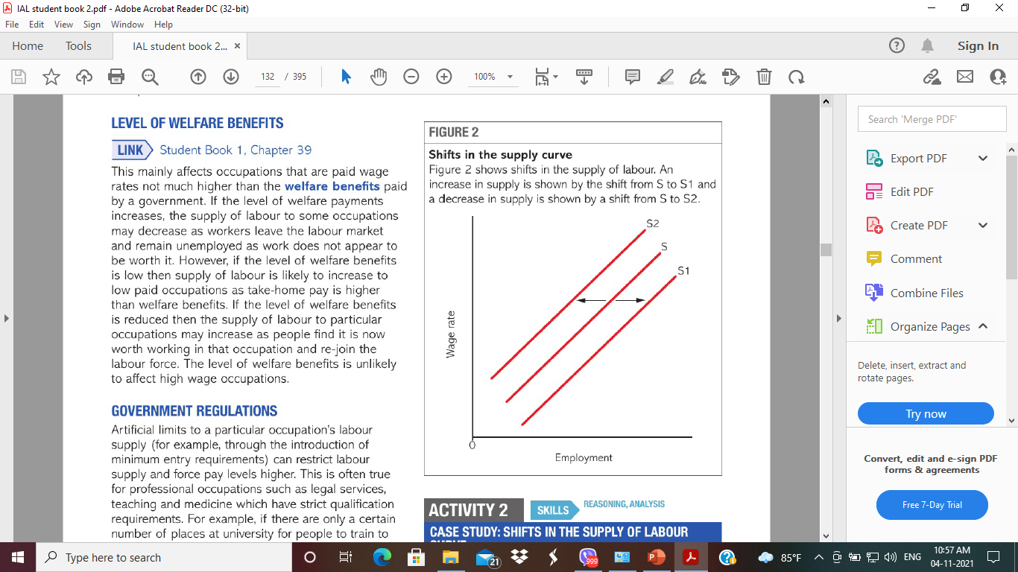
Level of welfare benefits
  Occupation where wage rates not much higher than welfare benefits
  Rise in welfare payment – decrease in supply of labour
  Fall in welfare payment – increase in supply of labour
  Affects low paid occupation and not high paid occupation.
Government regulations
  Artificial limits (minimum entry requirement) – restrict labour supply – higher wages
  E.g. professional occupation – legal services, teaching and medicine – strict qualification requirement
  E.g. less training opportunities – limited labour supply
Trade unions
  Existence of trade union – increase in supply of labour

Slide 7

Elasticity of supply of labour
Responsive of quantity of labour supplied to changes in price of labour (i.e. wage rate)
Positive relationship - Increase in wage rate – increase in supply of labour
Elasticity of supply of labour = $\frac{\% change in quantity supplied}{\% change in wage rate}$

Slide 8
Factors the influence Elasticity
Availability of suitable labour in other industries
  Skills suitable for more than one industry – elastic
  Skills not suitable to work in other industries – less elastic
Length of training
  Longer training period – inelastic supply
Time
  SR – Inelastic
  LR - Elastic
Extent of unemployment
  Higher unemployment – Elastic supply

Slide 9
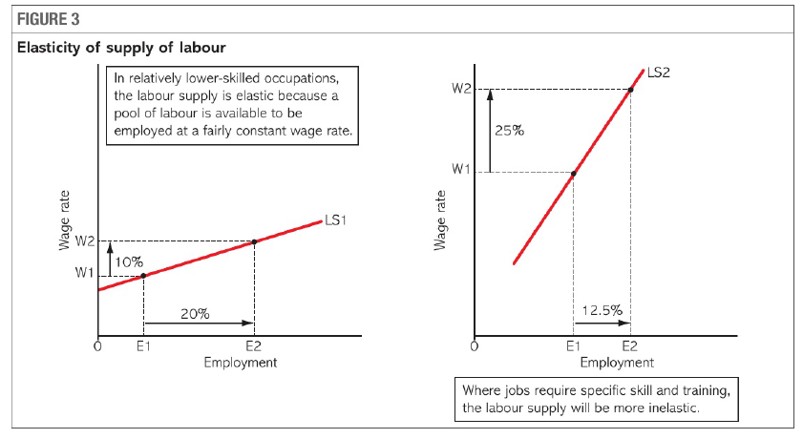

Slide 10
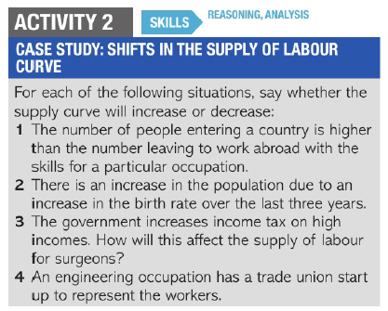

Slide 11
