Slide 1
Ch 17
Determination of wage rates in competitive and non-competitive markets

Slide 2
Labour market equilibrium
Wage rate is determined by demand and supply of labour.
Demand curve is MRP curve.
  Downward sloping – more labour demanded at lower wage rate.
Supply curve is upward sloping
  More labour supplied at increasing wage rate

Slide 3
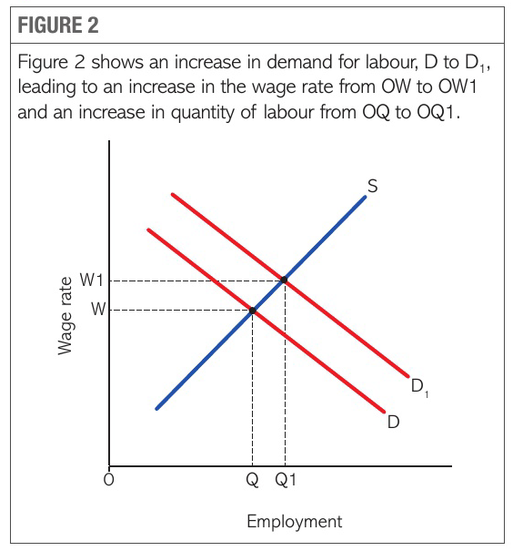
Changes in Equilibrium wage and quantity of labour
DL – shifts rights – shows increase in demand of labour if MRP increases
  Productivity improves – due to changing technology or more flexible working practices.
  Rise in price of product – increases the value of output of each worker.
  Rise in price of capital – substitute labour for capital.

Slide 4
Supply curve shifts right – increase in supply
  Increase in number of workers – due to change in demographic trends, lower taxes and increase in benefits – increase incentive to work
  Wages or conditions deteriorate in other industries, making this industry more attractive.

Slide 5
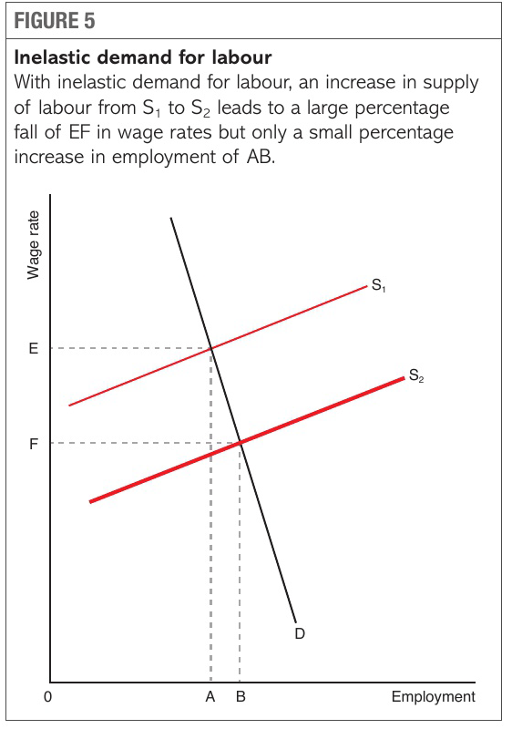
Elasticities of demand for and supply of labour
Elasticities of demand and supply of labour – wage rate and employment in market
Fig 4
Labour market when supply is highly inelastic
If demand for labour increases – very little increase in employment but large increase in wage rate.
Fig 5
Labour market when demand is highly inelastic
If supply of labour increases – very little increase in employment and large fall in wage rate

Slide 6
Why wage rates differ?
Labour is not homogenous or identical – each worker is unique factor of production
  Age – young, middle aged or old
  Education, training and work experience
  Ability to perform tasks – level of hard work, their strength, skills, intelligence
  E.g. Manager paid more than a cleaner working in same company
    MRP of manager is higher
    Manager’s education, skills and work experience provide greater value to company
    However, supply of managers is lower than supply of cleaners
    Only few workers in the workers who have sufficient qualities to be mangers
    Greater demand and less supply leads to higher wage rates for managers

Slide 7
Workers do not necessarily seek to maximise wages
  Wages are only part of net benefit workers gain from employment.
  Workers whose jobs are dangerous, unpleasant, repetitive, little chance of promotion, few or no financial benefits – seek higher wages
  Market forces tend to lead not to equality of wage rates but to equality of net benefits to workers.
Labour is not perfectly mobile
  There may be unemployment and low wages in one area while employers are offering much higher wages to attract labour in other area.
  Reason for lack of mobility – absence of perfect knowledge, workers unaware of job opportunities else where.

Slide 10
Non competitive labour market
Types of non-competitive labour market:
  Firm is a dominant/monopoly buyer of labour/monopsonist
    Public sector/state owned enterprises, but many individual workers
  Dominant supplier of labour/ monopoly supplier – trade union
  A firm is monopoly buyer of labour – monopoly supplier of labour

Slide 11
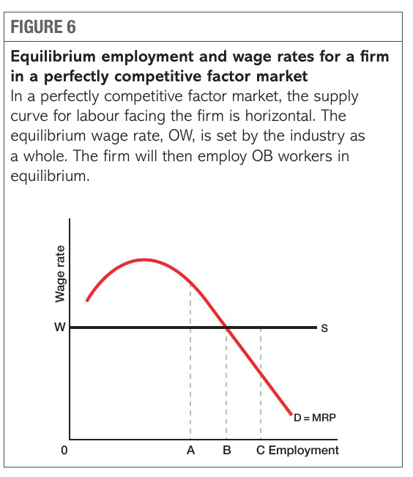
Perfectly competitive labour markets
Perfectly competitive labour market – large number of small firms hiring large number of individual workers
Individual firm in perfectly competitive market:
  Demand curve for labour / MRP curve – downward sloping
  Supply curve of labour – perfectly elastic and horizontal –
    firms can hire any number of workers at existing industry wage rate
  Firm will hire workers up to a point where
  marginal cost of labour = marginal revenue product of labour –
  equilibrium level of employment in perfectly competitive market
    MC > MRP – firm will make a loss on the output produced
    by marginal worker and hence will cut back on employment
    of labour
    MRP > MC – firm will hire more workers because
    these workers will generate a profit for the firm.

Slide 12
Wage settlement in public sector enterprise
Monopsonist – sole buyer of labour
Government employs most of the workers in that industry/occupation
E.g. government employs 90% of teachers in UK
  Judges and court workers are all employed by government
Exploit market power – forcing down wages
MC > AC (wage)
  Firm has to raise wage ratesto attract extra labour into the
  industry. Cost of employing extra unit of labour is not just the
  higher wage paid to that worker but also extra wages paid to
  all other workers in the industry.
Wage makers
Firm maximise revenue from workers by hiring upto
  where MC = MRP
Lower employment, lower wages

Slide 13
Monopoly seller of labour – Trade unions
Trade union – organisation of workers who combine together to protect their professional rights and interests
  Higher wages, health care, pensions, better working conditions, workplace safety.
Individual worker has relatively weak bargaining position compared to the employer.
Workers organise themselves in union to bargain collectively.
Workers appoint a representative to bargain on their behalf.
Act as a monopoly supplier of labour.
Achieve higher wages – fix minimum price for supply of labour – kinked supply surve

Slide 14
Demand and supply curve
Free market wage OA
Wage rate after union agreement – OB
Employers can not hire workers below wage rate OB
Perfectly elastic supply curve.
Employers need to pay higher wages if they wish to higher more workers than OG.
Above OG, new supply curve S2 is same as S1
Employment fall from OF to OE
Trade unions increase wages but also cause unemployment in the industry

Slide 15
Bilateral Monopoly
Sole seller of labour(trade unions) faces a sole buyer of labour (Monopsonist)
Trade union increases both wage and employment compared to monopsonist market.
Monopsonist market – employment level OA, wage rate OE.
Trade unions forces wage rate upto OF.
Kinked supply curve
Upto OB MC = Union wage rate – employer can hire extra unit of labour at OF wage rate
If employ more than OB workers – jump in MC

Slide 16
Market failure
The mobility of labour
  Perfect labour market – no barriers to supply of labour
    Labour easily move to any occupation/region
  Real world – high barriers to mobility of labour
    Causes market failure
    Highly immobile – unable to move from job to job despite high unemployment
  Types of immobility of labour:
    Geographical immobility of labour - difficult to move from one area/region/country to another.
    Occupational immobility of labour - difficult to move from one occupation to another.

Slide 17
Geographical Immobility of labour – causes
  Unaware of job opportunities in other area
  High cost of moving to another area
  Do not want to leave support network
  Housing
  Legal restriction, language, recognition of qualification.
Geographical immobility of labour - Consequence
  Increasing difference in wage rates
    Higher wage rate – shortage of labour
    Lower wage rate – excess supply of labour
  Increasing difference in house prices
    High house price – lack of workers
    Lower house price – high unemployment
Shortage of labour – lower output, firms unable to expand
Structural unemployment – waster of economic resource, lost in potential output, higher government spending and lower tax revenues collected
Lower standard of living – lower demand – negative impact on businesses

Slide 18
Occupational immobility of labour – causes
  Knowledge, talent, skills & qualification
  Education & Training
  Time
  Lack of natural talent
  High cost of education and training
  Lack of knowledge of education and training opportunities
Occupational immobility of labour – consequences
  Shortage – lower output, firms cant expand
  Structural unemployment – unemployed for long period
  Underemployment
  Waste of economic resource
  Distorted wage rates
    Skill shortage – higher wages
    Surplus labour – lower wages

