Slide 1
Chapter 20
Government Intervention in labour markets

Slide 2
Case for government intervention in labour markets
Gross earning and post – tax and benefits earning show Inequalities getting wider overtime
Growing inequalities raise incentives for workers on low incomes to gain skills to get more highly paid jobs.
Inequalities reduces economic growth
  Higher earners – larger percentage increase in earning
    Higher incentive to gain skills through education and training
  Lower earners – very small percentage increase in earning
    Rate of return on extra time spent on education and training might be too low
    Not worth spending extra year at college if they end up in minimum wage job
Rising wage inequality – significant fall in rate of improvement in education and skills of lower earners – drags down economic growth

Slide 3
Government intervenes in labour market
  Workers exploited and treated unfairly by monopsonist – lowest wage rate
  To reduce inequality and market failure
  To protect workers from being exploited
  Government set minimum wage rate
  Direct taxes and benefits – reduces earning gap between highest and lowest paid earners

Slide 4
Types of government intervention in the labour market and their effects
Maximum wage controls
Minimum wage control
Direct taxes

Slide 5
Maximum wage control
Maximum wages are relatively uncommon to minimum wage
Setting maximum wage for CEO – pay increasing much faster than their workers
Ratio of CEO pay to pay of the lowest wage rate earner
Government sets maximum pay limits for public sector workers to keep down public sector spendings

Slide 6
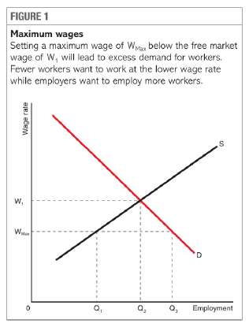
Impact of maximum wage in competitive market
Maximum wage(Wmax) imposed – excess demand(Q1Q3)
  OQ3 – Employer’s Demand
  OQ1 – Labour Supply
Less supply of CEO workers –
  Rewards for job do not match the stress and responsibilities of the job
  They move abroad to take jobs in other countries

Slide 7
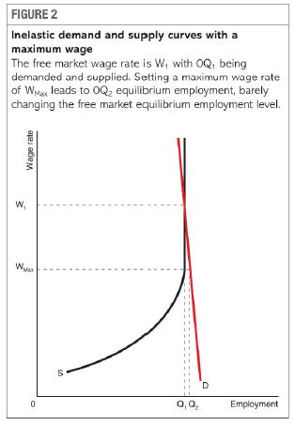
Impact depends on elasticities of demand and supply
  Supply highly wage inelastic – number of people capable of being chief executives is very small.
  Demand highly wage inelastic – only need one CEO for one company – CEO pay is relatively small part of Total Cost
Supply curve Perfectly inelastic at Q1
  Vertical supply curve – same number of chief executives are prepared to work whatever the wage rate they receive above Wmax
Demand curve highly inelastic
Equilibrium wage rate W1
Maximum wage Wmax imposed – Excess demand (Q1Q2)
Imposing maximum wage will have no effect on the market.

Slide 8
Minimum wage controls
Government intervenes to raise wage rates of lowest earning workers
  Impose minimum wage
  Employers have to pay minimum wage rate per hour or risk legal and financial penalties

Slide 9
Minimum wages benefit some but disadvantage others
  Demand and supply of labour
  Equilibrium wage rate OE
  Equilibrium level of employment OB
  Government imposes wage rate OF – industry wage rise
  Firms demand less labour AB
  More workers wish to gain jobs BC
  Result – AC unemployment
No benefit to existing workers
  OA workers gained higher wages
  AB workers lost Jobs
  Firms fired least productive employees – least employable

Slide 10
Minimum wage prevents market from clearing when there is increase in unemployment.
  Original demand(D1) and supply(S) curves
  Minimum wage set at OF
  Equilibrium market wage rate = minimum wage rate
  No unemployment
Assume economy goes into recession
Fall in demand for product – fall in demand for labour
New demand curve is D2
Fall in wage rate to OE
If minimum wage remains OF, AC unemployment is created.

