Slide 1
Ch 19
Government intervention in products markets

Slide 2
The case for government intervention
Profit maximizing monopolist output OA
Neither Productively Nor allocatively efficient
Productively efficient output OB
Allocatively efficient output OC
Profit maximising monopolist earn supernormal profits at the expense of customers
Extracts consumer surplus and converts it into producer surplus
Producing below allocatively efficient level of output produces - Deadweight welfare loss
Government should control firms that have significant monopoly power

Slide 3
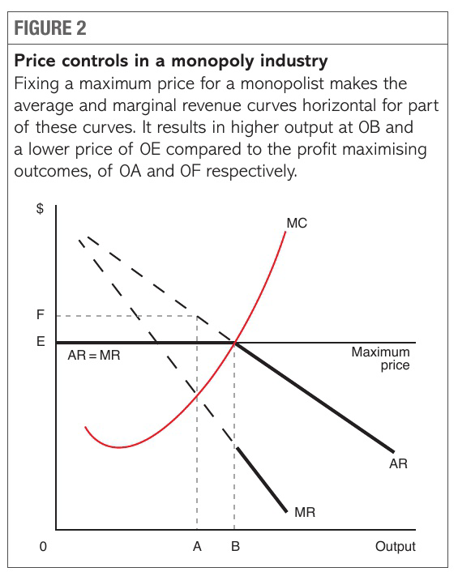
Measures to control monopolies & mergers
Price controls/ regulations
  Maximum price = marginal social cost of production
  Leads to allocative efficiency (P=MC)
  Without price control – downward sloping demand curve (AR),
          downward sloping MR curve
                Profit maximizing level of output OA
                Profit maximizing price OF
  If price set is OE – allocative efficiency achieve
  Government must impose maximum price OE on monopolist
    Output OB - MR = AR – each additional unit is sold
    at maximum price OE.
    If output sold is more than OB – AR (price) will fall,
    break in MR at OB
    selling an additional unit of output
    means that all output OB plus extra
    unit will be sold at lower price.

Slide 4
Government must impose maximum price OE on monopolist
  Output OB - MR = AR – each additional unit is sold
  at maximum price OE.
  If output sold is more than OB – AR (price) will fall,
  break in MR at OB
  selling an additional unit of output
  means that all output OB plus extra
  unit will be sold at lower price.
  MR of OB plus one unit is much lower than marginal revenue of OB unit sold at maximum price.
  Evaluation :
    Difficult for government to know where the costs and revenue curves lie and what is the allocative efficiency level
    Price controls can lead to dynamic inefficiency
    If monopolist allowed to operate at profit maximizing price, they may be prepared to increase investment leads to higher output in future, lower price due to increase in future productive efficiency

Slide 5
Profit regulation
  Fix maximum level of profit that monopolist earns
  Profit set at a level where a monopolist earns profit not more than profits earned in perfectly competitive market
  Calculated by : operating costs of the monopolist should be and adding a rate of return on capital employed.
  Problems
    Requires regulators to have good Understanding of costs and rates of returns
      Asymmetric information
    Little incentive to minimize costs.
    Higher incentive to employ too much capital

Slide 6
Quality standards
  Profit maximising monopolist is focused on profit and not quality.
  May provide high or low quality if able to maximise profits.
  Government intervenes by setting quality.
  E.g. postal services – deliver letter on daily basis in rural areas.
  Monopolist resist imposition on quality standards
    Self regulate
    Provide quality products in future, now regulation is unnecessary
  Both political will and understanding needed to impose meaningful quality standards

Slide 7
Performance Targets
  Government sets targets for variety of different output form a firm.
  Price charged, quality of products, degrees of customer choice, cost of production.
  E.g. Train companies given targets for % of train arriving on time.
  Water companies given maximum target for the volume of water leaked from water supply.
  Monopolist resist imposition of performance targets
    Not meeting them results in bad publicity and regulatory fines.
    Monopolist find ways to get around them
      Change in train timetable – train journeys officially become longer
    Targets might be changed frequently as monopolist find ways to meet them without improving quality.
  Political will and understanding of the industry needed

Slide 8
Referral to regulatory authority
  If monopoly exploits consumers, charging higher prices or anti-competitive, laws allow monopoly to be investigated by government and state authorities.
  If guilty, have to change ways or pay fines.
  Monopolists avoids referrals – costly to prepare a case, bad publicity.
laws to control mergers and takeovers
  Prevent creation of mergers or takeovers
  Competition authorities investigate large mergers that reduce competition
    Have power to prevent merger.
    May allow merger on condition:
      Assets that give new combined firm too much monopoly power to be sold off.
    Merger policy – prevent merged firm from exploiting customers raising prices and reducing choice in the market as a result of less competition.

Slide 10
Measures to promote competition and contestability
Reason
  Increase efficiency
  Reduce exploitation of consumers (Higher price and less choice)

Slide 11
Tax incentives and subsidies to promote small businesses and FDI
  Increase small business to increase competition
  Training and grants to potential new entrepreneurs
  Tax incentive and subsidies to existing small businesses
  Lower tax rate on profits than large businesses
  FDI – A firm in one country buys controlling interest in a firm based in another country.
    Best businesses receive funding and expertise to expand and produce goods and services that get to market faster, therefore businesses will be more competitive.
    Receive best investing firms and can use the latest technology and operational practices to ensure efficiency.
    Joint ventures created between local business and foreign firms – increase competition, choices and lower prices

Slide 12
Deregulation
  Process of removing government controls from markets - increase competition
  Government allows private firms to compete in a market currently being supplied by a state monopoly
    E.g. private firms compete with letter delivery against a state owned postal service
  Lift regulation that prevent competition between private firms
    E.g. end licensing system, any retailer could sell drugs from its premises.
  Improves economic efficiency through promoting competition.
    Lower costs (productive efficiency), reducing prices and increasing output (allocative efficiency)
  Problem with deregulation
    Encourages ‘creaming of markets’ – firms only provide service in most profitable areas

Slide 13
Privatisation
  If barriers to entry remains high, privatising a single firm may not be beneficial.
  Privatisation will only increase competition
    Nationalised firm is split up into competing firms
    Barriers to entry are lowered.
Competitive tendering for public sector contracts
  Government provides public goods.
  State is not the producer of all goods and services
  Goods are produced by private sector and sold to public sector
  Contract given to same firm competition will not increase
  Government does not want contract to go to foreign firm
    Security reasons, maintain jobs and income
  Introduce competition through competitive tendering of contracts
  Government draws up a specification for the good or service and invites private sector firms to bid for contract
    Firm offering lowest price, and guarantees quality goods, wins the contract

Slide 14
Trade Liberalisation
  Removal/ reduction of barriers to the free exchange of goods and services between nations
  Removal of tariff, quota, licensing rules
  Efficient foreign firms can export to the country and keep prices lower
  Encourage local firms to become more efficient
  Local monopolies no longer charge higher price – competition and contestable markets

Slide 15
Measures to protect suppliers and Employees
Local sourcing of raw materials and components
  Government can force firms to use a minimum amount of raw materials and component that are sourced locally from domestic manufacturers.
  Often when a firm is assembling products to be sold in domestic markets
  Prevents firm from using large amount of imported or raw material or components and protect domestic firm

Slide 16
Employment laws to protect workers from exploitation
  Employees are at risk of exploitation
  Profit maximising firms wish to pay lowest possible wages, give few benefits, spend little on working environment.
  Market provides some protection to employees
    Workers can choose not to be employed by firms with poor reputation on issues such as wages/ health/ safety
  Still workers need government protection from employers in different ways:
    Legal protection – laws on and safety at work, employment contract, maximum hours at work. Redundancy procedures and right to belong to a trade union.
    Trade unions – government provide a legal framework within which trade unions can operate.
    Government can encourage firms to draw up codes of conduct relating to employment practices.

Slide 17
Barriers to entry of foreign firms
    % of firm owned by local person or business –
    Discourage foreign firms to enter and earn high profits
    Local business gains knowledge from working with foreign firm
    Share of profits go to domestic economy
Restrictions on monopsony power of employer.
  Monopsony – sole buyer of product, have market power to reduce prices they pay to suppliers
  Prevent exploitation of suppliers
    Anti – monopsony laws which makes certain practices illegal
    Appoint independent regulator, force monopsonist to change buying practices, through code of practices, threat large fines
    Encourage monopsonists to regulate themselves,

Slide 18
Nationalisation
  Nationalised monopolist operates for benefit of customers and private shareholders.
  Prices fall and output higher.
  Right management – reduces costs
  Criticism
    Lack of competition, inefficiency, higher costs, higher prices

Slide 19
Impact of government intervention
Lower prices for customers
Reduce supernormal profits earned by converting consumer surplus to producer surplus.
Increase productive, allocative and dynamic efficiencies
Increase quality of product
Increase customer choice

Slide 20
Limits to government intervention
Firms have significant political power – large firm – more power – influence policies and practices of government – bribe ministers – take government to court (declare government decision illegal or get compensation)
Regulatory capture
  Form of government failure
  Regulatory agency – created to act in public interest – favour special interest of businesses or political groups that dominate industry
  Senior personnel come from firms they regulate
  become friendly and with firms and support their viewpoints
  Terms or regulation more generous

Slide 21
Symmetric information/ information gaps
  Regulator rely on information from firms price, costs, investment
  Firms present biased information
  Regulators become generous – allow price increase to fund necessary investment.
  Firms write voluntary code of conduct in a way to minimise the cost of implementation
Inadequate resources
  Resources available to regulators may be insufficient
    Less staff with regulatory agency, much higher staff in firms they regulating
Lack of regulatory power
  Limited power to enforce fines, punishments
  Profits higher than fines, firms ignore regulations

