Slide 1
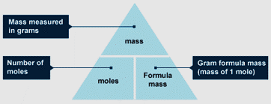
Mole Calculations – Part 1

Slide 2

Atomic Mass of elements
The atoms of each element have a different mass.
• Carbon is given a relative atomic mass (RAM) of 12.
• The RAM of other atoms compares them with carbon.
• Eg. Hydrogen has a mass of only one twelfth that of carbon and so has a RAM of 1.

Slide 3
Molecular Mass
The molecular mass and the formula mass of a compound are obtained by adding together the atomic masses of the atoms present in the molecular formula.
In covalent compounds we use molecular mass and in ionic compounds we use formula mass .

Slide 4
Formula Mass
For a number of reasons it is useful to use something called the formula mass.
• To calculate this we simply add together the
atomic masses of all the atoms shown in the
formula.
(N=14; H=1; Na=23; O=16; Mg=24; Ca=40)

Slide 5
Formula Mass

Slide 6
Mole
The formula mass in grams of any substance
contains the same number of particles. We call
this amount of substance 1 mole.

Slide 7
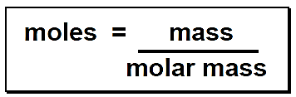
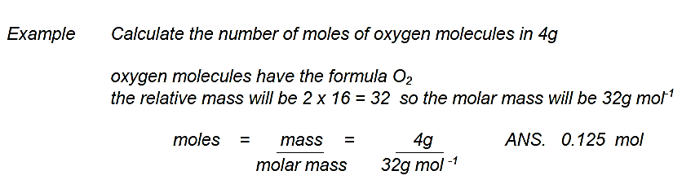
Mole Calculations

Slide 8
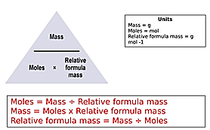
Mole Calculations

