Slide 1


Economics As A
Social Science

Slide 2
Learning Objectives
Definition and need for Economics
What is a scientific method?
Similarities between Economics and Science
Distinction between Economics and Science
Problems faced by Economists

Slide 3
Learning Objectives
Difference between theories and models
Simplification
Ceteris Paribus Assumption
Positive and Normative Economics

Slide 4
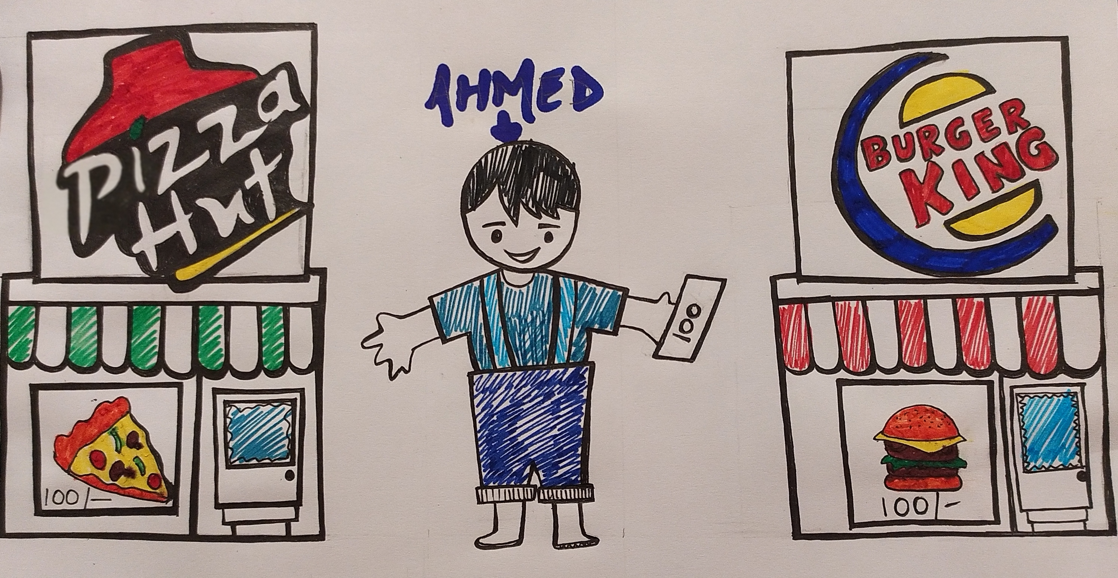
What is Economics and its Importance
Economics is a science which studies human behaviour as a relationship between ends and scarce means which have alternative uses.
Unlimited Wants
S
C
A
R
C
E
Alternative
Uses

Slide 5
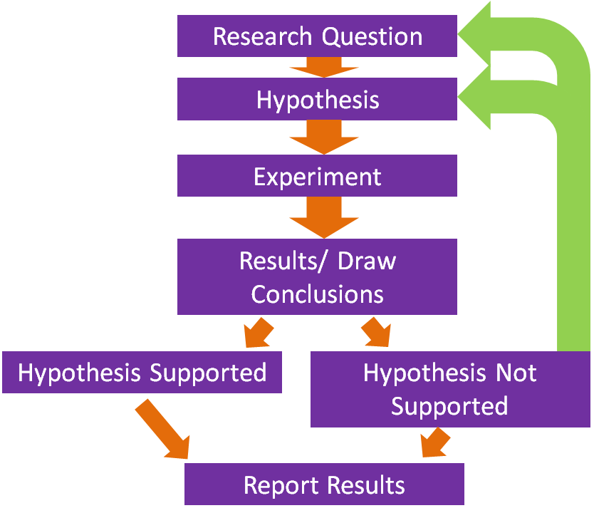
SCIENTIFIC METHOD: A particular method of work or enquiry
Similarities between Science and Economics: Both Scientists and Economists use Scientific Method.

Slide 6
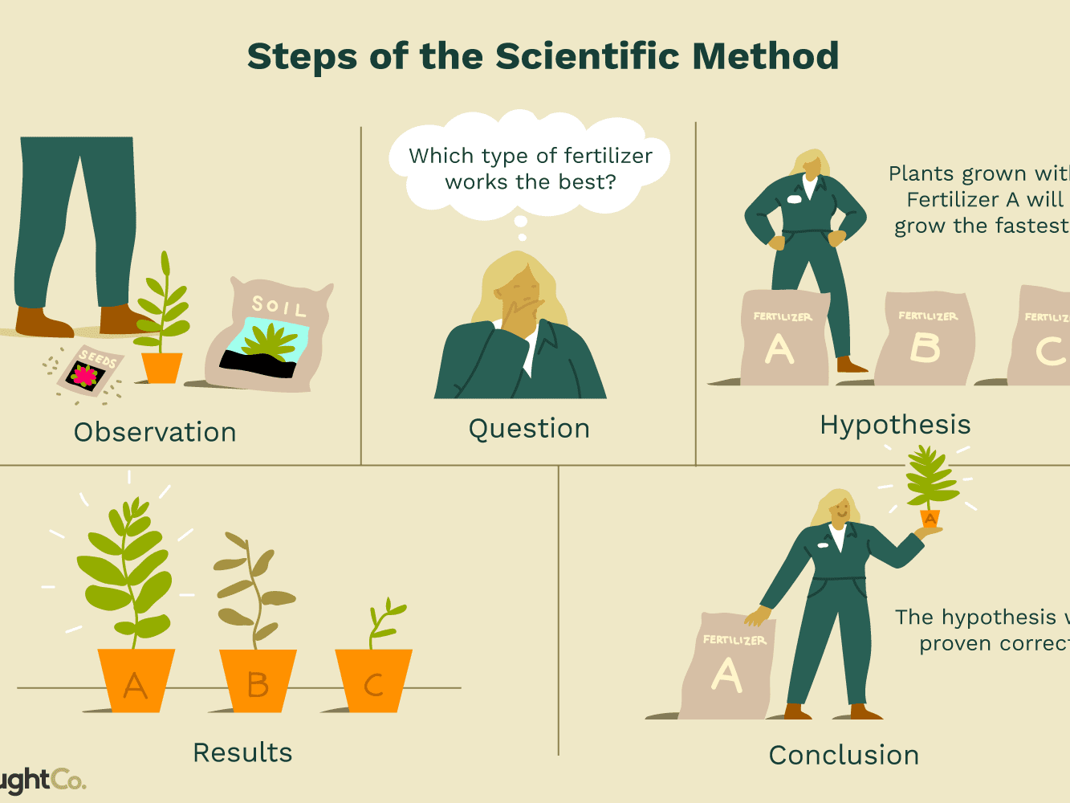
Scientific Method used by a Scientist

Slide 7
Scientific Method used by an Economist
Observation
MBA program has the best job placement rate.
Question
Which college provides the best MBA Program?
Hypothesis
X Y Z
College X provides the best placement opportunities.
Results
Conclusion
Hypothesis was proven correct.
20 MBA students of X college got salary package of $90000. | 5 MBA students of Y college got salary package of $60000. | 2 students of Z college got salary package of $48000.

Slide 8
Distinction between Natural science and Social Science
Natural Science | Social Science
Subjects: Physics, Chemistry, Mathematics etc | Subjects: Economics, Sociology, Politics
Work in laboratories | Data gathered from ordinary everyday world.
Observations made with some degree of certainty | Variables change over any given time period.
Control groups can be established | Not possible to setup experiments or establish control groups.
Easy to accept or refute a particular hypothesis. | It is difficult to decide whether evidence supports or refutes hypothesis.

Slide 9
Economics is a science but not a perfect science, it is a social science because it uses scientific method to explain human behaviour.
Different conclusions as interpretations may vary.
Unemployment rate of nation 3%
Unemployment rate of particular area 6%
Conclusion 1
Failure of government policy to help this particular area.
Conclusion 2
Policy had been a success as unemployment may have been far greater without the use of policy

Slide 10
Behaviour of group is far more predictable than of individuals.
Terms used by economists, ‘it is likely that’ or ‘it may possibly happen’
Economics is a SCIENCE because it uses scientific method, but NOT A PERFECT SCIENCE because it studies human behaviour and thus it is called a SOCIAL SCIENCE.

Slide 11
Difference between Theories and Models
THEORIES | MODELS
Expressed in words. | Expressed in mathematical terms.
Eg: ‘Consumption is dependent upon income’. | Eg: Ct = 567 + 0.852Yt Where, Ct = Current consumption 567 = Constant Yt = Current Income.
Why we construct theories and models:
There are infinite number of interactions happening at any moment.
Why something is as it is.
Decide how to act.

Slide 12
Simplification
If a model has to be useful, it has to be simple.
SIMPLIFICATION implies that some factors have been included in the model and some have been omitted.
CETERIS PARIBUS ASSUMPTION
Economist simplify reality by adopting ceteris paribus assumption.
Ceteris Paribus is Latin for ‘all other things being equal’ or’ all other things remaining the same’.

Slide 13
POSITIVE and NORMATIVE ECONOMICS
Positive Economics | Normative Economics
Concerned with finding out how economies and markets actually work. | Concerned with viewpoint about how economies or markets should work.
Includes facts and figures related with past, present and future. | Concerned with value judgements or opinions. Contain words like ‘ought’ and ‘should’.
Can be proven to be true or false. | Debatable, you can agree or disagree.
Verify the statement then accept or refute it. | Statement cant be verified and can’t be accepted or refuted.
Examples of Positive Statement | Examples of Normative statement
Population of India is greater than population of China. | Old age pension should be stopped.
There is inflation in the economy. | Poverty is bad, it should be eradicated.
25% of population is living below poverty line. | Government should make strong decisions to eradicate poverty.

