Slide 1
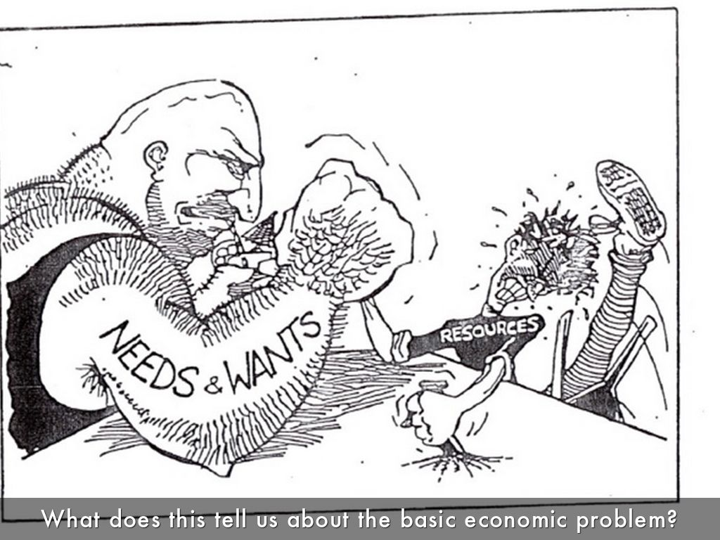

THE ECONOMIC PROBLEM

Slide 2
LEARNING OBJECTIVES
Scarcity
Difference between needs and wants
The Basic Economic Problem
Types of Economic problem
What is Economy?
Economic Resources

Slide 3
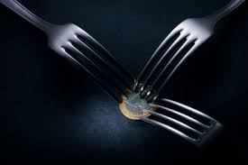
SCARCITY
Scarcity means that economic agents(Individuals, firms, governments, International agencies) can only obtain a limited amount of resources at any moment in time.
Resources that are scarce are called economic goods.
Resources that are not scarce are called free goods.

Slide 4
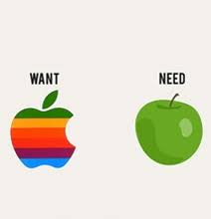
INFINITE WANTS
Needs- Limited/ Finite
Material needs- Food,water, shelter, clothing etc…
Emotional/ psychological needs- Self respect, being loved etc…
Wants - Unlimited/ Infinite
Materialistic wants - More food, bigger house etc…
Emotional/ Psychological wants- a cleaner environment, more friendship, greater fairness or justice etc…

Slide 5
THE BASIC ECONOMIC PROBLEM
Resources are scarce but wants are infinite which leads to basic economic problem and forces economic agents to make choices.
Economics is the study of allocation of resources.
Opportunity Cost: The benefit lost from the next best alternative.

Slide 6
TYPES OF ECONOMIC PROBLEM
What to produce?
An economy can choose mix of goods to produce
How to produce?
How production to be organised?
For whom to produce?
For whom production takes place?

Slide 7
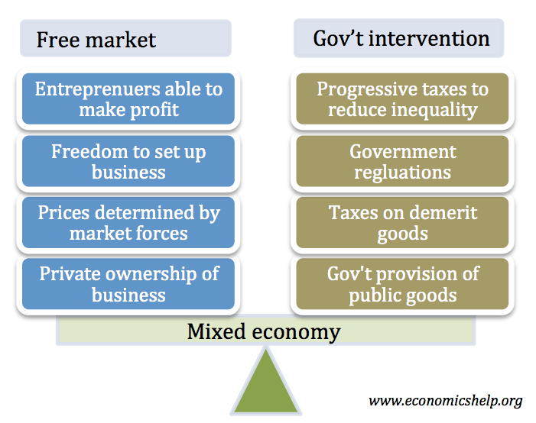
What is an Economy?
Economy is a system that attempts to solve this basic economic problem.
Different Types of Economies
Free Market Economies
Solve economic problem with the minimum intervention of government
Command Economies
The state makes most resource allocation decisions

Slide 8
ECONOMIC RESOURCES
Resources available for use in production process.
Factors of production
Land
Reward- Rent
Labour
Reward- Wages
Capital
Reward- Interest
Entrepreneur
Reward- Profits
Non-renewable- Once used will never be replaced. Oil, Coal, Gold, Copper
Renewable- Can be used and replaced. Fish stocks, forests, or water.
Working/Circulating- raw material, semi-manufactured goods and finished goods
Fixed Capital- Factories, offices, machinery. Used to transform working capital into finished goods.

