Slide 1

PRODUCTION POSSIBILITY FRONTIER

Slide 2
The Problem Scarcity
Production Possibility Frontier: It is a curve showing different combinations of economic goods that an economy is able to produce if all resources in the economy are fully and efficiently employed.
Other names: Production possibility curve or boundary and transformation

Slide 3
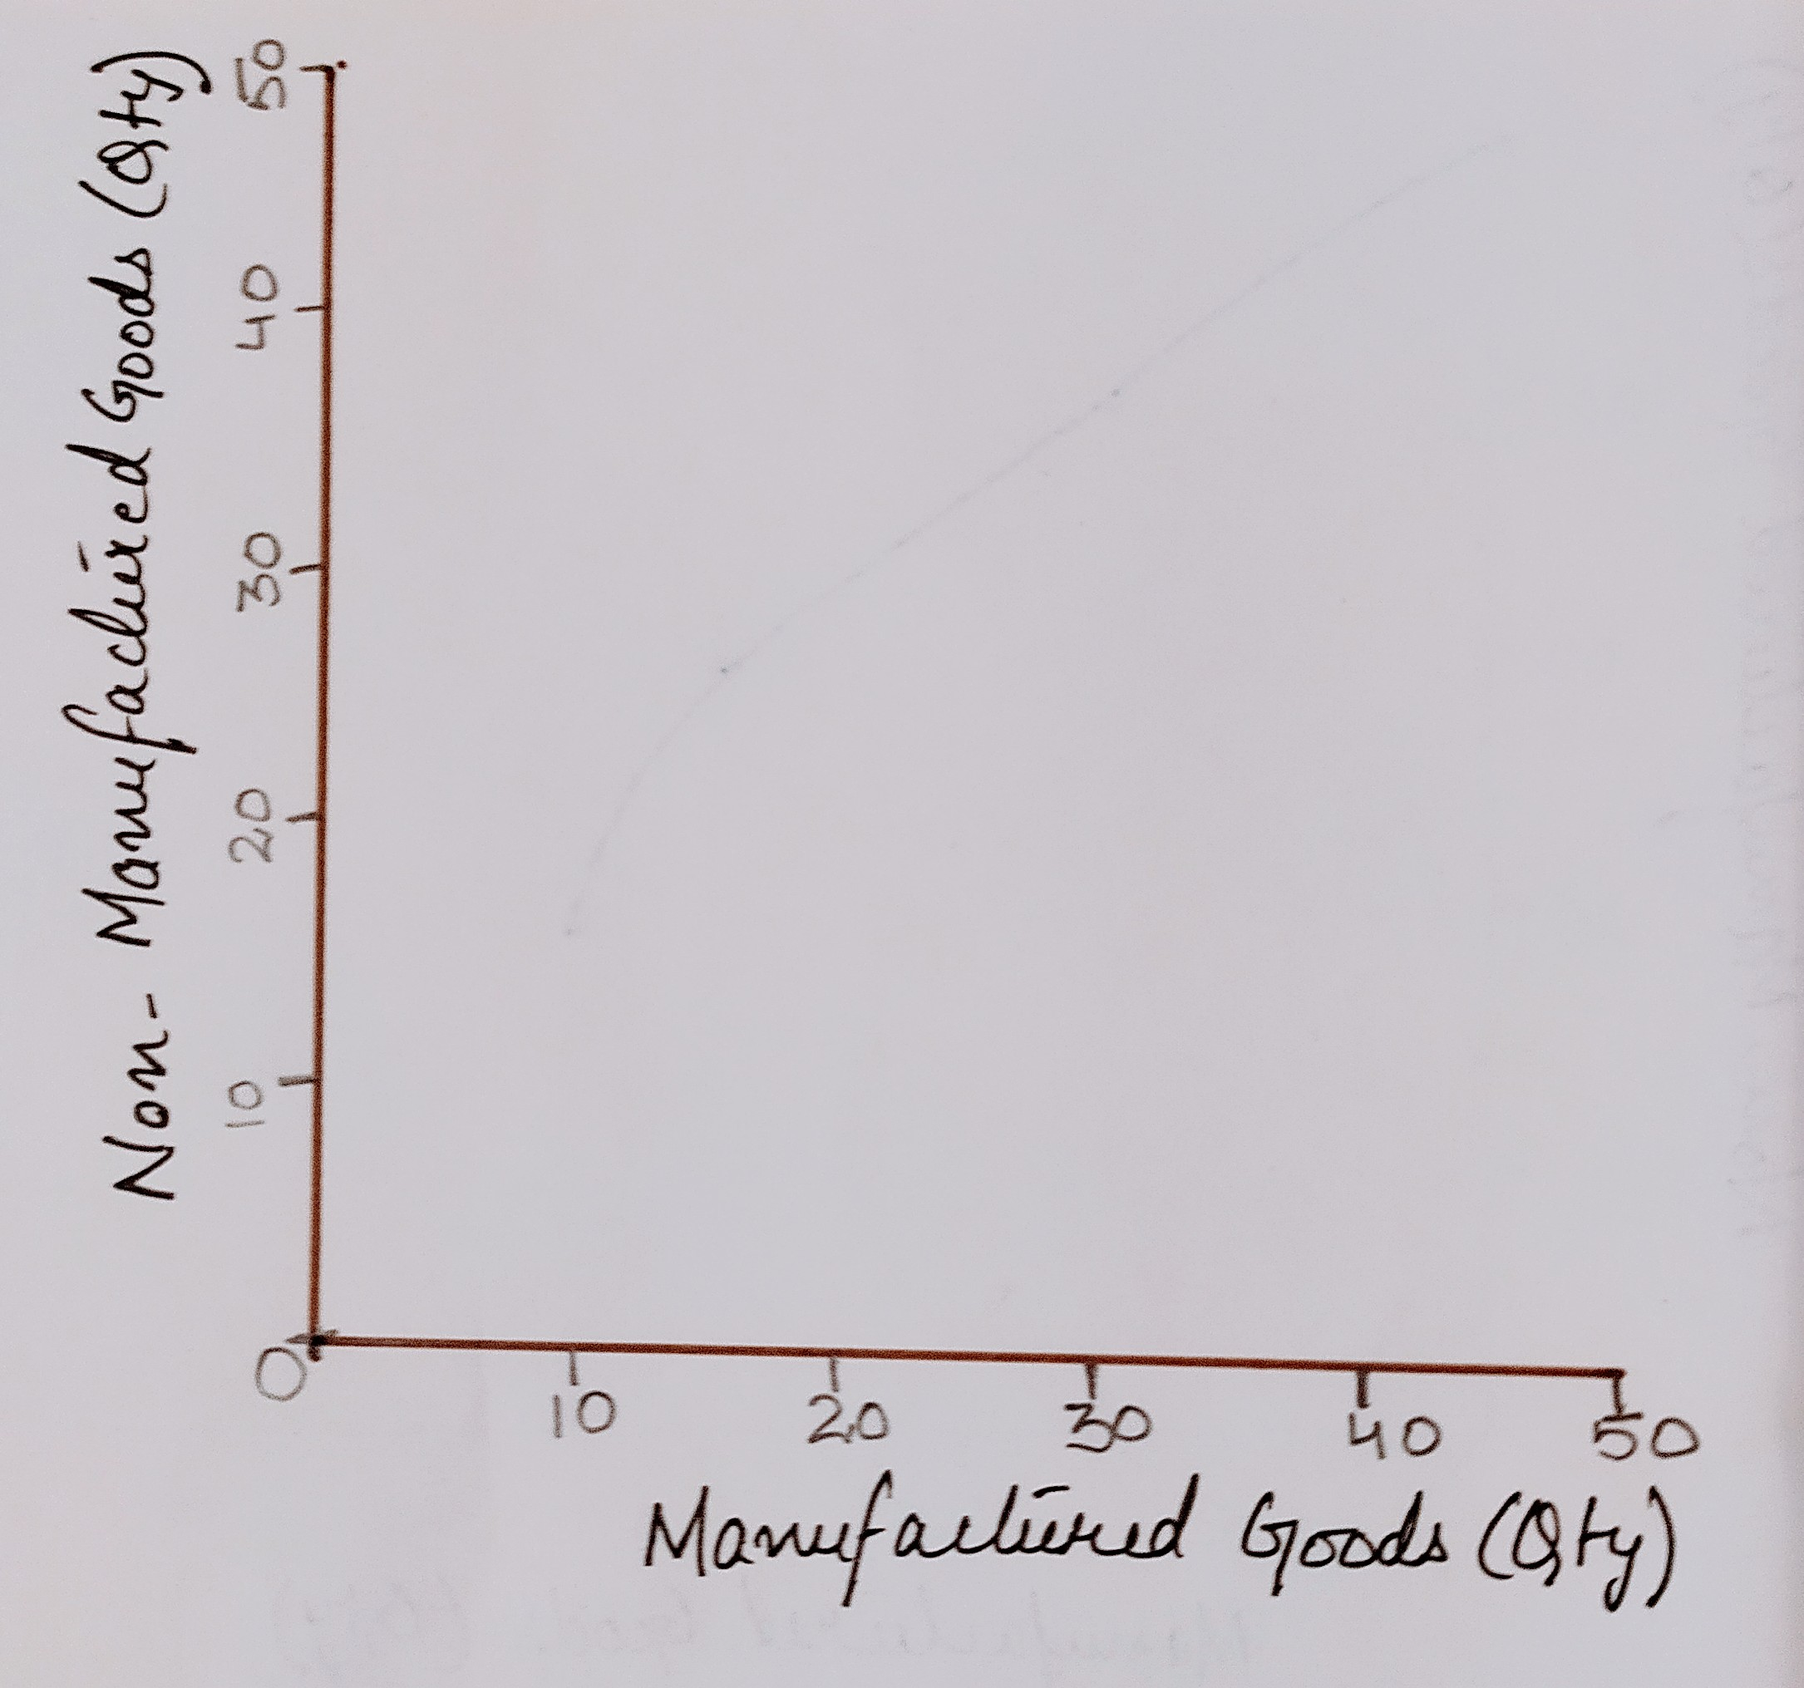
PPF Diagram
X axis shows the quantity of manufactured goods to be produced in the economy
Y axis shows the quantity of non-manufactured goods to be produced in the economy.

Slide 4
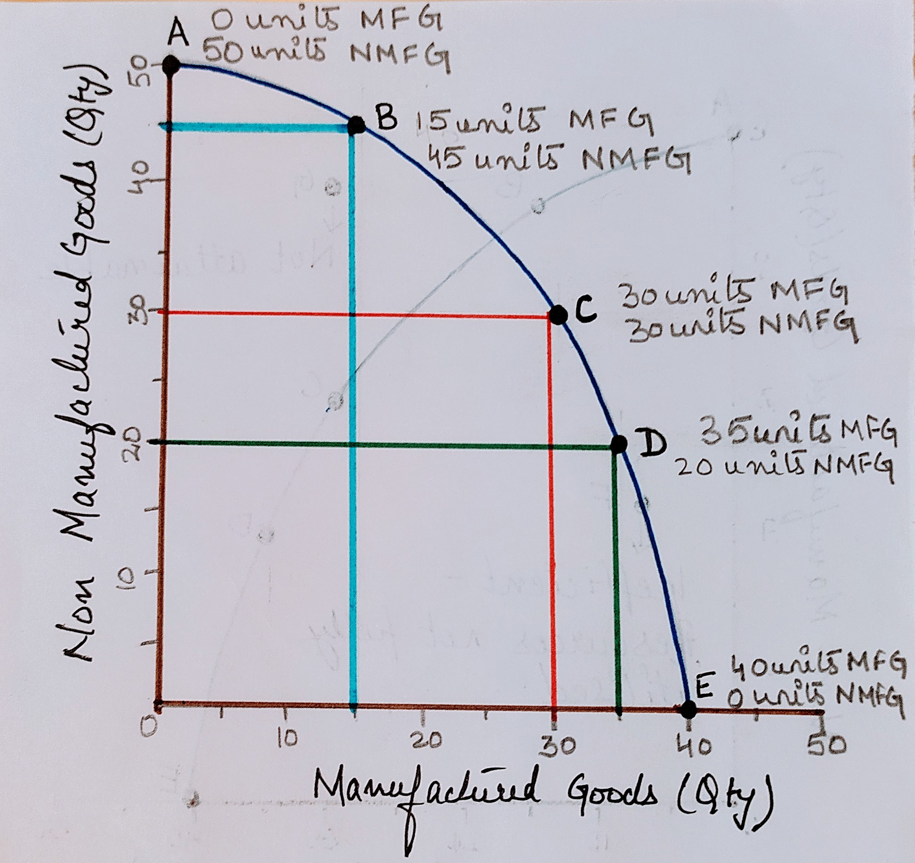
The economy could be:
At point C on its PPF, producing 30 units of manufactured goods and 30 units of non-manufactured.
At point D, producing 35 units of manufactured goods and 20 units of non-manufactured goods.
At point B, producing 15 units of manufactured goods and 45 units of non-manufactured goods.
At point A, devoting all of its resources to the production of non manufactured goods.
At point E, devoting all of its resources to the production of manufactured goods.

Slide 5
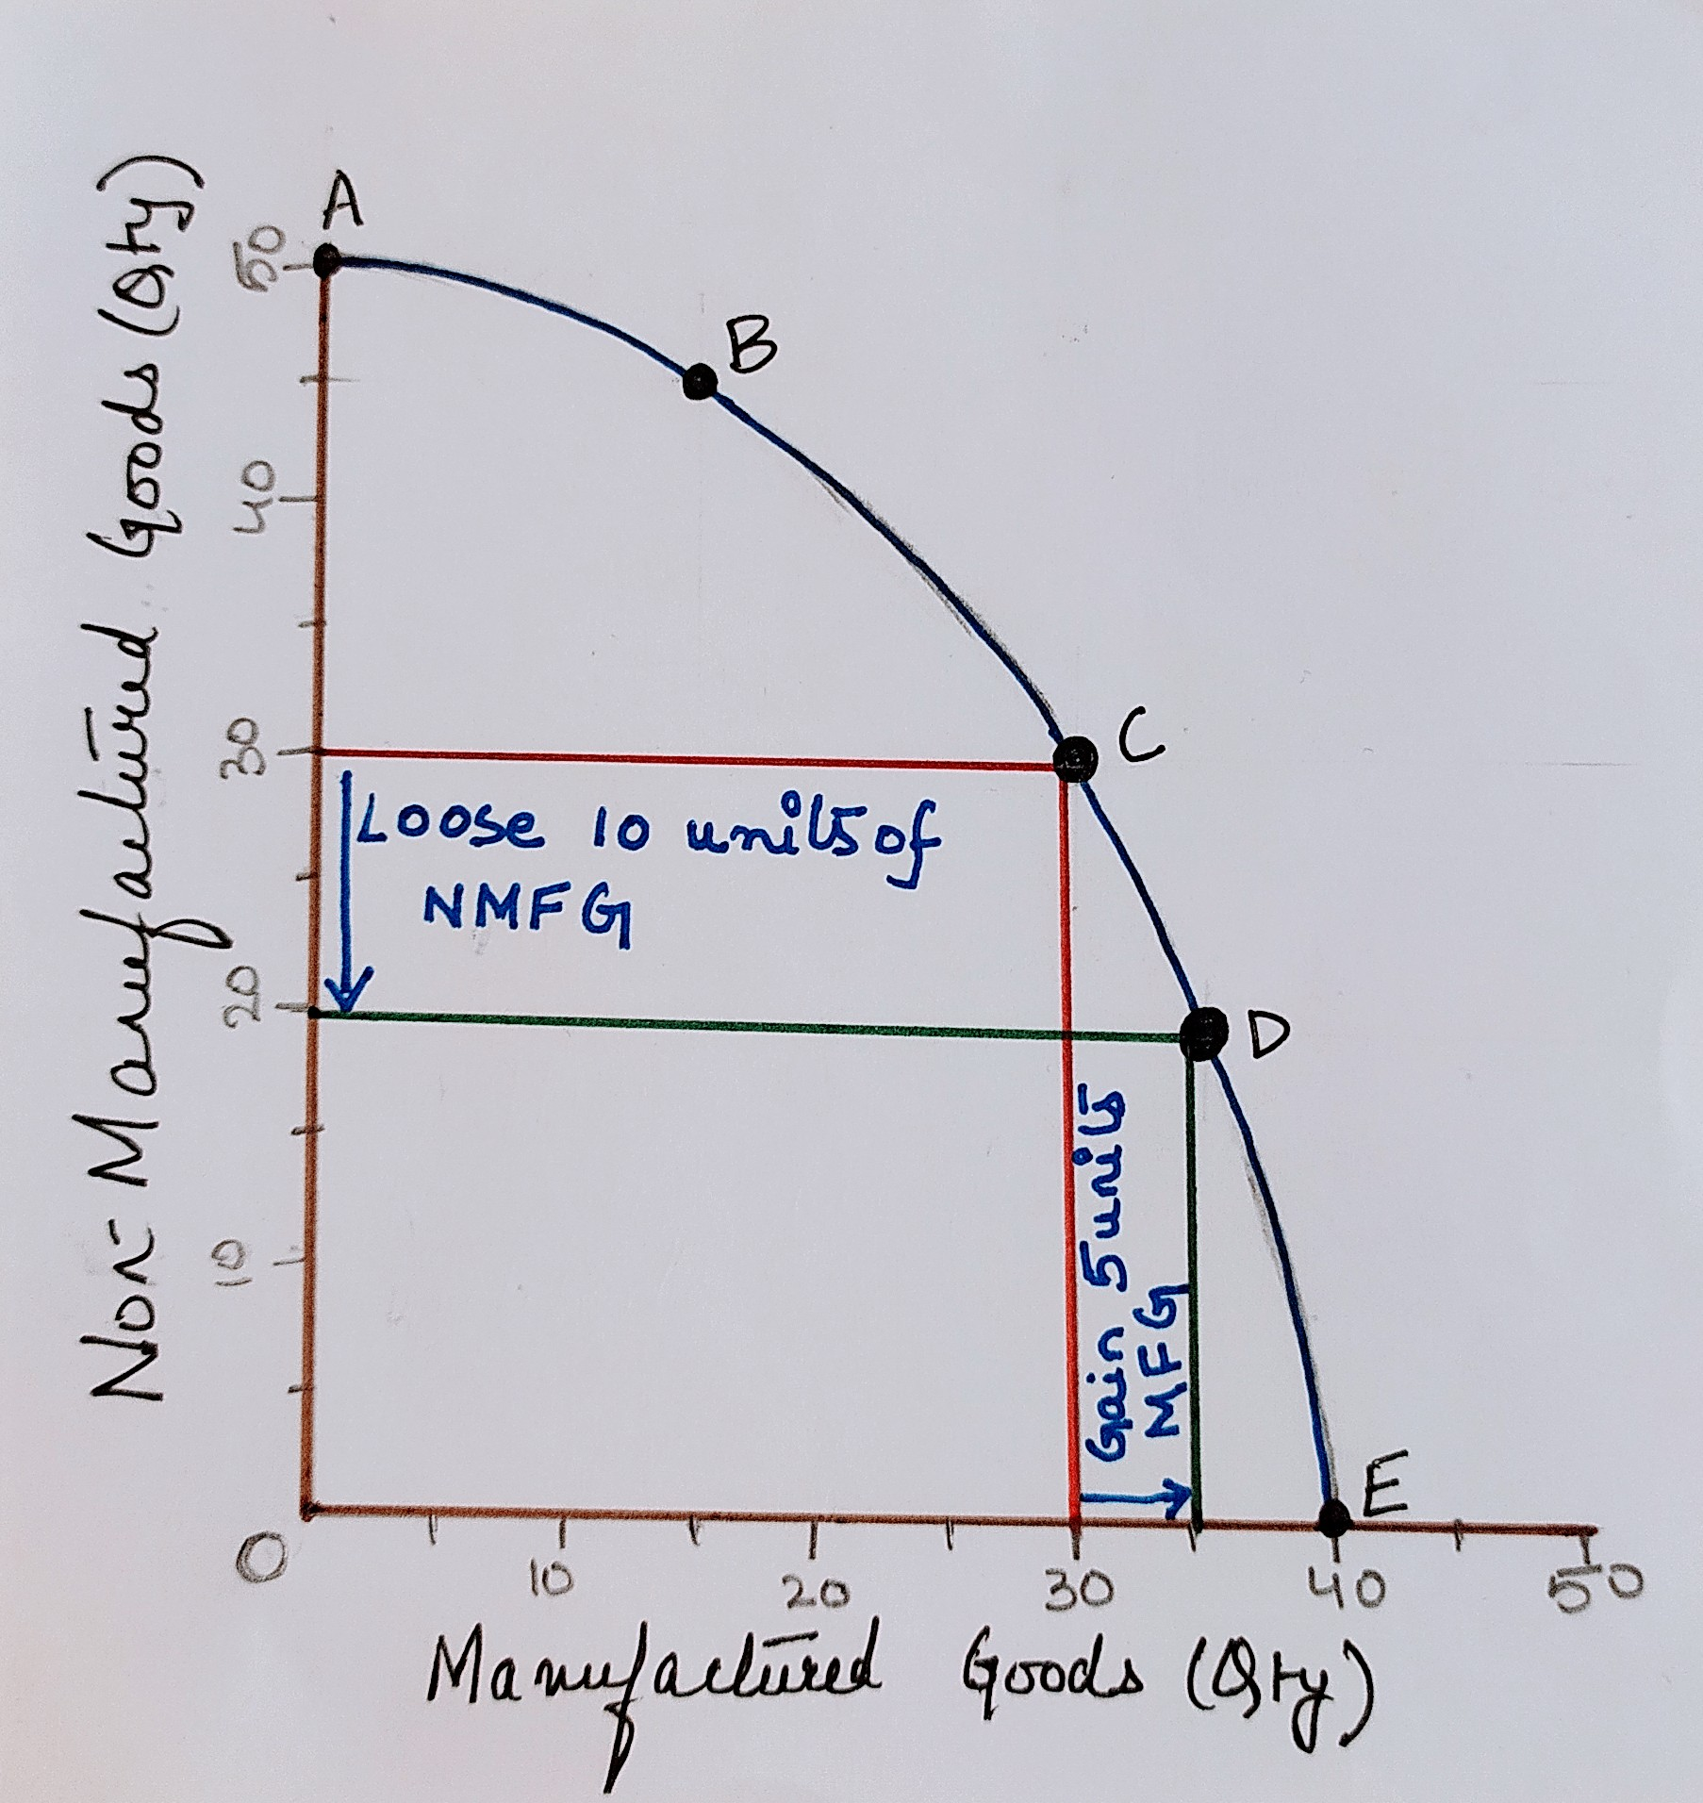
OPPORTUNITY COST:
Assume, economy producing at point C moves to point D.
Output of manufactured goods will increase from 30 to 35 units.
Output of non-manufactured goods will fall from 30 to 20 units.
The opportunity cost of producing manufactured goods is the lost output of non-manufactured goods.
Opportunity cost at C of increasing manufacturing production by 5 units is 10 units of non-manufactured goods.
Concept of margin, point of possible change.
Marginal cost of 5 more units of manufactured goods would be 10 fewer units of non-manufactured goods.
Shown by the movement from C to D along the boundary.

Slide 6
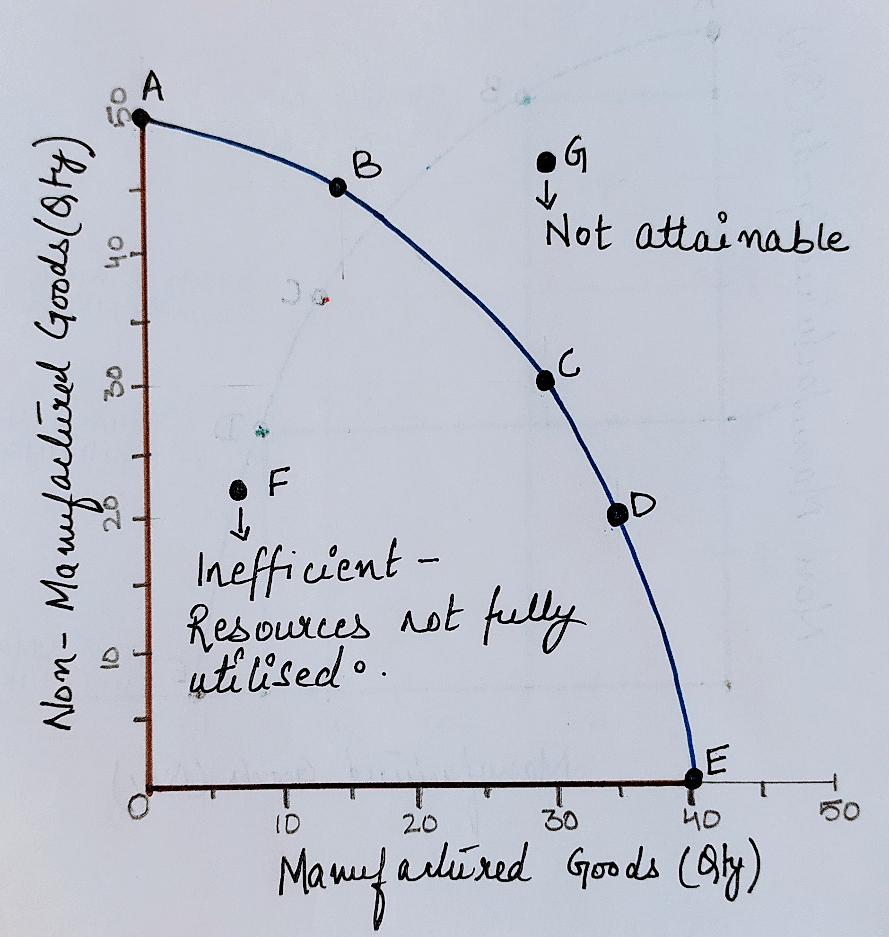
It can not produce at G because PPF shows the maximum that can be produced.
It can produce within PPF, such as at F, but less will be produced than the maximum possible.
If production occurs within the boundary:
Economies experience high level of unemployment of workers.
Factories and machines may not used.

Slide 7
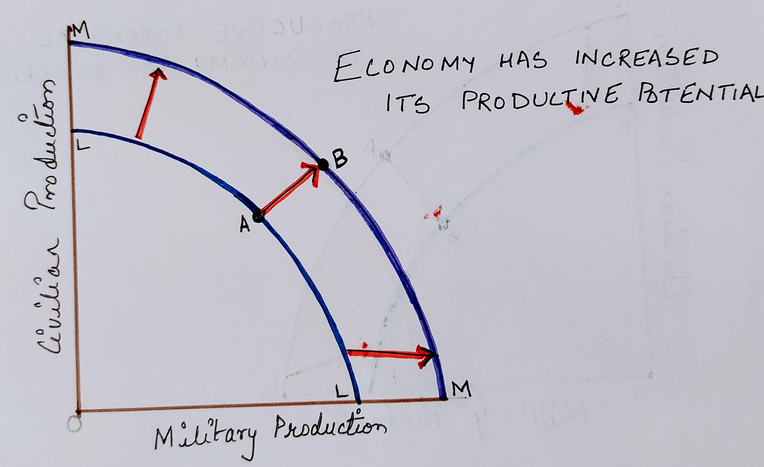
Economic Growth Or Decline:
Economy might be able to move to the right of its PPF in the future if there is economic growth( i.e. increase in productive potential of the economy.
Economic growth is shown by outward/ right shift of PPF.
Economic growth pushes the PPF from LL to MM, allowing the economy to increase its maximum level of production, from A to B.
Growth in the economy can happen if:
Increase in Quantity- Number of workers increased, new factories or offices built.
Increase in Quality- Workers are educated or trained, technological progress.

Slide 8
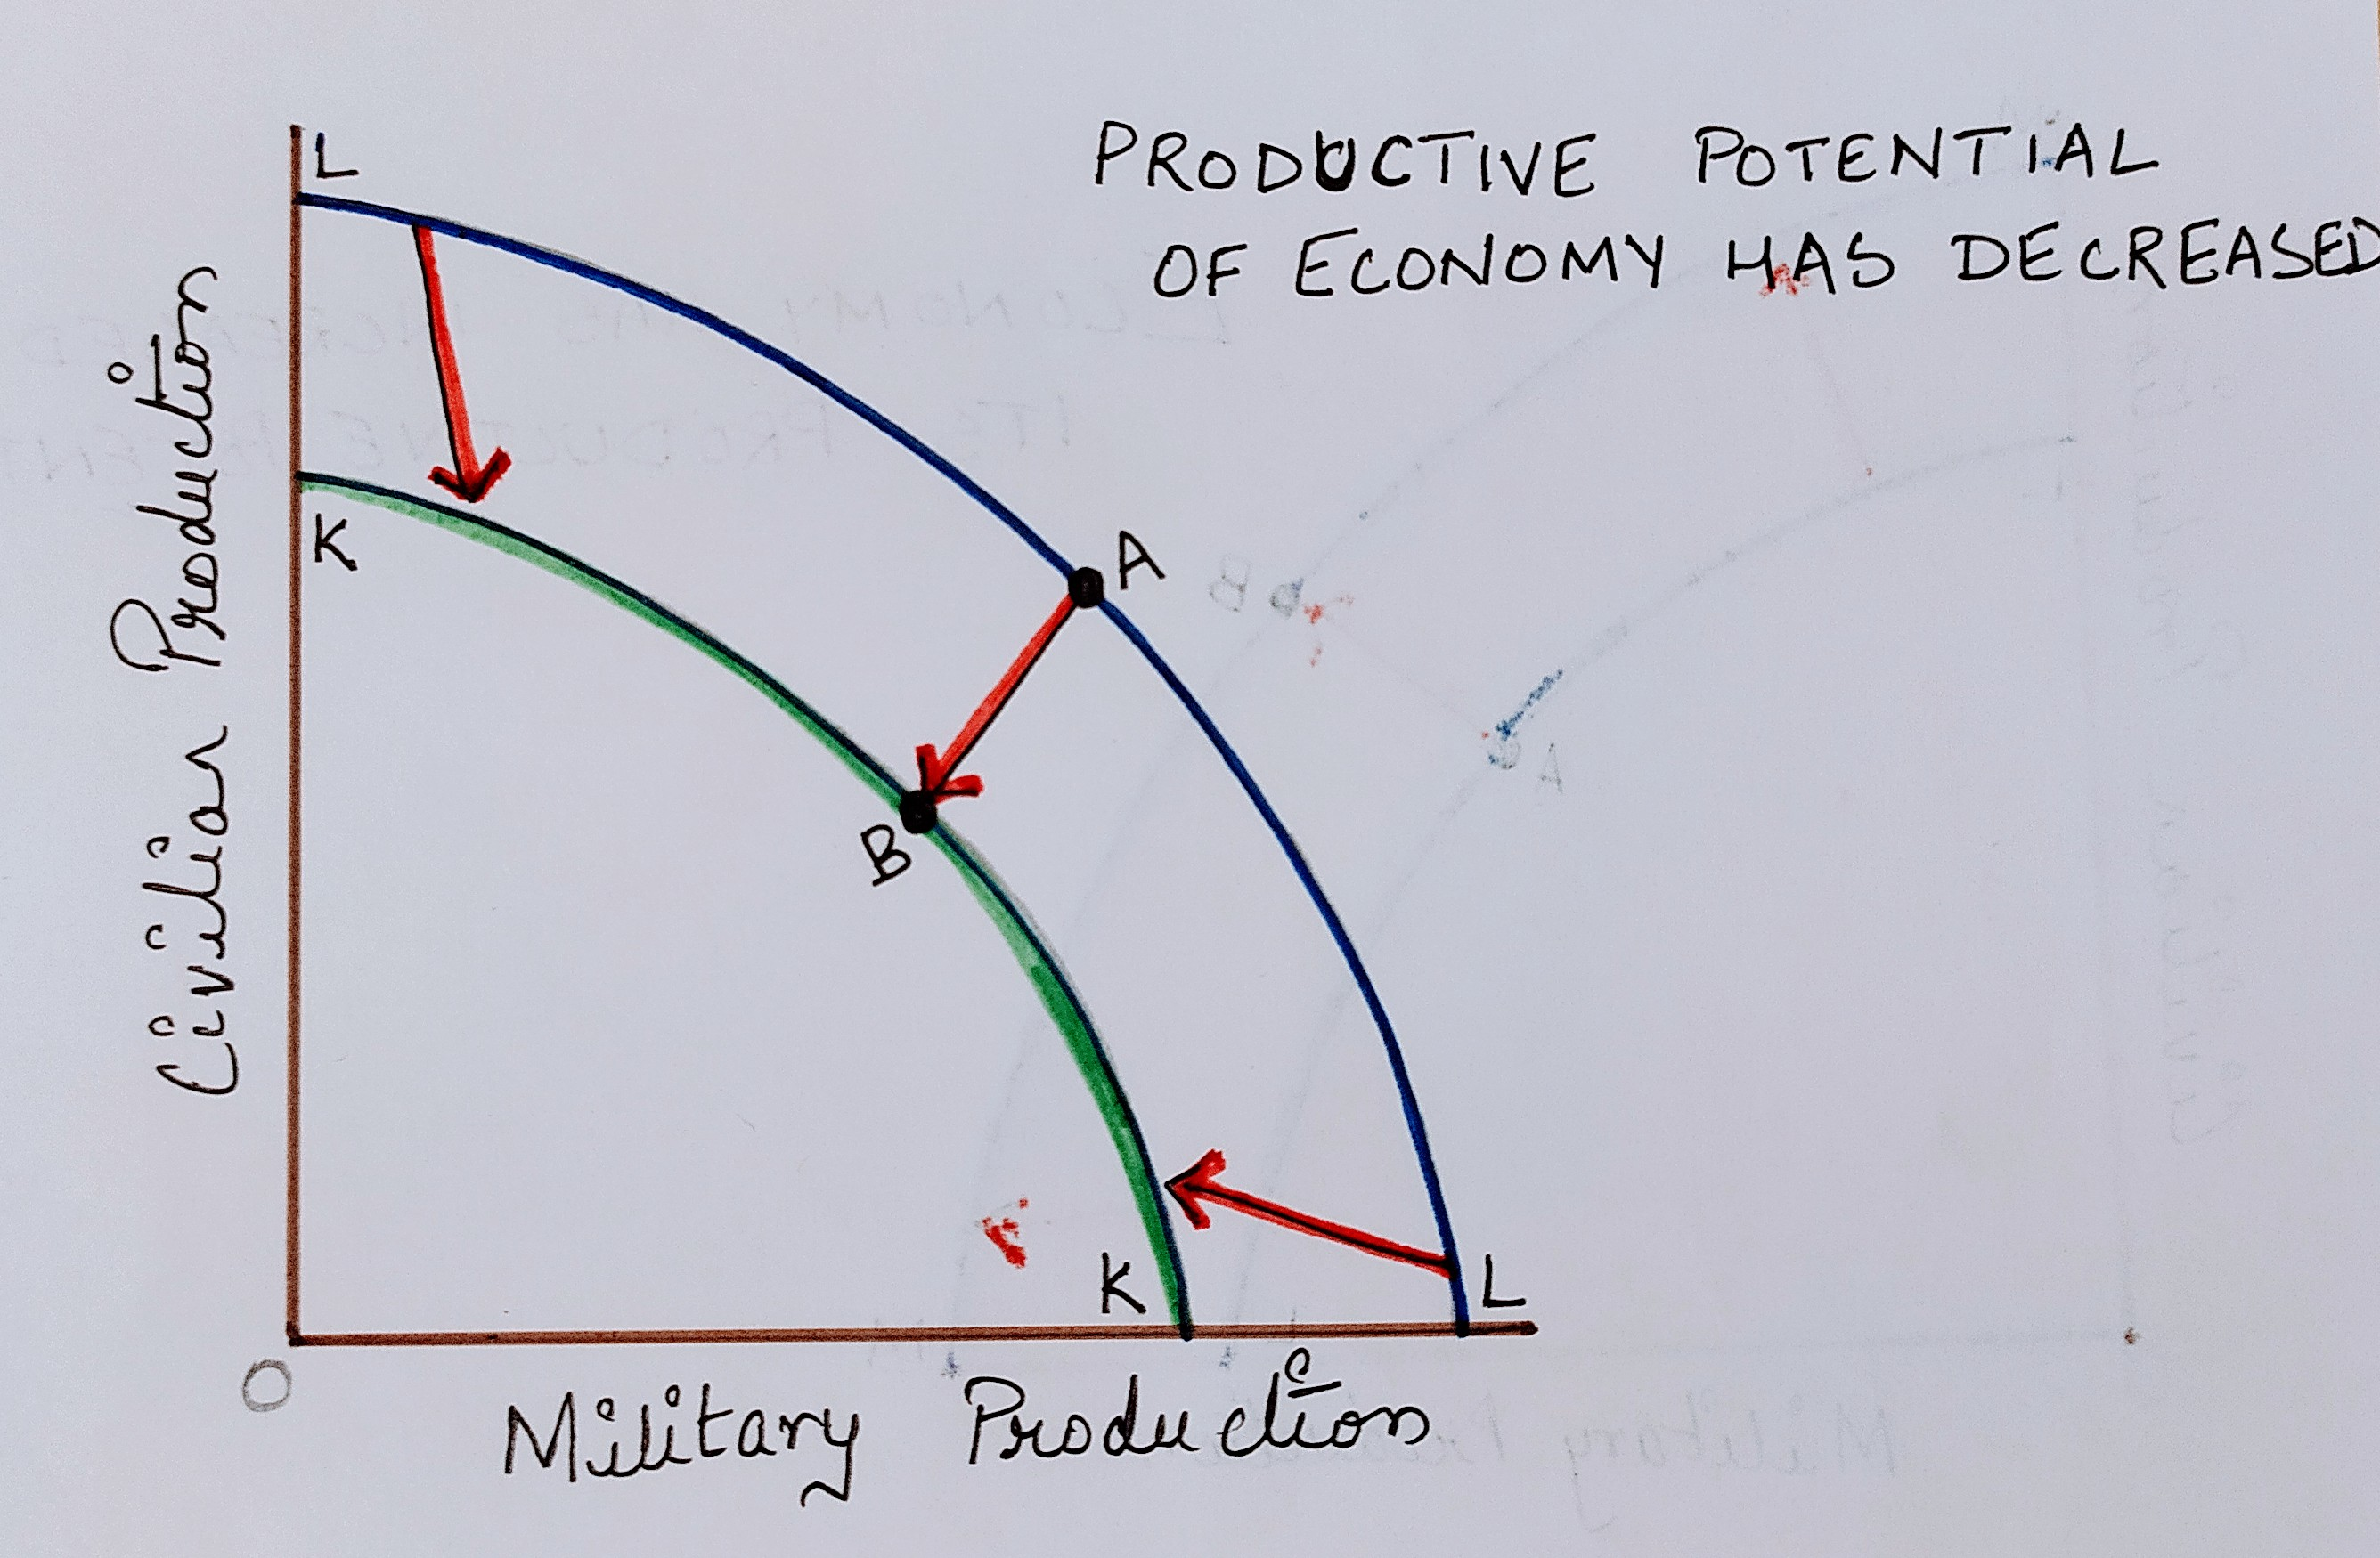
If productive potential of economy falls, PPF can shift inwards.
War can destroy economic infrastructure.
Rapid fall in the number of workers.
Global warming might damage agriculture production.

Slide 9
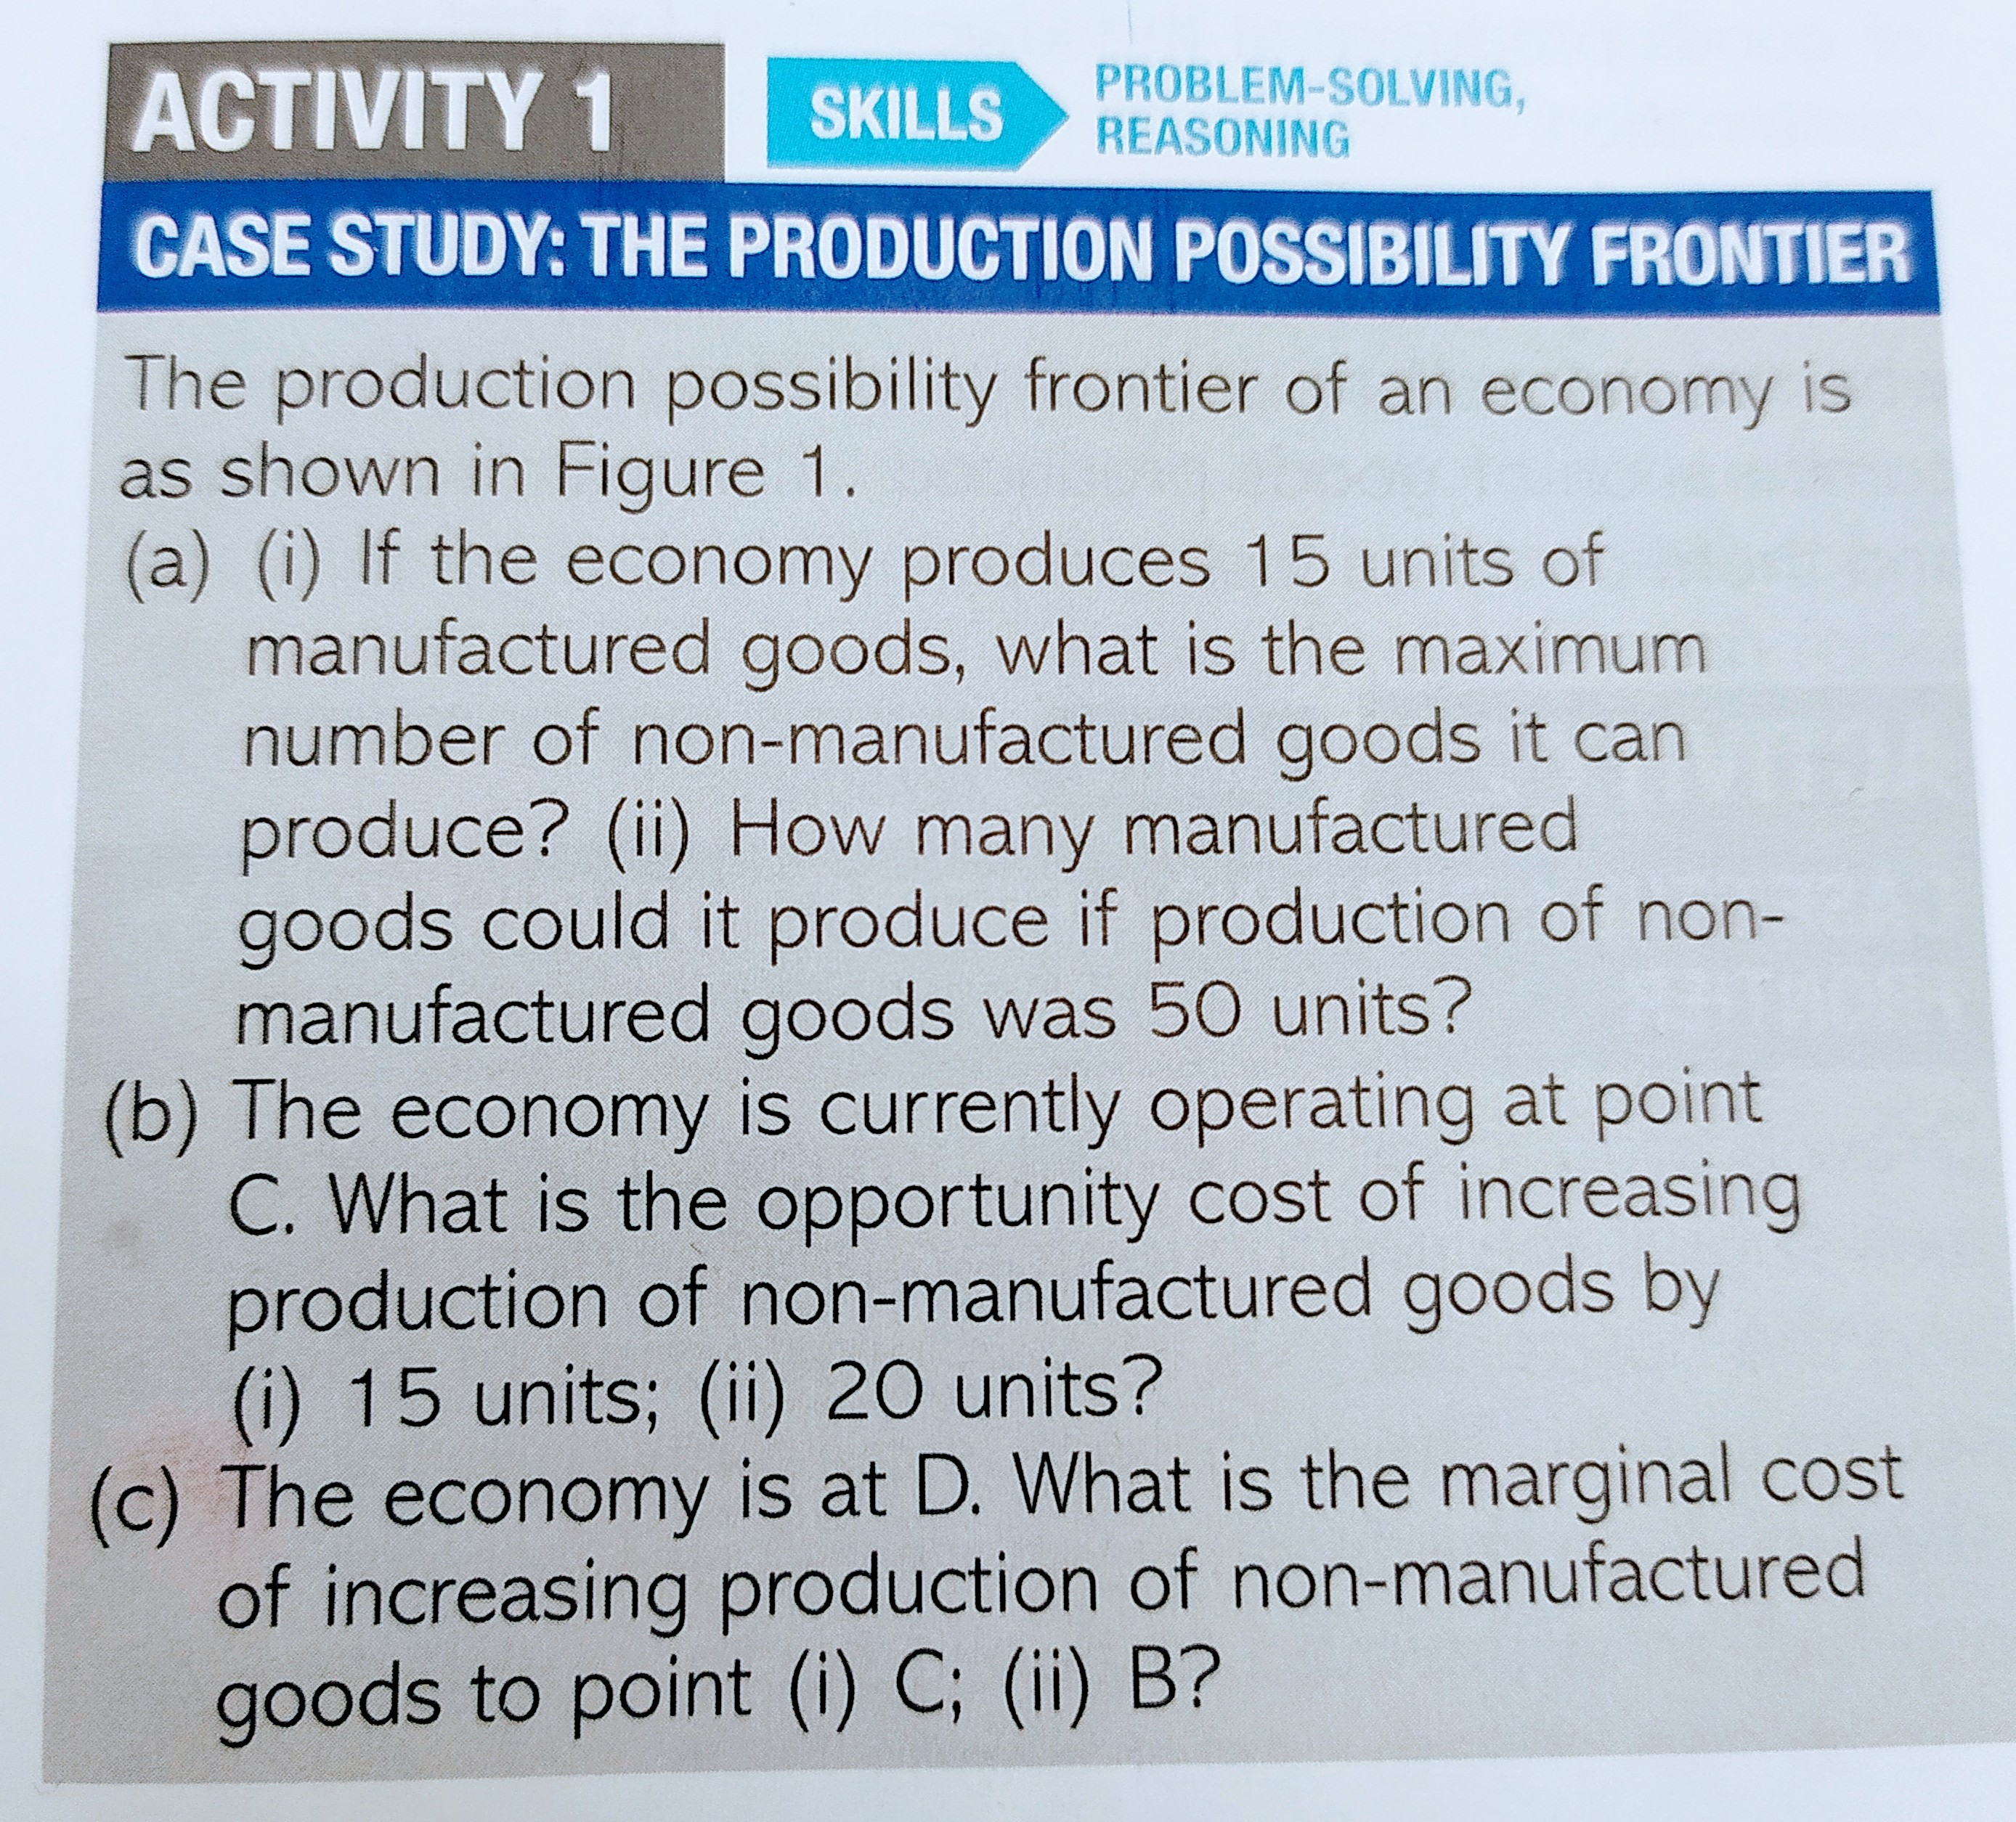

Slide 10
Consumption Vs Investment
Potential conflict between consuming now and economic growth caused by investment.
  Produce $10 billion worth of restaurant meals for consumers – Consumers better off today
  Spend $ 10 billion on new factories, offices or new machinery – Consumers better off in future.

Slide 11
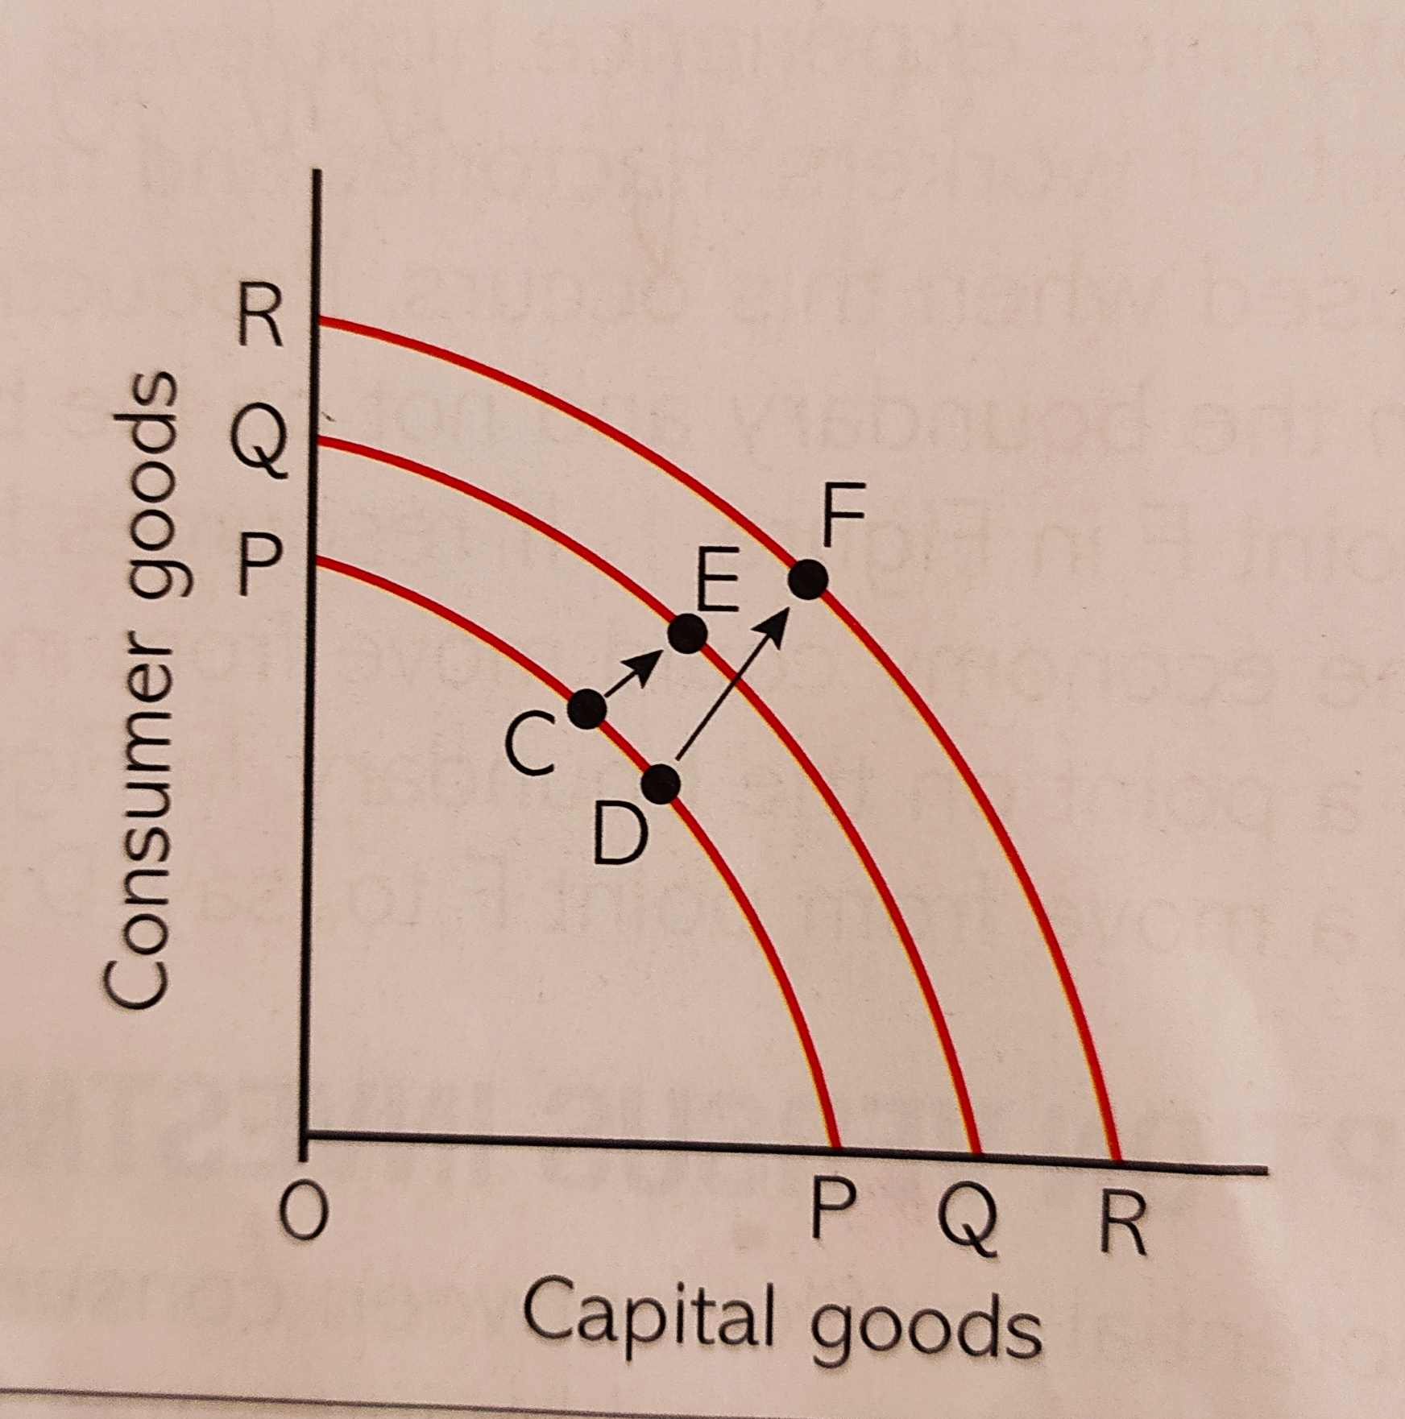
Diagrammatic explanation:
Y axis- Consumer goods- Food, DVD’s etc.
Xaxis- Capital goods- Machines and equipment etc.
Two economies, A and B, same size in terms of overall production and population.
Economy A is at point C, produces more consumer goods and less capital goods than B, thus economy B is at point D.
After ten years,
    Economy A producing at point E on QQ PPF.
    Economy B producing at point F on RR PPF.
Initially, Economy A reached point E and became wealthier than B because consumption is high.
Later, Economy B reached point F, producing more of both consumer and capital goods.
Economy B devoted its finite resources to capital goods and grows faster than Economy A.

Slide 12
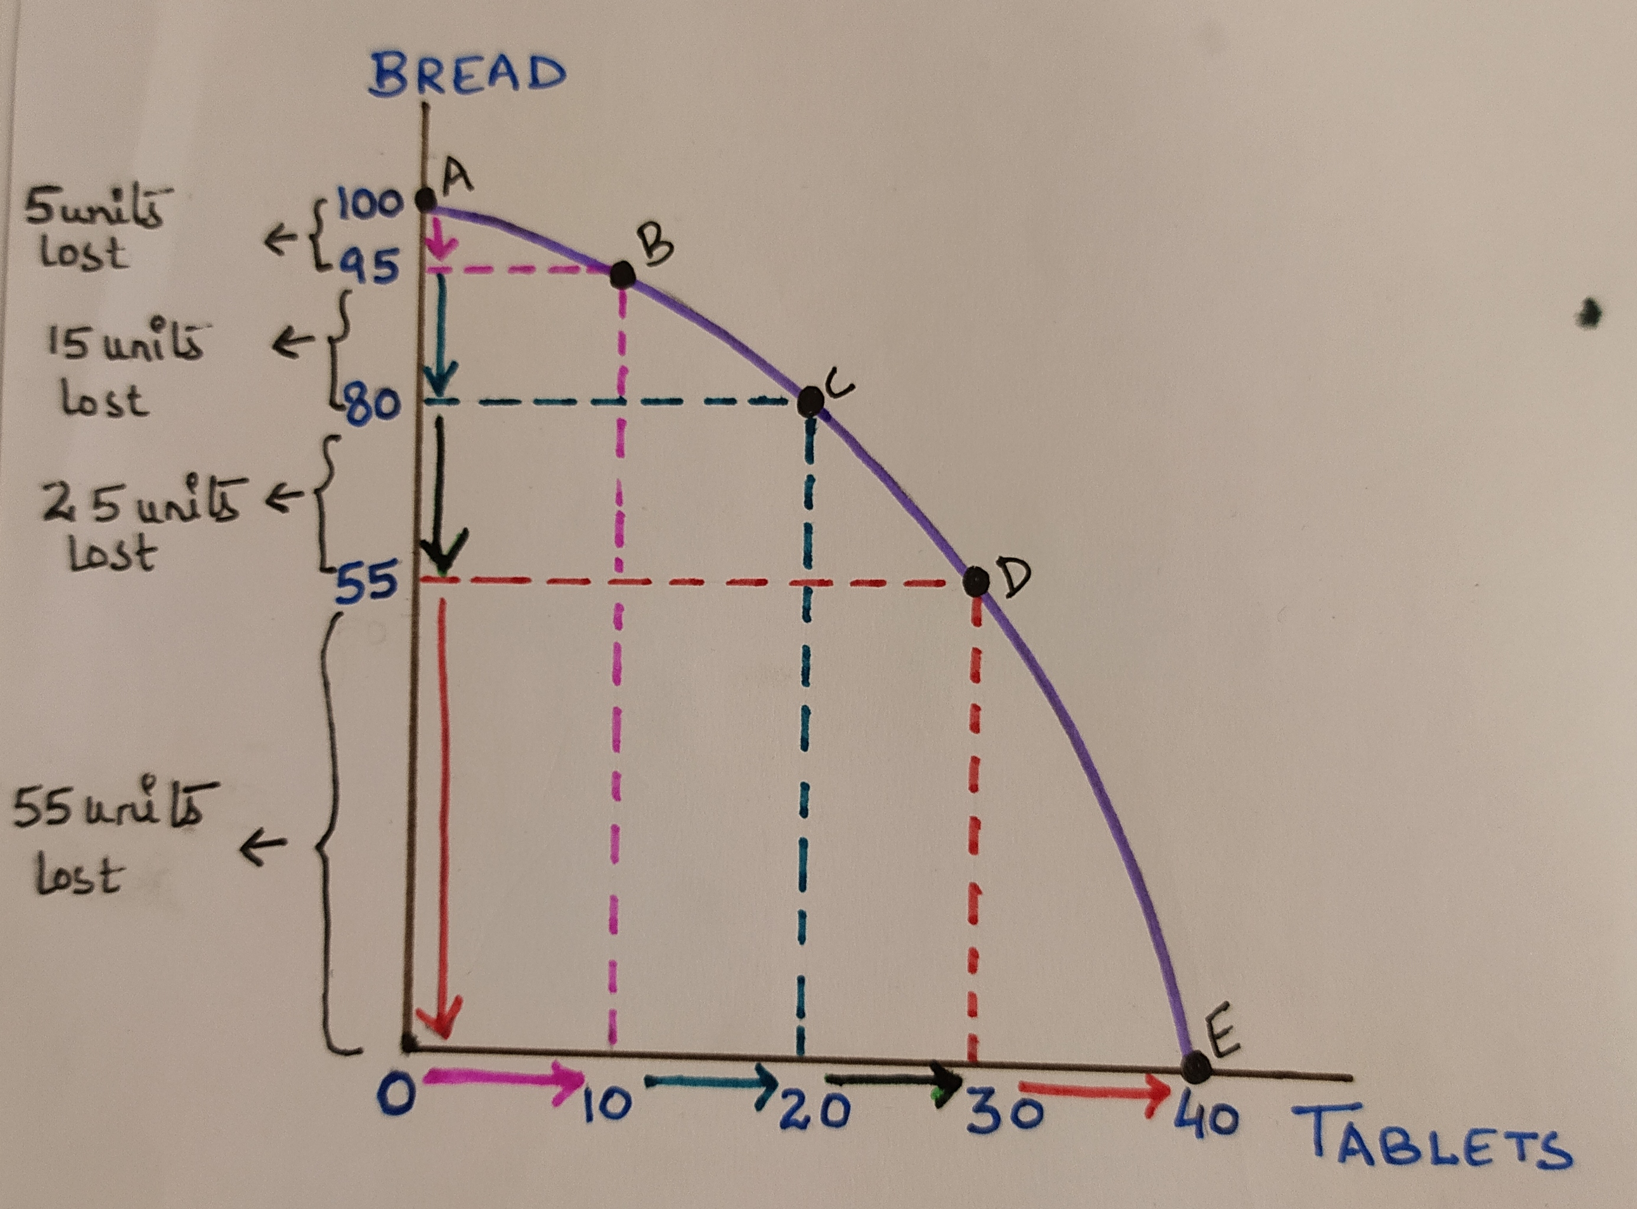
Assumption for PPF: Not all resources in the economy are as productive in one use compared to the another
Assumption for PPF in figure: Resources are more productive in production of Bread.
Increasing Marginal Opportunity cost
OR
Rate of sacrifice is increasing
When we increase one good at uniform rate we have to sacrifice other good at increasing rate.

Slide 13
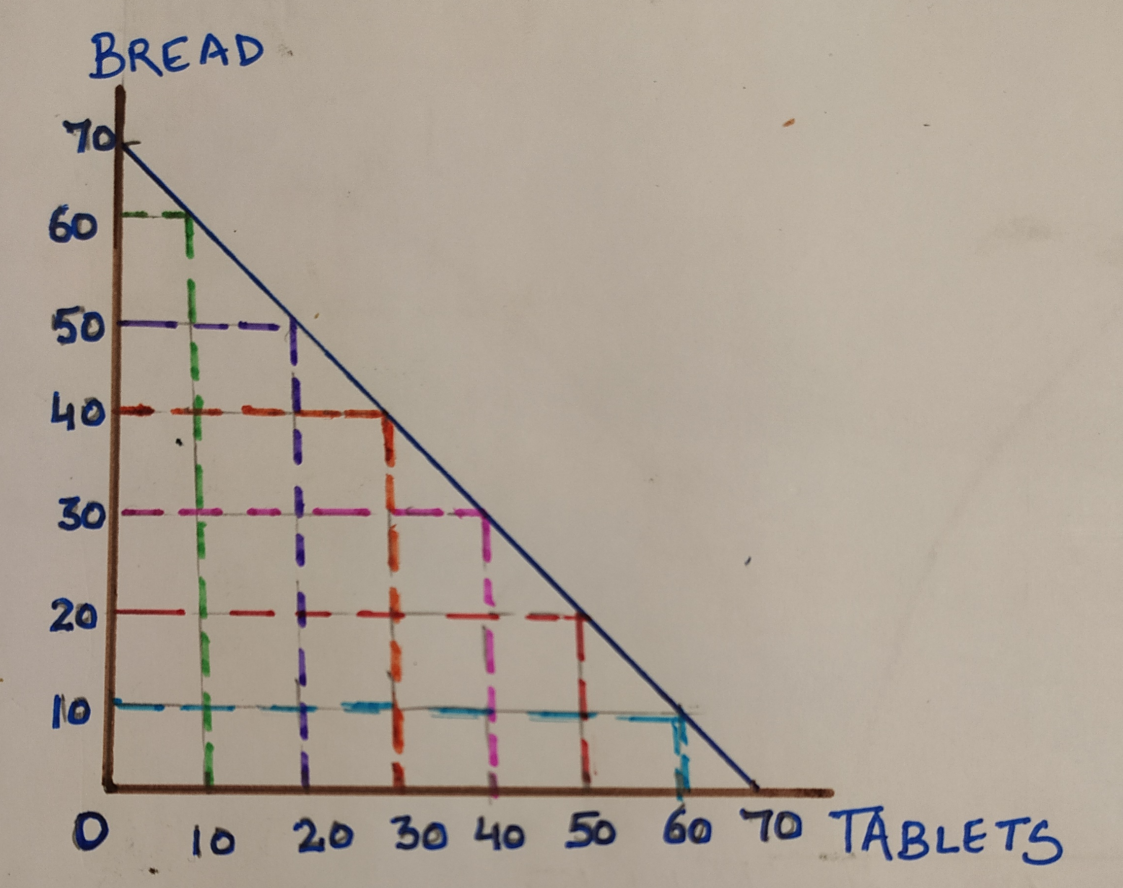
Constant Marginal Opportunity cost.
To produce 10 units of tablet, you have to sacrifice the production of 10 units of bread.
PPF shows that resources are equally productive in the production of both the goods which contradicts our assumption.

Slide 14
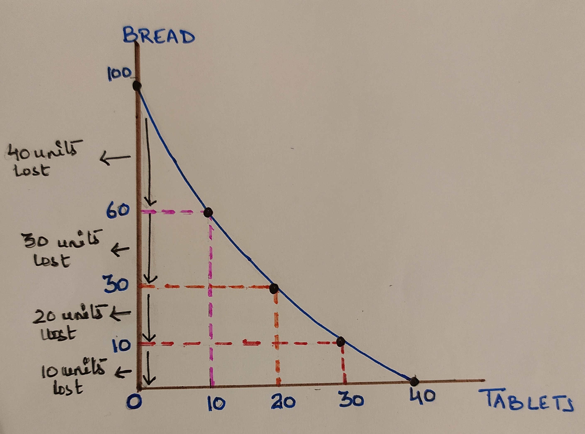
Decreasing Marginal Opportunity Cost
To produce 10 units of tablet, you have to sacrifice less units of bread.
PPF shows that resources are productive in production of tablets which contradicts our assumption.

Slide 15
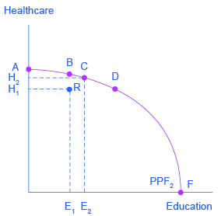
EFFICIENCY
PPF shows the different combination of economic goods that an economy is able to produce if all the resources in the economy are fully and efficiently employed.
Efficiency on the boundary is of two types:
Productive efficiency means maximum number of goods produced at lowest cost. All points on the boundary are productively efficient. Point inside the curve is productively inefficient.
Allocative efficiency concerned with optimal distribution of goods and services or maximisation of social welfare. Not all points on the boundary are allocatively efficient.

Slide 16
Conclusion:
PPF by itself gives no indication of which combination of goods will be produced in an economy.
It shows a range of possibilities and much of economics is concerned with explaining why an economy chooses to produce at one point either on PPF rather than another.

Slide 17
