Slide 1

Chapter 4 SPECIALISATION AND DIVISON OF LABOUR Part-1

Slide 2
Learning Objectives
Understand that specialisation and the division of labour give rise to large gains in productivity.
Understand that economy can be divided into three sectors: primary, secondary and tertiary. And also into state sector and private sector.
Know that markets exists for buyers and sellers to exchange goods and services using barter or money.

Slide 3
Specialisation
It is the production of a limited range of goods by an individual, firm or country in co-operation with others so that together a complete range of goods is produced
Specialisation can occur between nations/ within nation.
Globalisation is currently increasing this process of specialisation between nations.

Slide 4
Division of labour
Specialisation by Individuals is called Division Of Labour.
Adam Smith, in a passage in his famous book An Enquiry into the Nature and Causes of the wealth of the Nations(1776), described the division of labour among pin workers.
One worker might be able to make 20 pins a day if he were to complete all the processes himself. But ten workers together specialising in a variety of tasks could make 48000 pins.
Increase in productivity(output per unit of input employed) arises from both increase in labour productivity(output per worker) and capital productivity(output per unit of capital employed)

Slide 5
Advantages of division of labour
Workers gain skills and become more productive.
Cost effective
Time saving
Workers can specialise in those tasks to which they are best suited.

Slide 6
Disadvantages of division of labour
Work can become tedious and monotonous.
Workers do not feel connected to their work.
Poor quality of work and less output per person.
Workers will avoid work.
Size of the market limits the division of labour.
Overspecialisation will lead to unemployment.
Breakdown in part of chain of production can cause chaos within the sytem.

Slide 7
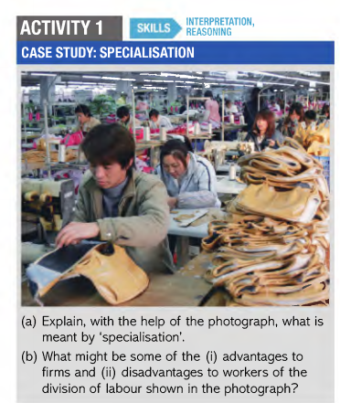

Slide 8
Sectors of Economy
Primary- raw materials extracted or food grown.
Eg: agriculture, fishing, mining, oil extraction etc.
Secondary- raw materials transformed into goods.
Eg: motor manufacturing, food processing, furniture making etc.
Tertiary- produces services
Eg: Health, Education, Transport, financial services etc.

Slide 9
Sectors of the economy
Public- state or government sector of the economy
Private- owned by private individuals, companies and charities

Slide 10
Markets
A market is any convenient set of arrangement by which buyers and sellers communicate to exchange of goods and services.
Eg: Digital or online(Amazon or Ebay), Newspapers and magazines, mail or telephone.

Slide 11
Types of Market
International
National
Local or Regional
These markets are interlinked but separate.

Slide 12
Submarkets
A market within a large market
Eg:
Market for cars
Electric Car
Hybrid car
Housing Market
Residential
Commercial

Slide 13
