Slide 1

Ch 5 TYPES OF ECONOMY Part-1

Slide 2
Learning Objectives
Understand that the function of an economic system is to resolve the basic economic problem.
Understand the different ways in which resources are allocated.
Know that free market economies, mixed economies and planned economies are three different types of economic system.

Slide 3
Economic System
An Economic System is a complex network of individuals, organisations and institutions that allocates resources.
Various actors in economic system are:
  Individuals
  Firms
  Government

Slide 4
The Allocation of Resources
The Market Mechanism: Through bringing buyers and sellers together, they agree on a price and a product or a resource is sold.
For eg: In the market for teachers, schools hire teachers and teachers sell their labour.
Planning: Through administrative decisions
For eg: In firms, managers decide how to allocate resources.
For eg: in a budget, the finance minister will announce plans for how the government will spend money.

Slide 5
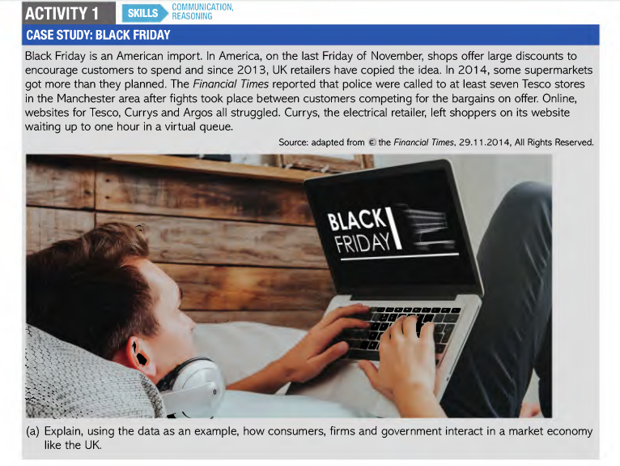

Slide 6
Types of Economy
Free Market Economies/ Capitalist Economies:
  A system in which privately owned business creates goods and services.
  Majority of resources are allocated through markets rather than through government or planning.
  Hong Kong and Singapore have a greater proportion of their resources allocated by the market, therefore they are tend to be called ‘free market economies.
  There are no pure market economies.

Slide 7
Command Economies/ Panned or Centrally Planned Economies:
  All economic and business decisions by government.
  Most resources are allocated by the state and the market mechanism only plays a small part
  Cuba and North Korea are some examples of Command Economies.

Slide 8
Mixed Economies:
  Combination of free market and command economies.
  Companies are usually owned by citizens.
  Government regulations are imposed for well being and safety of citizens.
  Welfare benefits- state pension, unemployment benefit etc…
  Healthcare and education provided by state.
  Eg: Iceland, France and India

Slide 9
