Slide 1

Chapter 1 Economics As A Social Science

Slide 2
Learning Objectives
Economics is social science that uses scientific method
Economists builds models and theories based on assumptions
Ceteris paribus assumption is used in building models and drawing conclusions
Distinction between positive and normative economics

Slide 3
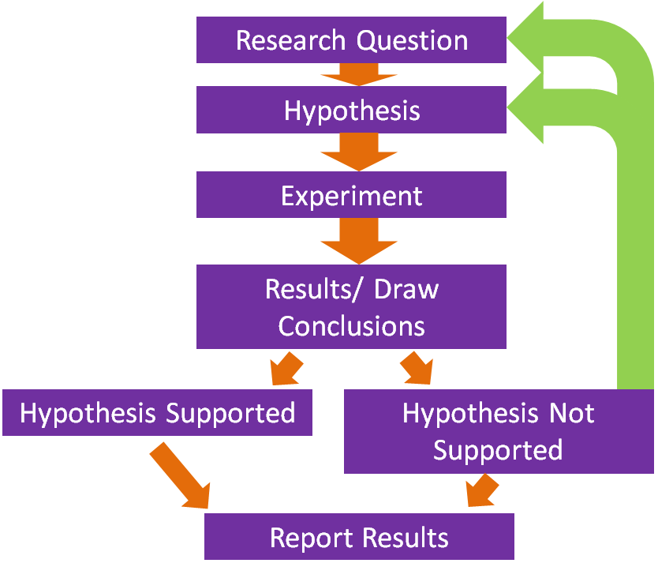
SCIENTIFIC METHOD: A particular method of work or enquiry
Scientist puts forward a theory/model/hypothesis that is capable of being disapproved.
Hypothesis – Observation based on cause and effect.
Model/ Law – Hypothesis becomes a model after some testing has been done and appears valid.
Theory – Model repeatedly tested and confirmed becomes scientific theory.

Slide 4
Economists use theories and models
THEORIES | MODELS
Expressed in words. | Expressed in mathematical terms.
E.g. ‘Consumption is dependent upon income’. | E.g. Ct = 567 + 0.852Yt Where, Ct = Current consumption 567 = Constant Yt = Current Income.
Gather evidence through controlled experiments to support or refute a theory.
Controlled experiment – All factors held constant except one.
Accept, modify or refute the theory
Laws - Theories that gain universal acceptance.
Why we construct theories and models?
Why something is as it is.
To decide how to act.

Slide 5
Scientific Method used by Economists
Observation
MBA program has the best job placement rate.
Question
Which college provides the best MBA Program?
Hypothesis
X Y Z
College X provides the best placement opportunities.
Results
Conclusion
Hypothesis was proven correct.
20 MBA students of X college got salary package of $90000. | 5 MBA students of Y college got salary package of $60000. | 2 students of Z college got salary package of $48000.

Slide 6
Natural science and Social Science
Natural Science | Social Science
Physics, Chemistry, Mathematics etc | Economics, Sociology, Politics
Work in laboratories | Data gathered from ordinary everyday world.
Observations made with some degree of certainty | Variables change over any given time period.
Easy to establish control group | Not possible to setup experiments or establish control groups.
Easy to accept or refute a particular hypothesis. | It is difficult to decide whether evidence supports or refutes hypothesis.

Slide 7
Economics - science but not a perfect science.
Social science - uses scientific method to explain human behaviour.
Behaviour of individual – difficult to understand & predict
Behaviour of group of individuals – more predictable
Insufficient data – uncertainty
Words used ‘likely that’ or ‘this may possibly happen’

Slide 8
Different data interpretation – different conclusion
Conclusion 2
Policy had been a success as unemployment may have been far greater without the use of policy
Conclusion 1
Failure of government policy to help this particular area.
National unemployment rate 3%
Unemployment rate of particular area 6%

Slide 9
Simplification
Economic theories and models – unrealistic
Theory or model – simplification of reality
Simplification:
Some factors included some omitted
Some factors distorted to draw attention to particular points

Slide 10
Assumptions & Ceteris Paribus
Assumptions – simplify a problem
Ceteris Paribus – All other things being equal

Slide 11
Positive Economics | Normative Economics
Scientific/objective study of subject | Value Judgements
How economies/markets actually work | How economies/markets should work
Proven true/false Supported/refuted by evidence | Arguments Can not be supported/refuted by evidence
Facts and figures | Words used ‘should’ and ‘ought’
Positive Statements | Normative statements
Population of India is greater than population of China. | Old age pension should be stopped.
There is inflation in the economy. | Poverty is bad, it should be eradicated.
25% of population is living below poverty line. | Government should make strong decisions to eradicate poverty.

