Slide 1
Chapter 3 PRODUCTION POSSIBILITY FRONTIER

Slide 2
Learning objectives
Production possibility frontier (PPF) shows maximum potential output of an economy
Outward and inward shift in PPF
Consumption or investment
PPF shows what could be produced, not what should be produced

Slide 3
The Problem Scarcity
Production Possibility Frontier: shows different combinations of economic goods that an economy is able to produce, if all resources in the economy are fully and efficiently employed.
Other names: Production possibility curve or boundary and transformation

Slide 4
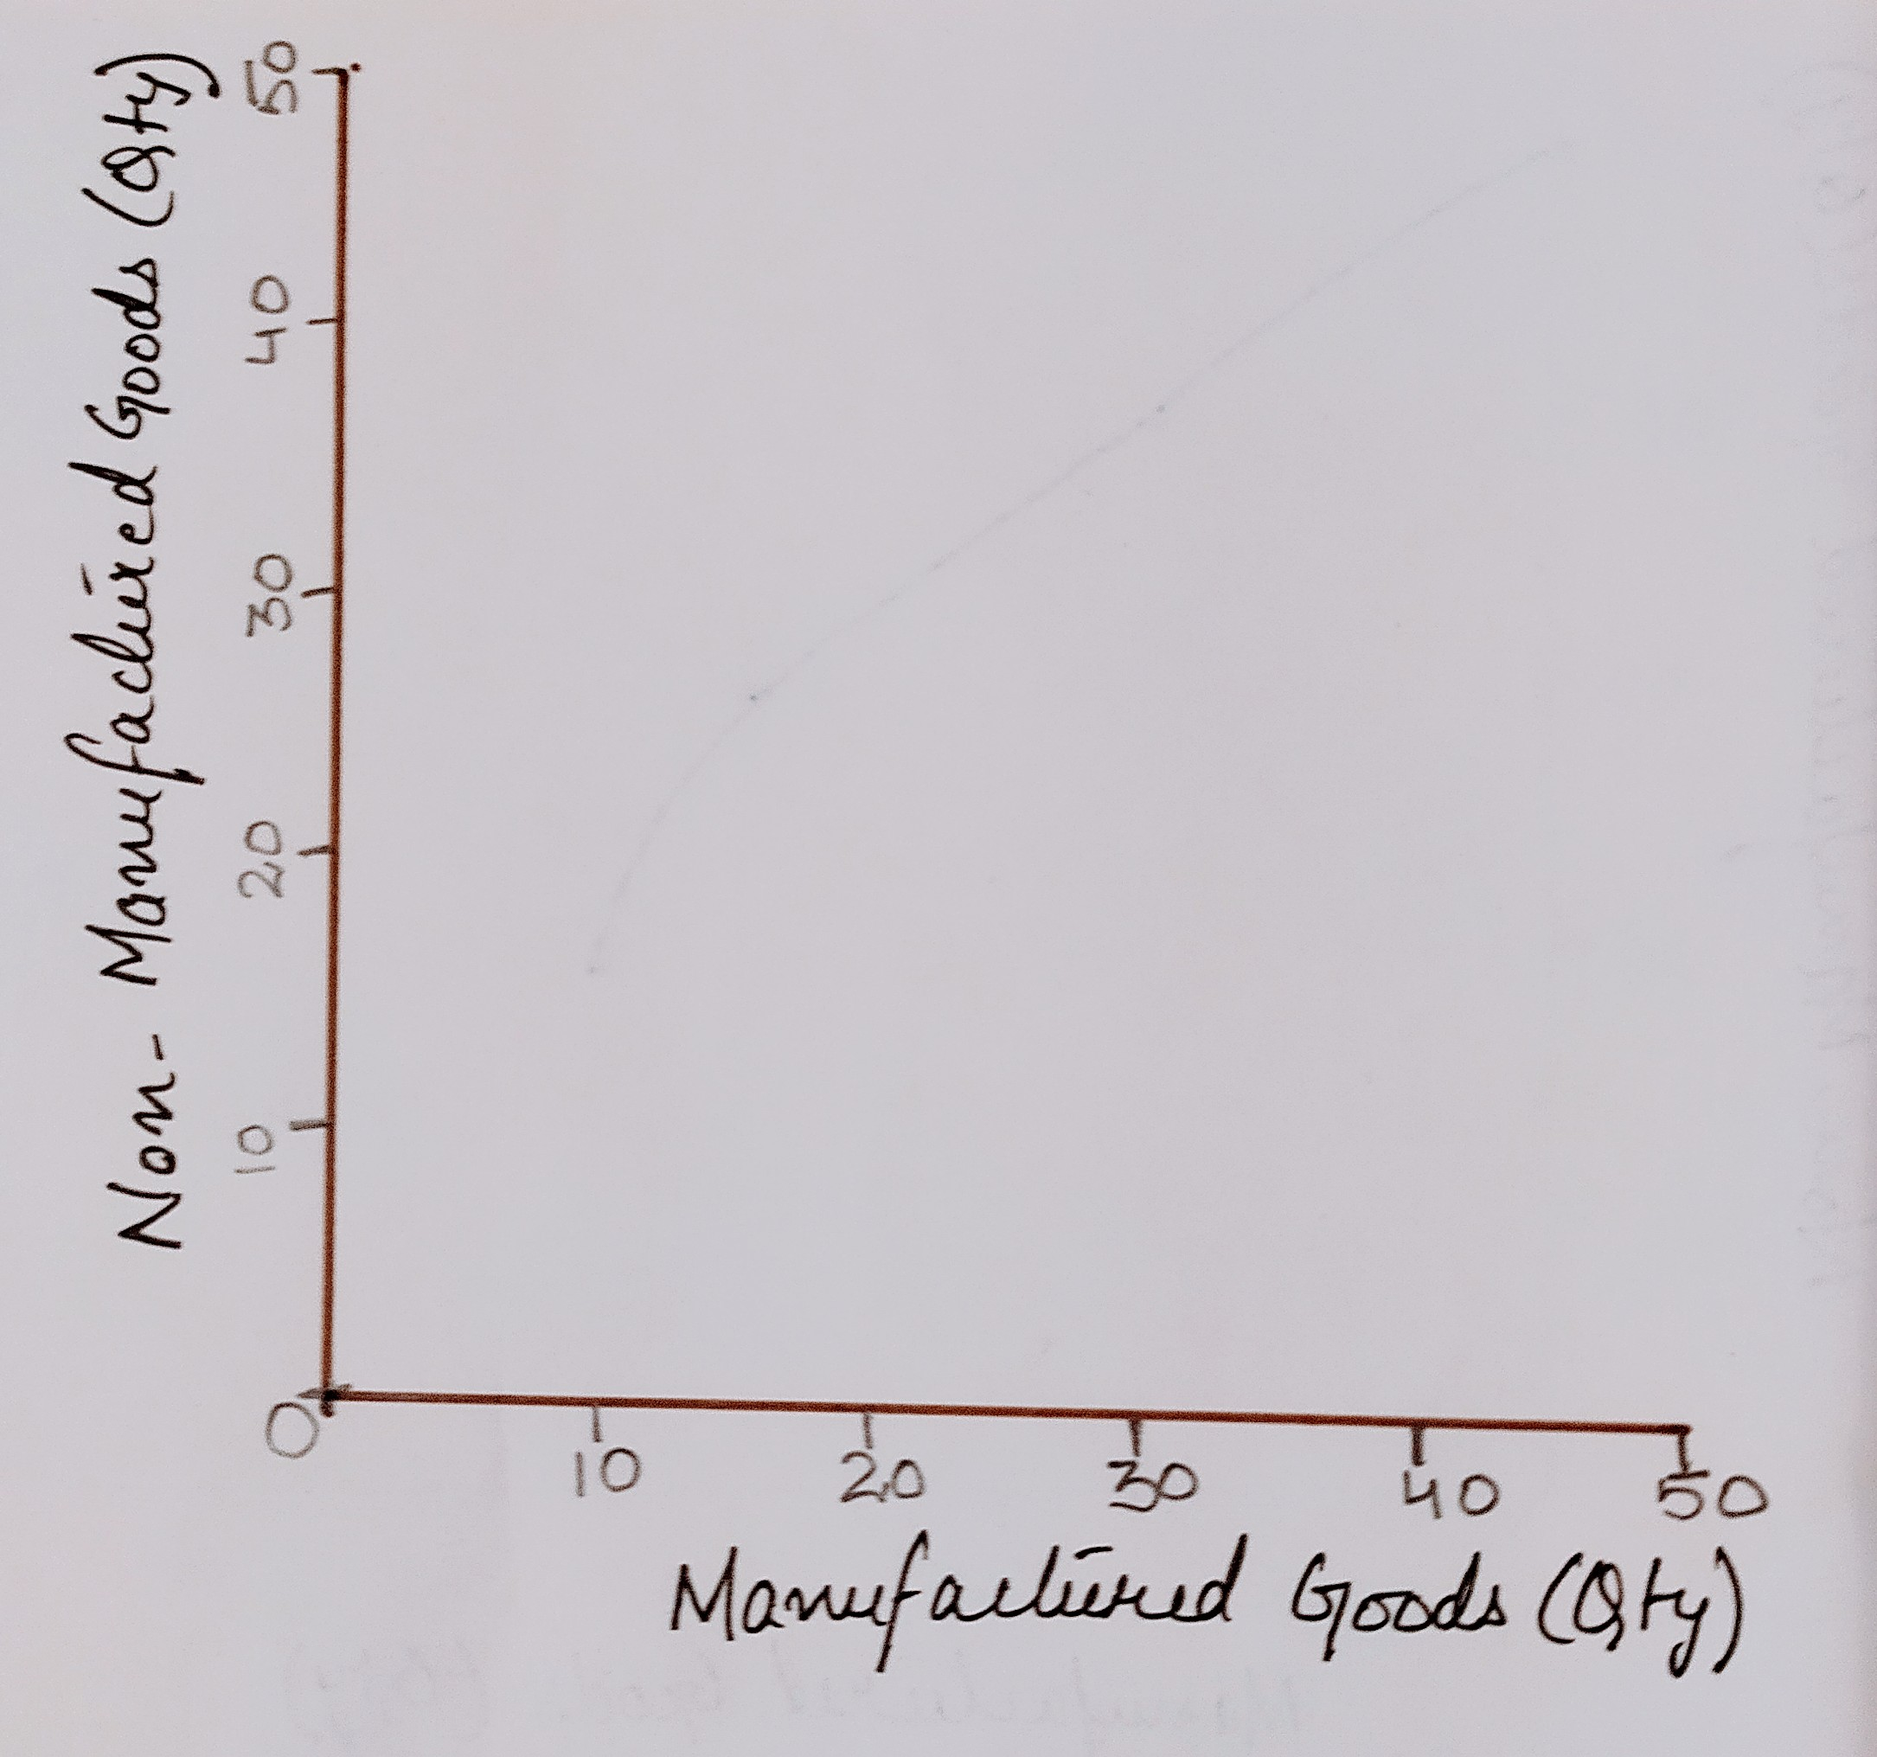
PPF Diagram
X axis shows the quantity of manufactured goods to be produced in the economy
Y axis shows the quantity of non-manufactured goods to be produced in the economy.

Slide 5
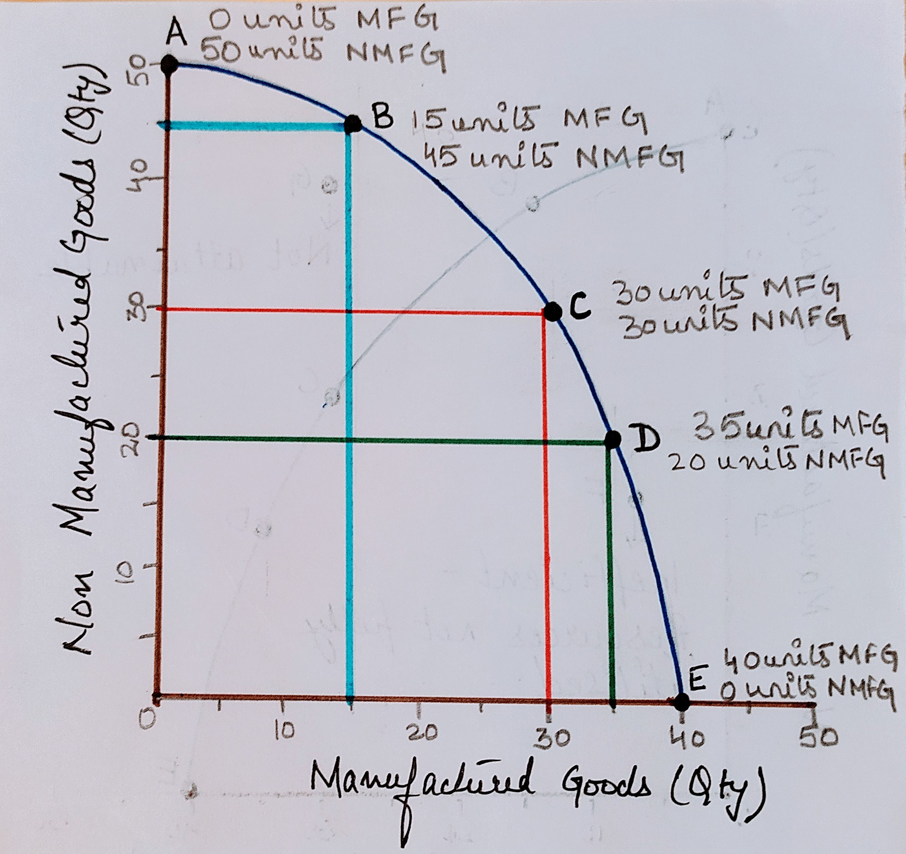
The economy could be:
PPF – ABCDE – different combinations of goods produced if all resources are fully and efficiently utilised. Economy can produce at any point on the line.
A, all resources used for production of non manufactured goods.
B, More non-manufactured goods and less manufactured goods
C, both manufactured and non manufactured goods produced in equal quantities
D, Less non-manufactured goods, more manufactured goods
E, all resources used for production of manufactured goods.
G, unattainable, not enough resources
F, Inefficient, resources underutilised

Slide 6
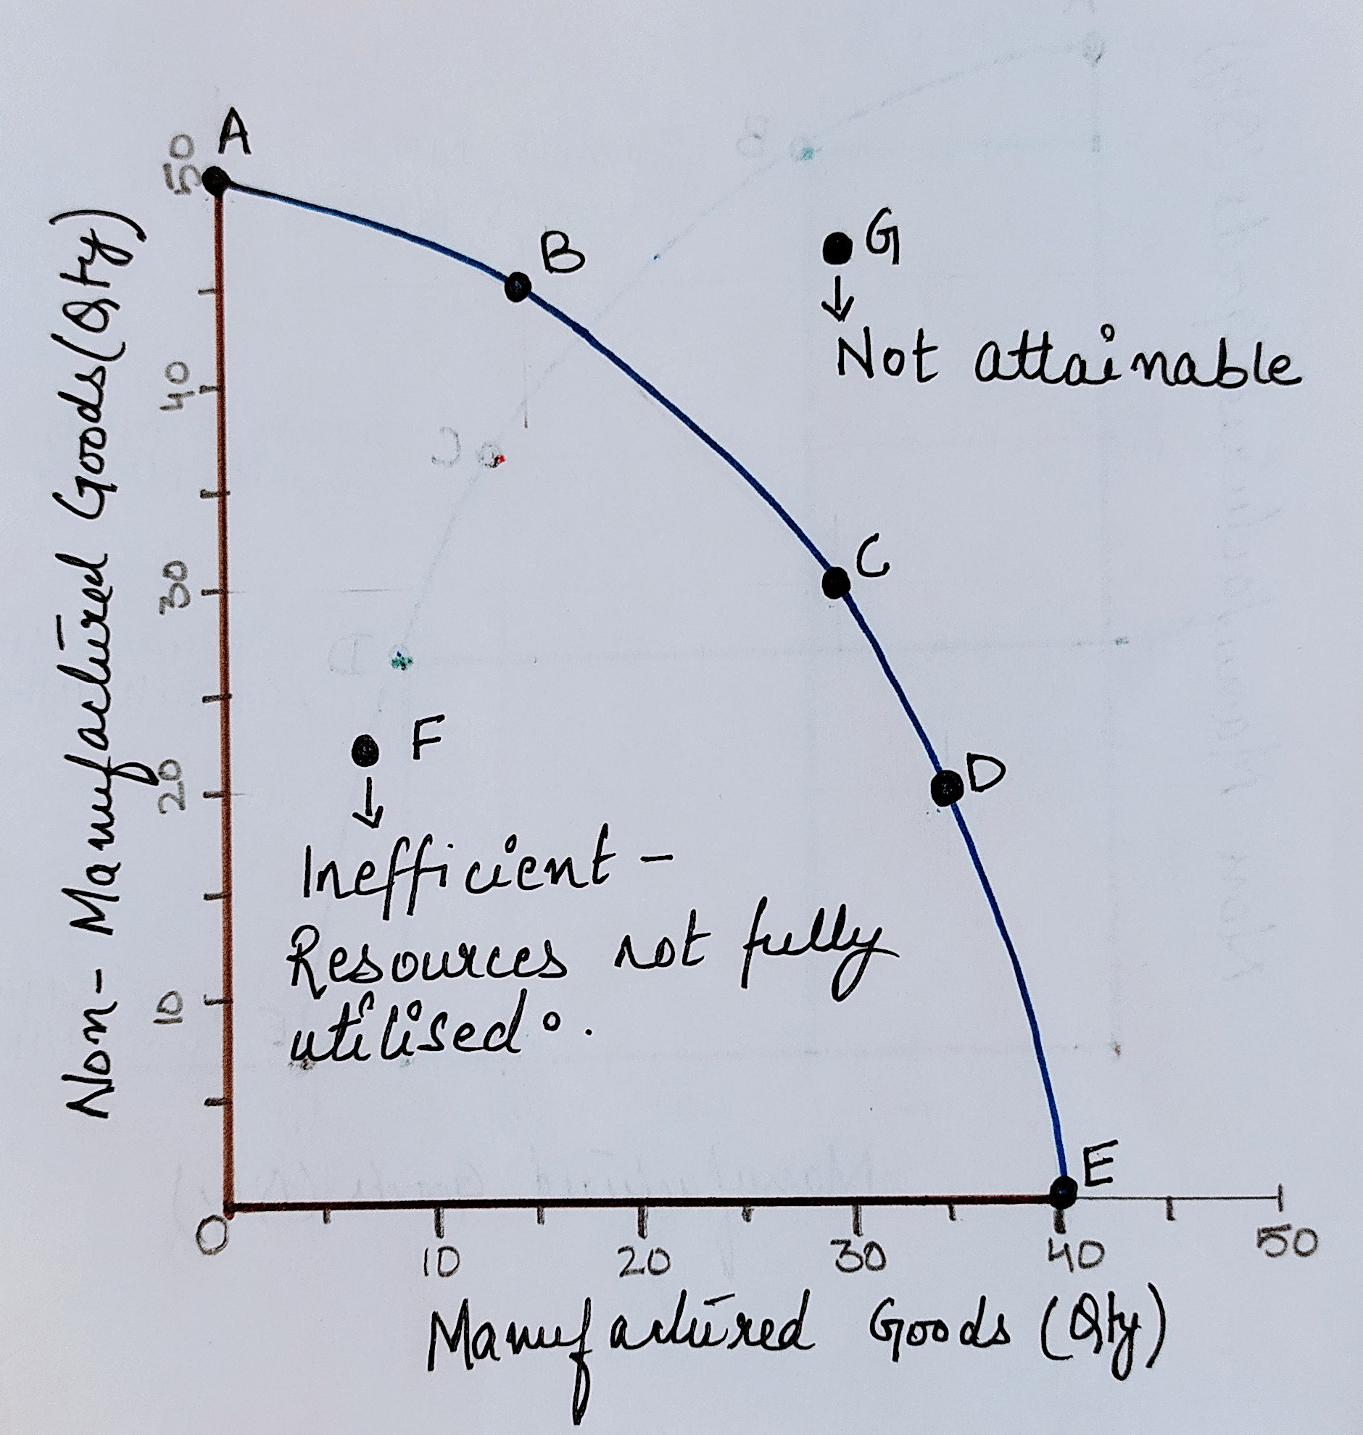
F - Inefficient production – unemployed resources
High level of unemployment of workers
Factories and machines not used
Production occurs within the boundary

Slide 7
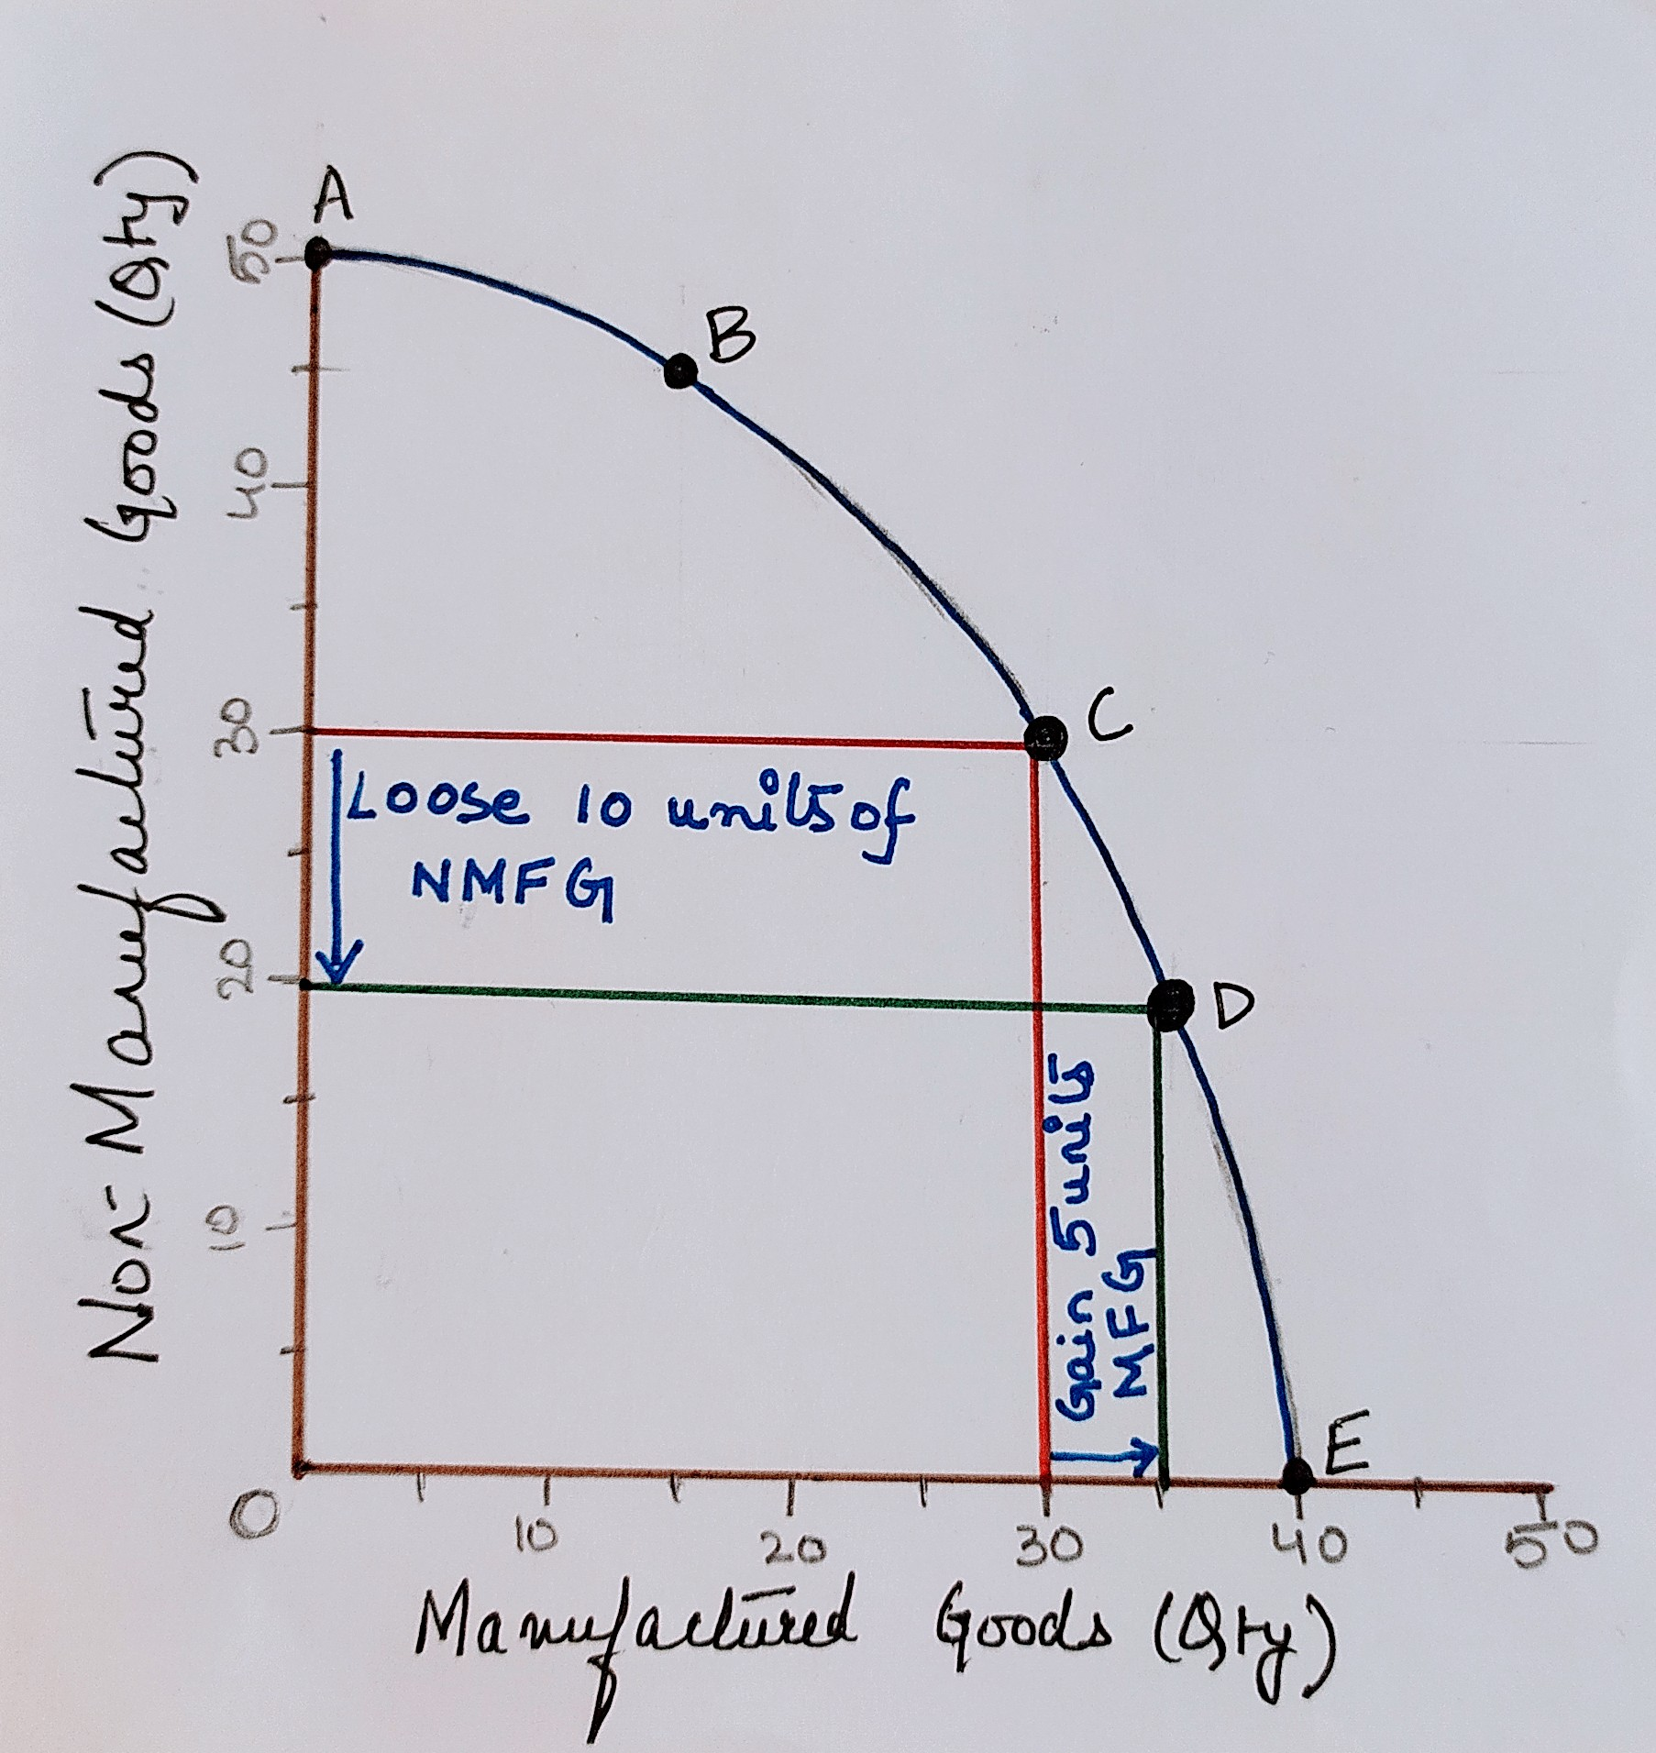
OPPORTUNITY COST:
PPF – shows opportunity cost
Economy producing at C
Aims to move to D
Output of manufactured goods increased by 5 units
Output of non-manufactured goods decreased by 10 units
Opportunity cost at C of increasing manufacturing production by 5 units is 10 units of non-manufactured goods.
Shape of PPF
Typically curved outwards
Resources more productive in production of one good to another good
More of non-manufactured goods given up to produce each unit of manufactured goods

Slide 8
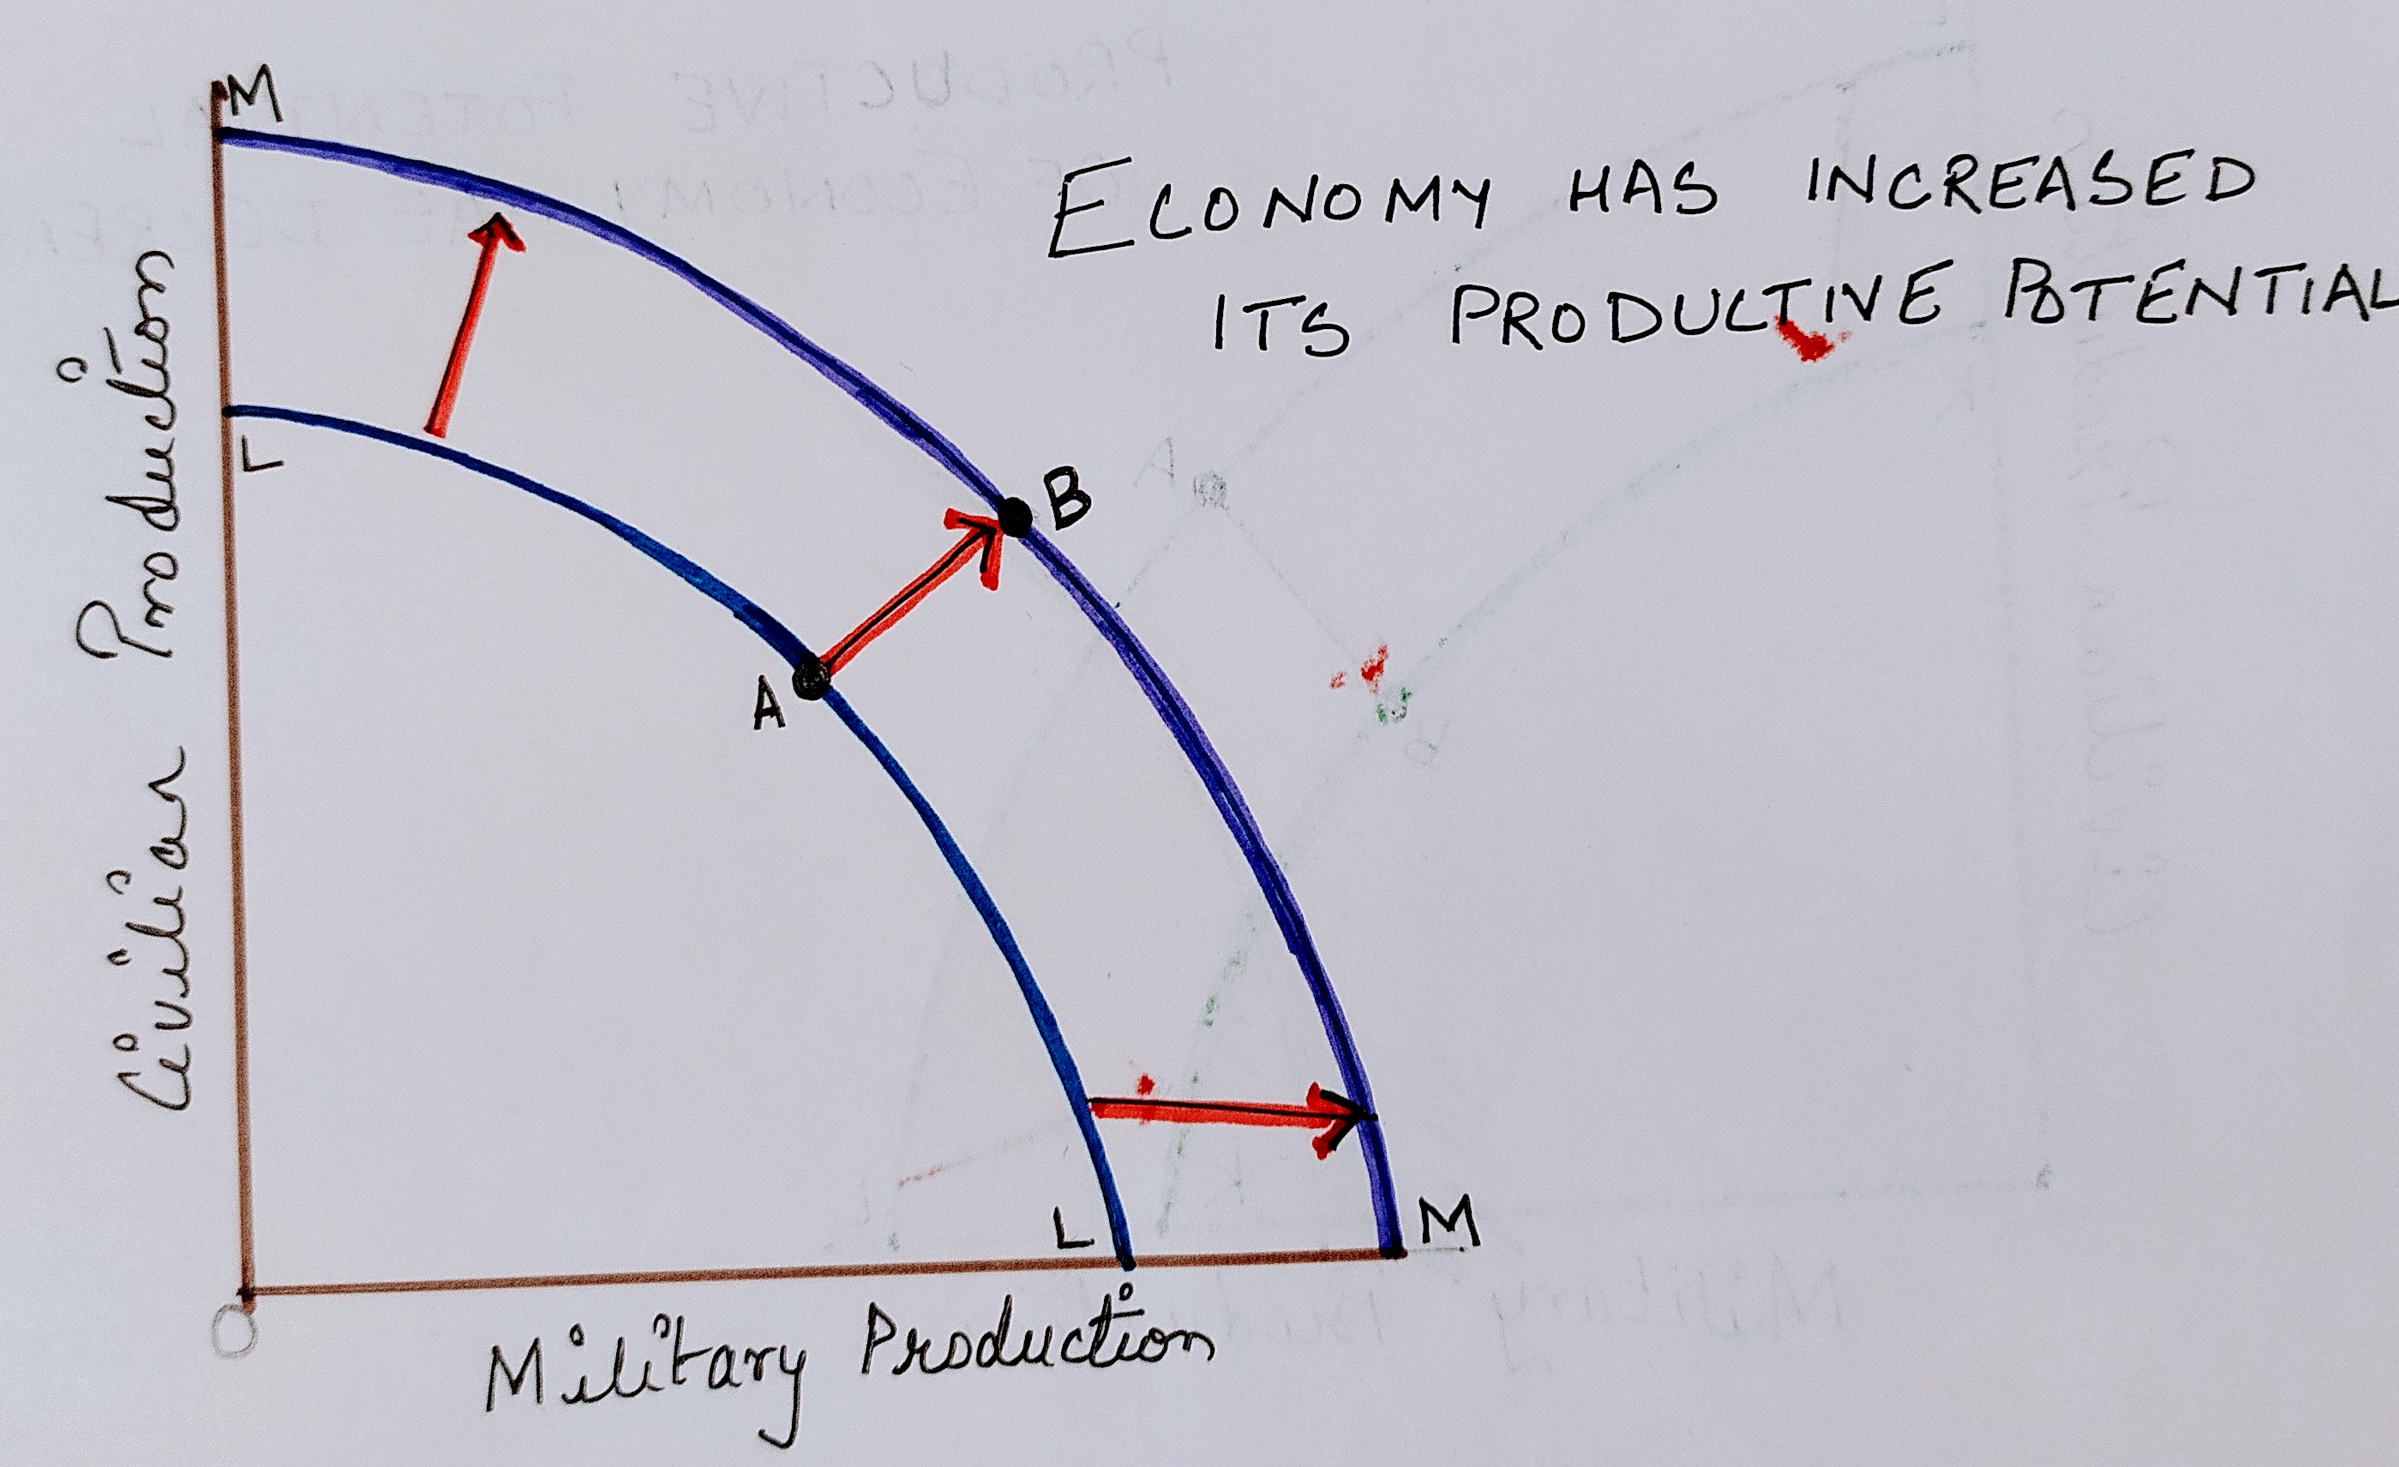
Economic Growth – PPF shifts right/outwards (LL to MM)
Increase in productive potential
Increase in level of production (A to B)
Reason for economic growth
Increase in quantity of resources
Increase in number of workers
New factory, office built
Increase in quality of resources
Education – workers more productive
Technical progress – machines produce more with same resources

Slide 9
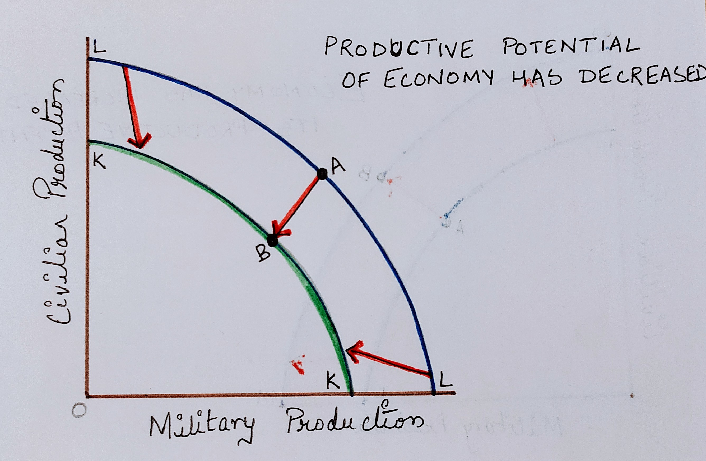
Economic Decline – PPF shifts left/inwards (MM to LL)
Decrease in productive potential
Fall in level of production (B to A)
Reasons for economic decline
Fall in quantity/quality of resources
War – economic infrastructure destroyed
Fall in number of workers – fall in potential output
Global warming – affects agriculture

Slide 10
Consumption Vs Investment
Economic Growth
Consumption
Consumer goods
Investment
Capital goods

Slide 11
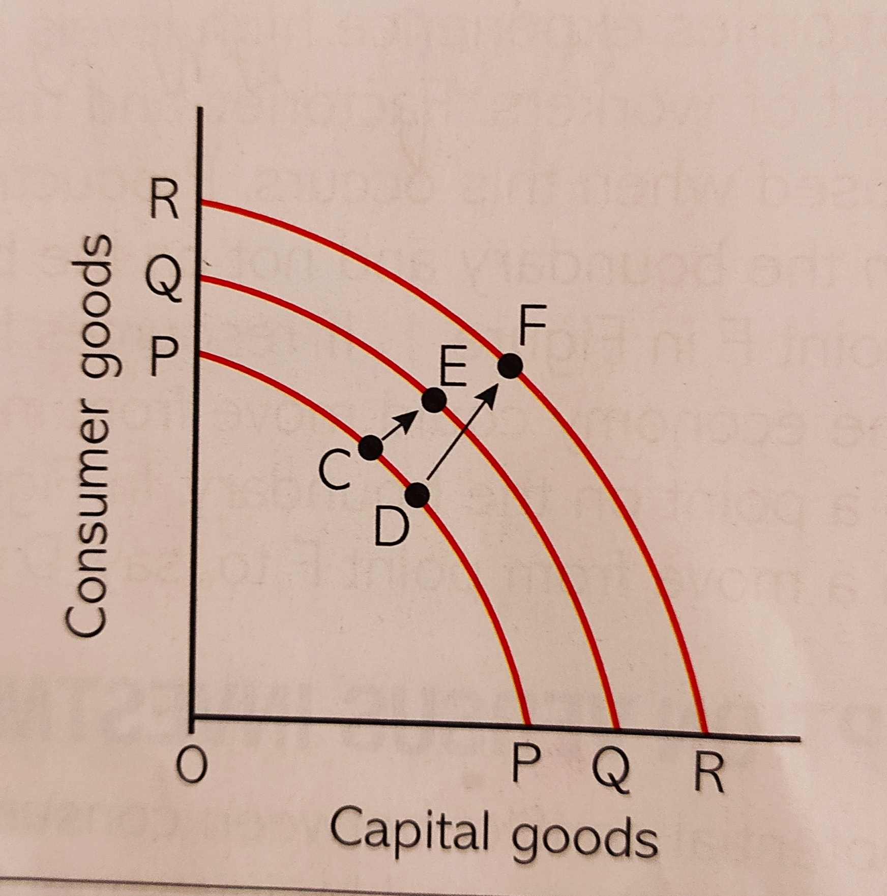
Diagrammatic explanation:
Y axis- Consumer goods- Food, DVD’s etc.
Xaxis- Capital goods- Machines and equipment etc.
Two economies, A and B, same size in terms of overall production and population.
Economy A is at point C, consumer goods > capital goods
Economy B is at point D, capital goods > consumer goods
Growth after ten years
Economy B, invested more resources to capital goods, grows faster (PP to RR) from D to F
Economy A, invested more resources to consumer goods, slower growth (PP to QQ) form C to E
Short term – A wealthier than B
Long term – B wealthier than A
When resources invested on capital goods, economic growth is much faster in long run.

Slide 12
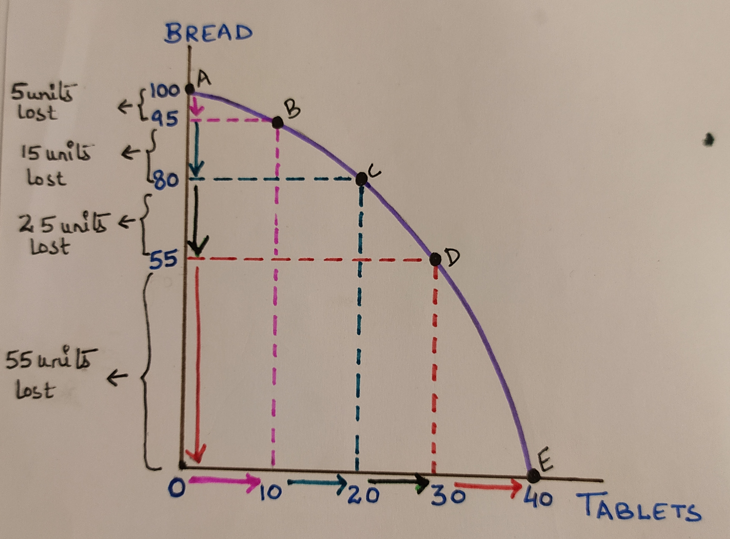
Assumption for PPF: Not all resources in the economy are as productive in one use compared to the another
Assumption for PPF in figure: Resources are more productive in production of Bread.
Increasing Marginal Opportunity cost
OR
Rate of sacrifice is increasing
When we increase one good at uniform rate we have to sacrifice other good at increasing rate.

Slide 13
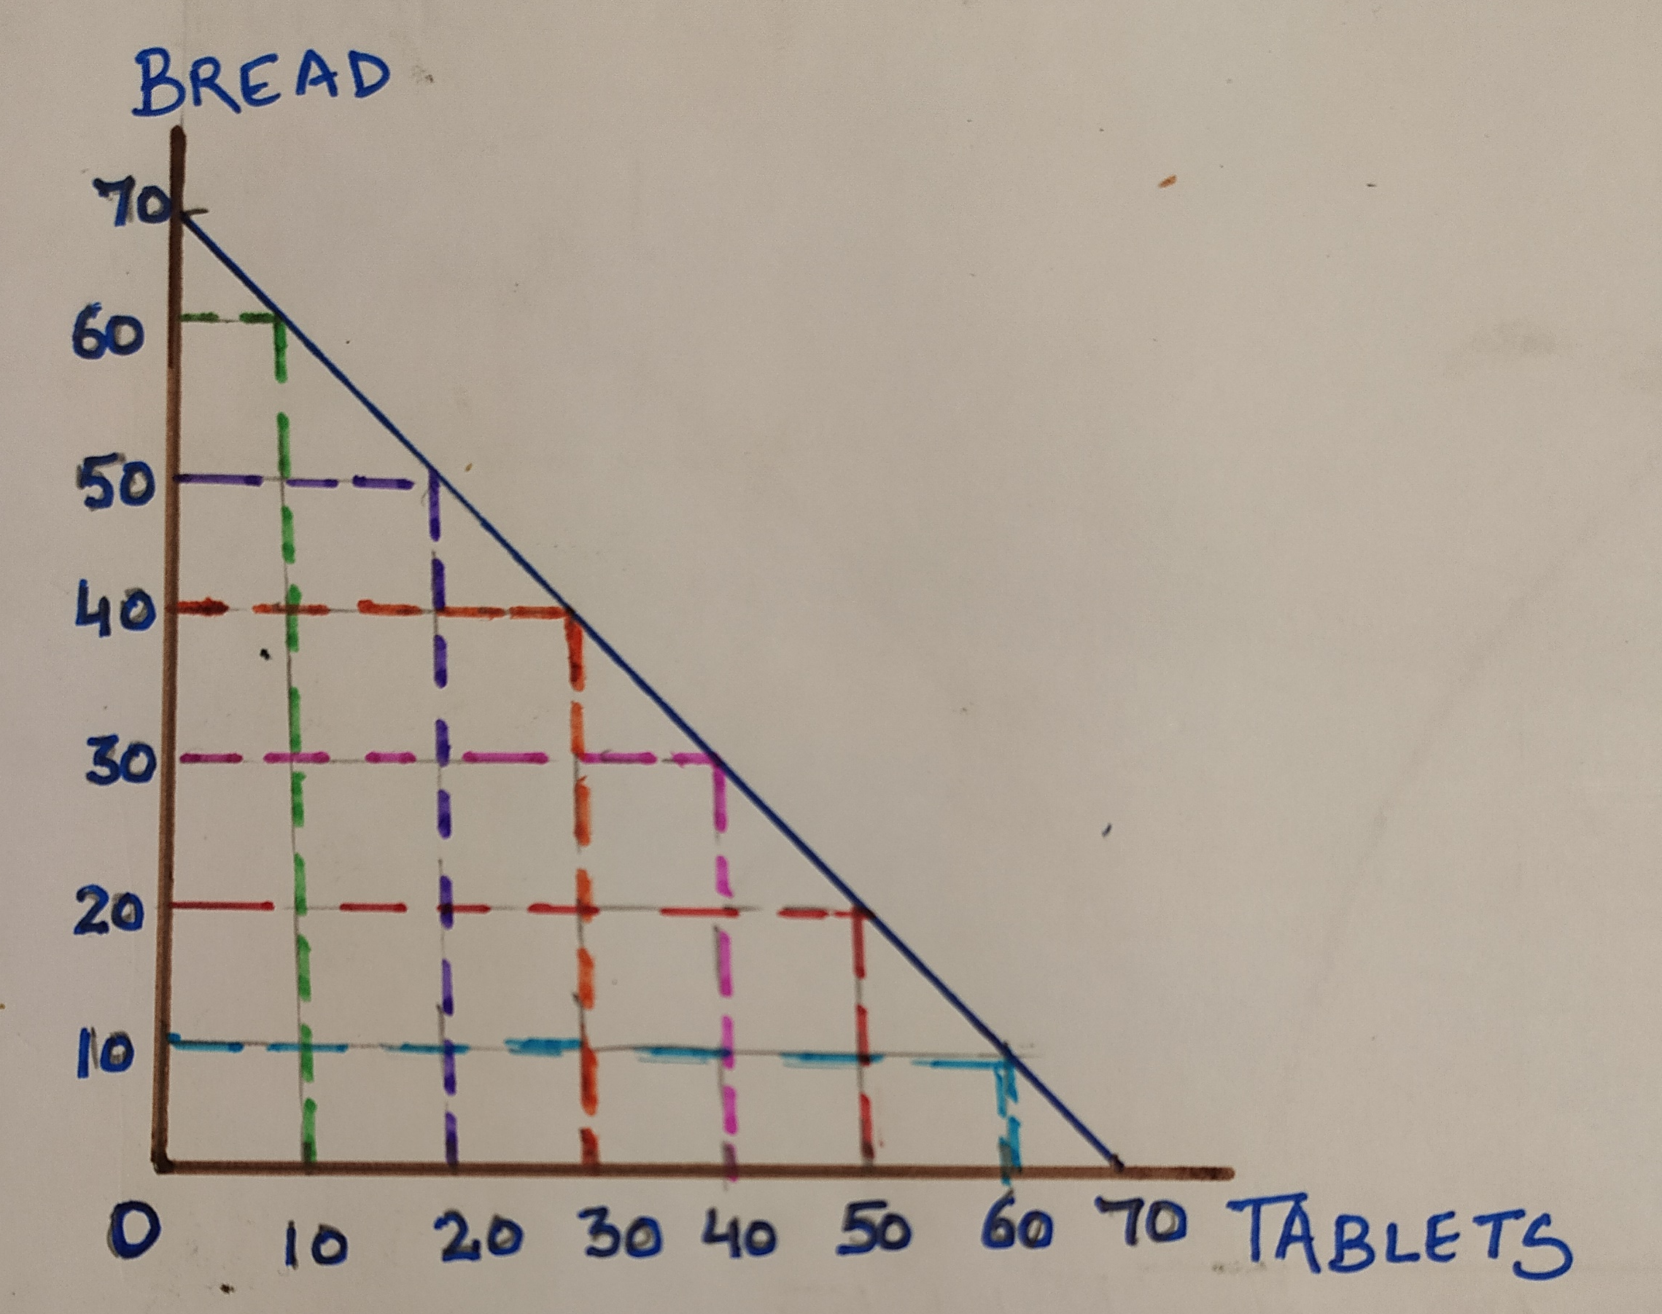
Constant Marginal Opportunity cost.
To produce 10 units of tablet, you have to sacrifice the production of 10 units of bread.
PPF shows that resources are equally productive in the production of both the goods which contradicts our assumption.

Slide 14
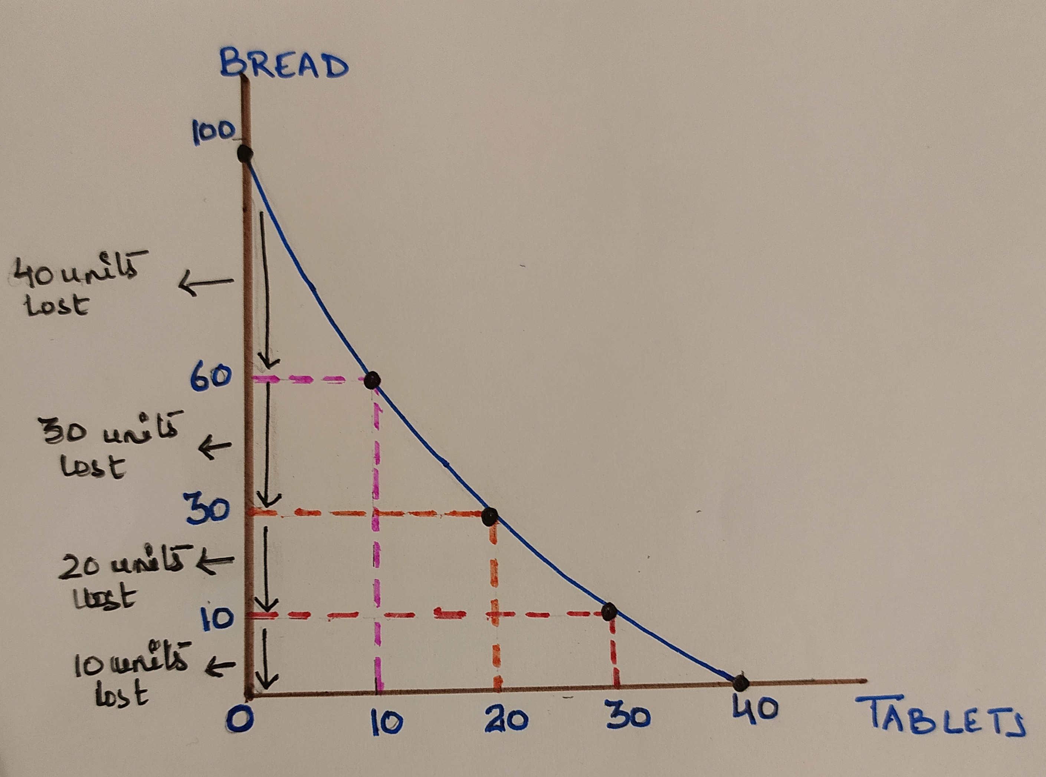
Decreasing Marginal Opportunity Cost
To produce 10 units of tablet, you have to sacrifice less units of bread.
PPF shows that resources are productive in production of tablets which contradicts our assumption.

Slide 15
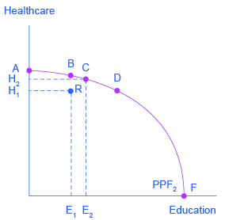
EFFICIENCY
PPF shows the different combination of economic goods that an economy is able to produce if all the resources in the economy are fully and efficiently employed.
Productive efficiency | Allocative efficiency
Production takes place at lowest cost. Given resources produces maximum goods. All points on PPF – productively efficient | Production where social welfare is maximised. Combination that is desired most by society Just one point on PPF What society desires? Controversial question Different society/economy – different desires Economy with old age population – higher demand for healthcare and lower demand for education

Slide 16
Conclusion:
PPF by itself gives no indication of which combination of goods will be produced in an economy.
It shows a range of production possibilities, if output is maximised with given resources
Economics explains why an economy chooses to produce at one point either on PPF rather than another, or within PPF

