Slide 1

Chapter 4
SPECIALISATION AND DIVISON OF LABOUR

Slide 2
Learning objective
Specialisation & Division of labour leads to productivity
Advantages & Disadvantages of division of labour
Three sectors in the economy: primary, secondary & tertiary
Private & Public sector
Importance of markets

Slide 3


Specialisation
It is the production of a limited range of goods by an individual, firm or country in co-operation with others so that together a complete range of goods is produced
Specialisation can occur between nations/ within nation.
Globalisation is currently increasing this process of specialisation between nations.
Notes:
https://www.youtube.com/watch?v=XnkKTxf1LHc

Slide 4
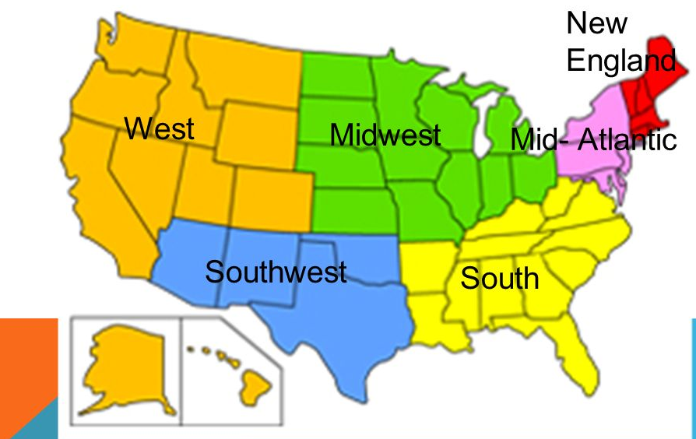

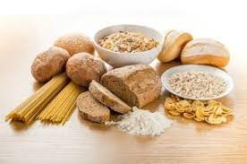

Specialization occurs within a country's borders:
As is the case with the United States. For example, citrus goods grow better in the warmer climate of the South and West, many grain products come from the farms of the Midwest, and maple syrup comes from the maple trees of New England. All these areas focus on the production of these specific goods, and they trade or purchase other goods.

Slide 5


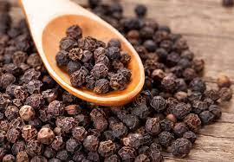
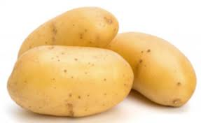

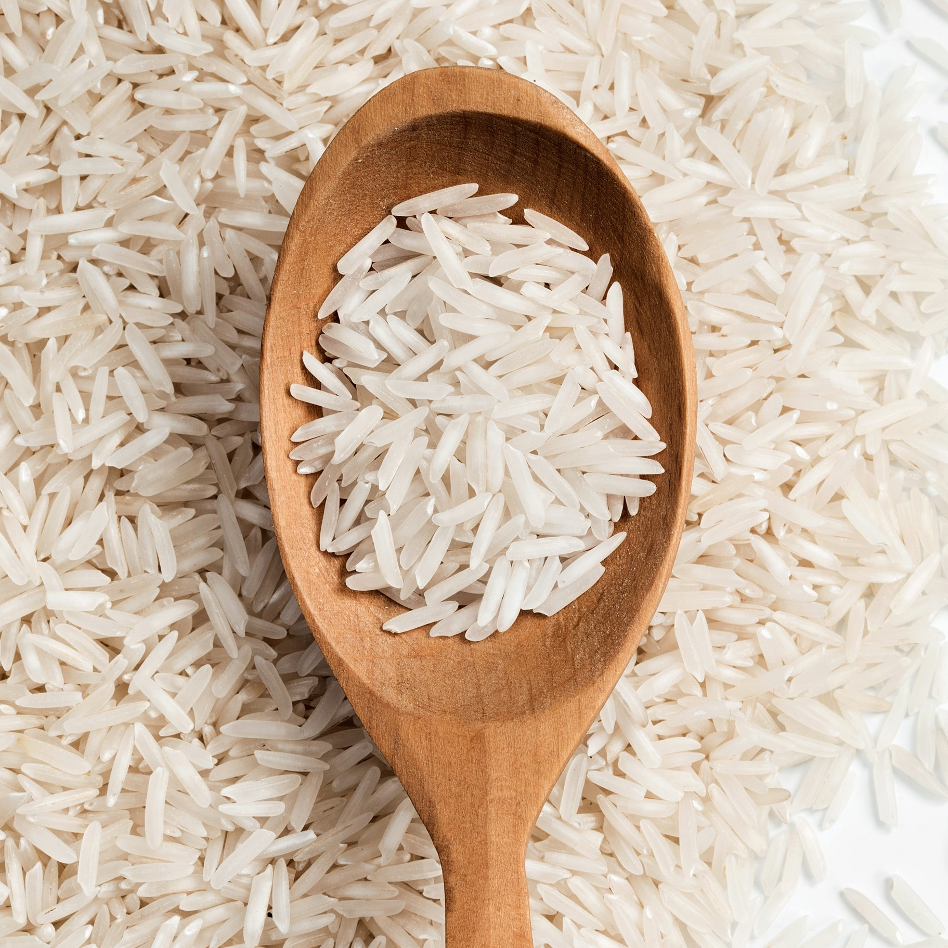
Specialisation between nations

Slide 6
Division of labour
Specialisation by Individuals is called Division Of Labour.
The division of labor occurs where production is broken down into many separate tasks
Pin factory example
All process done by 1 worker – only 20 pins produced in a day
Each process by individual worker – 4800 pins produced in a day
Worker 1
Draws out wire
Worker 2
Straightens wire
Worker 7
Puts head
Worker 8
Paints
Worker 9
Puts in the box
Worker 3
Cuts the wire
Worker 4
Points the tip
Worker 6
Makes head
Worker 5 Grinds

Slide 7
Advantages of division of labour
Increase in productivity – labour and capital productivity
Workers gain skills and become more productive.
Cost effective – provide specialist tools
Time saving – not constantly changing tasks, machines, moving around
Workers can specialise in those tasks to which they are best suited.

Slide 8
Disadvantages of division of labour
Jobs divided too much - Work becomes tedious and monotonous.
Workers do not feel connected to their work.
Poor quality and less output per person.
Workers avoid work – long breaks, sick leaves
Size of the market small – not profitable to specialise
Overspecialisation – unemployment – difficult to find jobs in other industry
Breakdown in part of chain of production can cause chaos within the system.

Slide 9
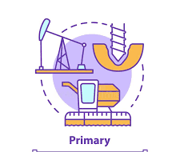
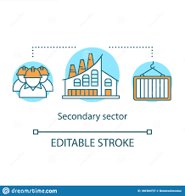
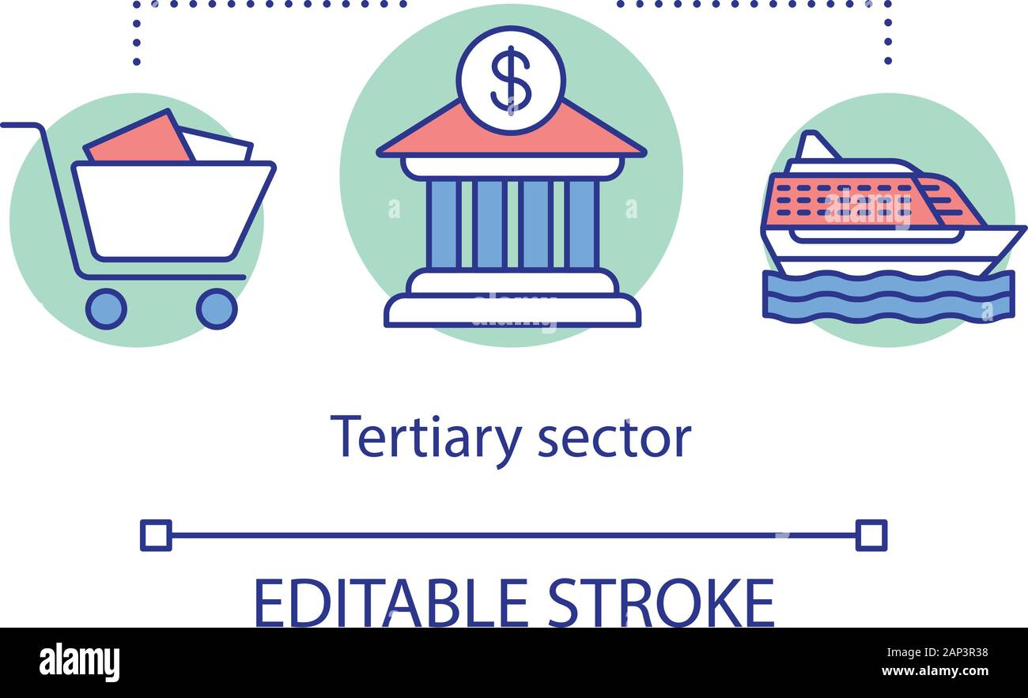
Sectors of Economy
Primary- raw materials extracted or food grown.
Eg: agriculture, fishing, mining, oil extraction etc.
Secondary- raw materials transformed into goods.
Eg: motor manufacturing, food processing, furniture making etc.
Tertiary- produces services
Eg: Health, Education, Transport, financial services etc.

Slide 10


Sectors of the economy
Public-owned by government
Production achieved by government departments, local authorities, state-owned businesses
Private- owned by private individuals, companies and charities

Slide 11
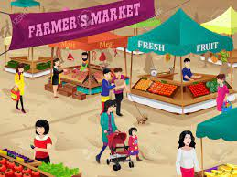






Markets
A market is any convenient set of arrangement by which buyers and sellers communicate to exchange of goods and services.
Eg: Digital or online(Amazon or Ebay), Newspapers and magazines, mail or telephone.

Slide 12
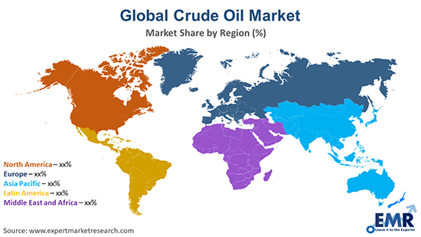
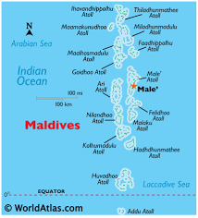
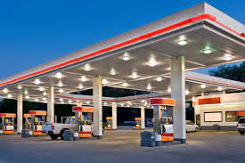
Types of Market
International
National
Local or Regional
These markets are interlinked but separate.

Slide 13
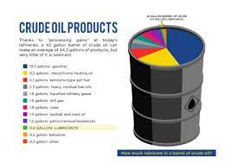

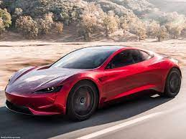
Submarkets - A market within a large market
Market for oil
Diesel
Petrol
Markets increase prosperity but does not always leads to most efficient allocation of resources
Housing Market
Residential
Commercial
Market for cars
Electric Car
Hybrid car

Slide 14
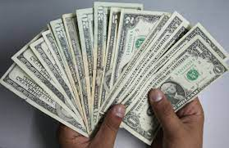
Money and Exchange
Specialisation requires exchange
Money is anything that is widely accepted as payments for goods received, services performed or repayment of past debts.

Slide 15
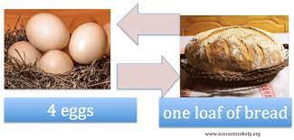
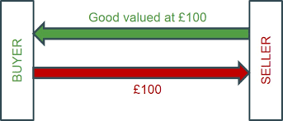
Functions of money
Barter – swapping one good for another
A medium of exchange
  Money is used to
  buy and sell
  goods and services
  Money separates
  the two sides
  of transaction
Problem with barter system
Double coincidence of wants – costly & discourages trade
No trade – No specialisation
No specialisation – no increase in living standards
Possible where individuals/small groups are self sufficient – need for trade is small

Slide 16
Measure of value
  Barter system - difficult to establish an agreed unit of account as peoples opinions of the value of certain items greatly differ.
  Money acts as unit of account
  Money represents value of a good
  Very high inflation – value of money falls by huge amount, money ceases to act as unit of account

Slide 17
Store of value
  It acts as store of value.
  Links present and future.
  Can be stored to be used for later
  Same amount of goods bought now and in future
  Hyperinflation destroys the link of present and future
    Value of money is far less in future than today
A method of deferred payment
  Money used for lending/borrowing
  Value of money is stored – same amount of goods can be bought when paid back
  Hyperinflation – value of money lost in future
    Fall in credit/ borrowings
    Fall in investment
    Fall in economic growth

Slide 18
Forms of money
Cash
  Notes and coins.
  Token(symbolic) money - has no intrinsic(actual) value unlike gold.
  Issued by government
  Legal currency – must be accepted by law as means of payment
  High inflation – do not function as measure of value, store of value, method of deferred payment
  Cash not a good form of money but ideal medium of exchange

Slide 19
Money in current account
  Banks offer current account facilities
  Two features of current account
    If account is in credit, cash can be withdrawn
    Account holder provided with debit card and cheque book
  Cheques/ debit cards
    Medium of exchange
    People and firms can refuse to accept
  Little/ no interest offered on current account
  Inflation – store of value damaged – deposits lose value overtime

Slide 20
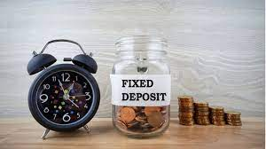

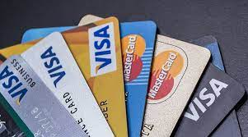
Near Monies:
  Assets that fulfil some but not all functions of money.
  Measure of value – yes, store of value – yes. Medium of exchange – no
  Liquid assets
  Higher interest rate, saved more and less spend
  Notice to withdraw
  Eg : fixed deposits
Non-money financial assets
  Eg: Shares- sold easily but take months to receive the money
  Value changes rapidly
  Not good store of value or method of deferred payment
Money substitutes:
  Eg: Credit cards
  Not store of value because possession of card does not show that the person who owns the card has money in the card account.
  Card only represents the ability to borrow

Slide 21

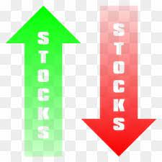



Financial Markets
A financial market is any convenient set of arrangements where buyers and sellers can buy or trade a range of services or assets that are monetary in nature.
Financial markets are different from product market or factor market
Financial markets exist for two reasons:
  Provide services demanded by households, firms and government.
  Allow participants to speculate and realise financial gains.

Slide 22
The Role of Financial Markets
To facilitate savings: Financial assets such as money or stocks and shares are a ways of transferring spending power from the present into the future. facilitating savings is a key role of financial markets.
To make funds available to business and individuals: Households, firms and governments all borrow money.
To facilitate the exchange of goods and services: Financial institutions play a vital role in creating payment systems for goods and services. Central bank mints coin and print paper money. Retail banks offer debit cards and credit cards.
To provide forward markets in commodities and currencies: Firms sometimes wants to buy and sell forward.
To provide a market for equities: issuing shares or equity finance can be an important way in which companies, particularly those that are growing in size can finance their expansion.

