Slide 1
Ch 5 TYPES OF ECONOMY Part-1

Slide 2
Economic System
Function of an economy – to resolve basic economic problem
Economic problem – scarce resources , infinite wants
Resource allocation
Three basic questions – what to produce? How to produce? And for whom to produce?
An Economic System is a complex network of individuals, organisations and institutions that allocates resources.
Various actors in economic system are:
Individuals – consumers & workers, own factors of production and supply for production
Firms
Government – key role – to exercise power, establishes relationship between consumers and firms by passing and implementing these laws

Slide 3
The Allocation of Resources
The Market Mechanism: Through bringing buyers and sellers together, they agree on a price and a product or a resource is sold.
For eg: In the market for teachers, schools hire teachers and teachers sell their labour.
Planning: Through administrative decisions
For eg. In Households, make decisions about their expenditures
For eg: In firms, managers decide how to allocate resources.
For eg: In government, how the government will spend money.

Slide 4
Types of Economy
Free Market Economies/ Capitalist Economies/ Free enterprise economy:
A system in which privately owned business creates goods and services.
Majority of resources are allocated through markets rather than through government or planning.
Hong Kong, USA have a greater proportion of their resources allocated by the market, therefore they are tend to be called ‘free market economies.
In USA, government allocates resources – education, defence, roads police service etc
There are no pure market economies.

Slide 5
Command Economies/ Panned or Centrally Planned Economies:
All economic and business decisions by government.
Most resources are allocated by the state and the market mechanism only plays a small part
Cuba, North Korea & China are some examples of Command Economies.

Slide 6
Mixed Economies:
Combination of free market and command economies.
Companies are usually owned by citizens.
Government regulations are imposed for well being and safety of citizens.
Welfare benefits- state pension, unemployment benefit, sickness benefits, child benefits etc…
Healthcare & education administered and financed by state.
Pure free market- healthcare & education entirely financed by private sector – no welfare benefits.
Eg: Iceland, France and India

Slide 7
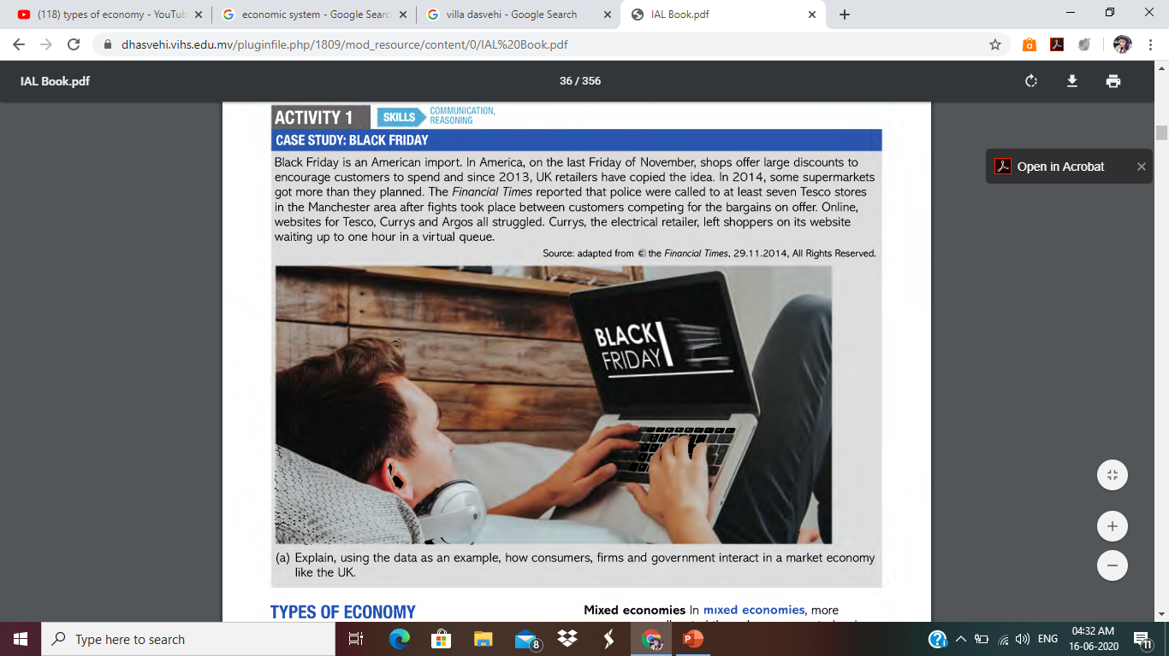

Slide 8
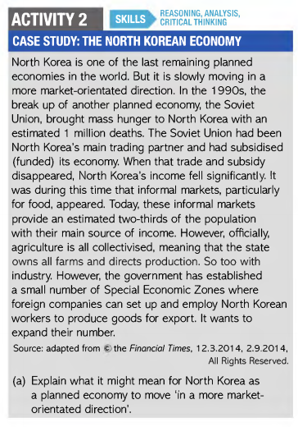

Slide 9
Evaluation of different types of economy
Choice:
More choice in free market economies.
Large quantities but little varieties produced (uniform products) in Planned Economies.
People have choices about which jobs to apply for in free market economies.
Much more direction with workers being allocated jobs in planned economies.
Citizens have far less income after tax in planned economies. Small amount left to spend on goods of their choice
People with high income or high level of education have far more choices than with low income or low levels of education in free market economies.

Slide 10
Quality and innovation:
Free market - Strong motivation, Innovative and quality goods produced.
Companies driven out of business by more efficient firms
However, many markets dominated by few large producers – exploit consumers
Choice and innovation are greater in free market economies.
Efficiency:
Planned economies proved to be inefficient.
Little incentive to work efficiently – guaranteed jobs, minimum targets to be met.
Free markets – more competition – higher efficiency – firms survive and make higher profits.
However, limited competition – few large firms dominate.
Large firms – small planned economies – struggle to maintain efficient production.

Slide 11
Economic growth:
More market-oriented, higher rate of growth.
Markets are dynamic, government discourage innovation and best practices.
Planning whole economy – produces large inefficiencies.
However, both mixed and free markets at same level of development, grow at similar rates over the long term.
Distribution of income and wealth:
Free market economies - higher levels of inequality than mixed or planned economies.
Planned economies – resources distributed more equally.
Progressive taxes in mixed or planned economies.

Slide 12
Risk:
Free market economies, more risk than mixed or planned economies.
Less provision for risks associated with ill health, unemployment, and old age
Wealthy can afford, poor left out
Planned economies – birth to death group of services and benefits provided
Political freedom:
Planned economies - limited political freedom.
Mixed and free market economies - associated with political freedom.

Slide 13
Smith, Hayek and Marx
Adam Smith:
‘An Enquiry into the nature and causes of the wealth of the nation’- explained invisible hand.
Markets allocate resources to everyone’s advantage
Selfish desire for profits by every individual maximises the benefit.
Criticised restriction of free trade – protectionism, economic restrictions, legal barriers.
Supported of free market economies and laissez fair government.
Laissez fair – government should leave markets as much as possible to regulate themselves.
Emphasized on role of state in providing structure within which free markets can operate:
Poor needed to be defended.
Provide those goods and services which free markets would not provide.

Slide 14
Karl Marx:
Wrote famous book Das Kapital.
Great economic gap between property owners and workers.
Workers rise up in revolution against property owners.
Rise of a new democratic society.
How to go from capitalist economy to an ideal economy.
Problem solved by creating a command economy.
Command economy was not as successful as mixed economy and free market economy.

Slide 15
Friedrich Hayek:
Wrote a famous book ‘The Road to Serfdom’.
Control by state leads to totalitarianism and loss of freedom.
Individuals forced to comply with state wishes.
Free unregulated markets are better than regulated markets.
Will of small minority of individuals imposed on whole of society in centrally planned economy.

