Slide 1

Ch 6
RATIONAL DECISION MAKING

Slide 2




Rational Economic
Decision Making
Microeconomics (study of individual markets)- Based on Neo-Classical theory.
Neoclassical Theory | Classical Theory
Supply and demand is the driving force behind the production, pricing, and consumption of goods and services. A product or service often has value above and beyond its production costs. Utility to consumers determines the value or price of a product or service. Competition leads to an efficient allocation of resources within an economy. The forces of supply and demand create market equilibrium. | The most important factor in a product's price is its cost of production. A product's value is derived from the cost of materials plus the cost of labor.

Slide 3
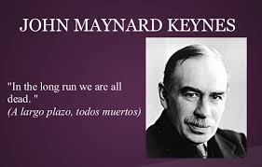
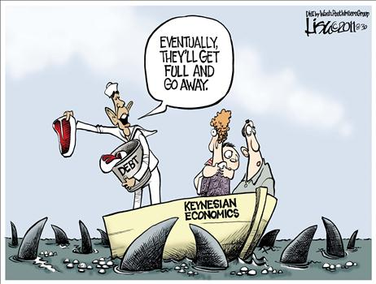
Macroeconomics (study of an economy as a whole) - Fusion of Neo-Classical theory and ideas of John Maynard Keynes.
Keynesian economics is a macroeconomic economic theory of total spending in the economy and its effects on output, employment, and inflation.

Slide 4


Key assumption of neoclassical theory -Individual and firms make decisions in a rational way.
‘Rational’- Economic agents rank the order of different outcomes in terms of net benefit. Then they act in a way that will maximise their net benefit
Same price
Same quantity
No change in income

Slide 5
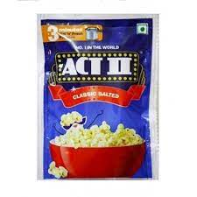
No. of factors will influence decision making.
Nearest shop Distance: 2 mins away Price: MVR 6 | Local supermarket Distance: 10 mins away Price: MVR 4
If you value 8 mins more than MVR 2– you will buy at local shop
If you value 2 minutes more than MVR 6 – not buy popcorn at all.
Two costs involved:
Cost of packet
Value of time and effort

Slide 6


Maximisation
Economic agents act in a way that will maximise their net benefits.
Consumers maximise their utility/satisfaction.
  Scarce resources, choice to be made
  Compare utility gained from extra unit
  with opportunity cost
Workers maximise their own welfare at work.
  Where to work, work hours, wages/salary
  Job security, time taken to commute to work,
  satisfaction- type of job, co-workers,
  cost of looking for another job.

Slide 7



Firms will maximise their rewards from ownership/ profits.
  However, large firms – run by managers - maximise their rewards.
Governments maximise welfare of citizen,
increased welfare of the country
  However governments around the world are corrupt
  Benefits own political members or leaders
  Biased - Reward their supporters at the expense of citizens.

Slide 8
The Margin
Some economic theories – economic agents will act to maximise their total net benefit.
Neoclassical theory - assume that decisions are taken at the margin.
You look at one decision in isolation.
What will give greatest utility?
Buying a packet of popcorn, you don’t look at total spending, but extra utility derived from it
Hiring extra worker, firm do not look at all spending decisions, profit increased by taking extra worker.
Marginal utility, marginal cost, marginal benefit, marginal product, marginal rate of tax, marginal propensity to consume.

Slide 9
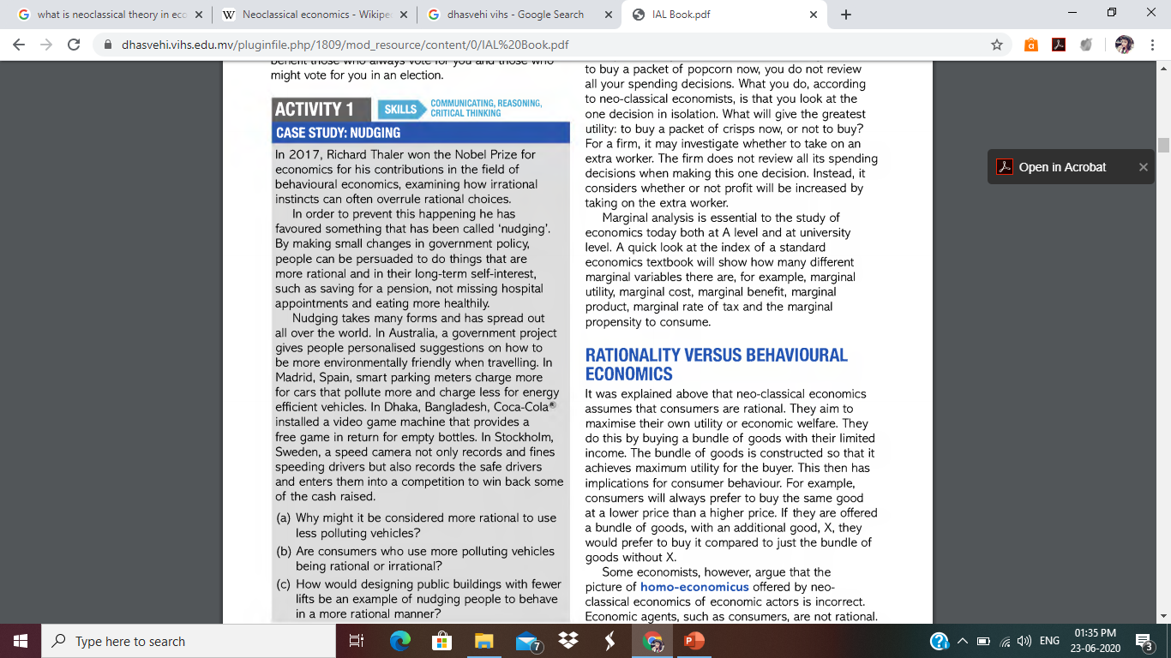

Slide 10
Rationality Vs Behavioural Economics
Neo-classical economics assumes that consumers are rational.
  Aim to maximise their utility/economic welfare, has implications for consumer behaviour
  Consumers prefer to buy same goods at lower price, or more goods at same price
Some Economists argue that Economic agents are not rational.
  May not buy at lower price.
  Consumers choices can be manipulated.
This view is explored by a branch of economics called Behavioural Economics.

Slide 11
Why Consumers may not behave rationally?
Influence of other peoples behaviour and the need to feel valued:
  Individuals make choices that are influenced by social norms.
  E.g. going for night out with friends, buying expensive goods, spending more
Importance of habitual behaviour and inertia:
  Habits represents shortcuts in decision making.
  Consumers do not gather all the information they need to make good decision - only part of information needed to make good decision.
  Firm exploit consumers – products displayed at eye level,
  Habits can be particularly damaging when they become addiction – addiction of tobacco/ cigarettes
  Because of lack of self control, consumers end up making decisions that are not beneficial for them.
  Do not change behaviour because of inertia – too much trouble and not worth the effort
    Changing bank account, electricity provider

Slide 12
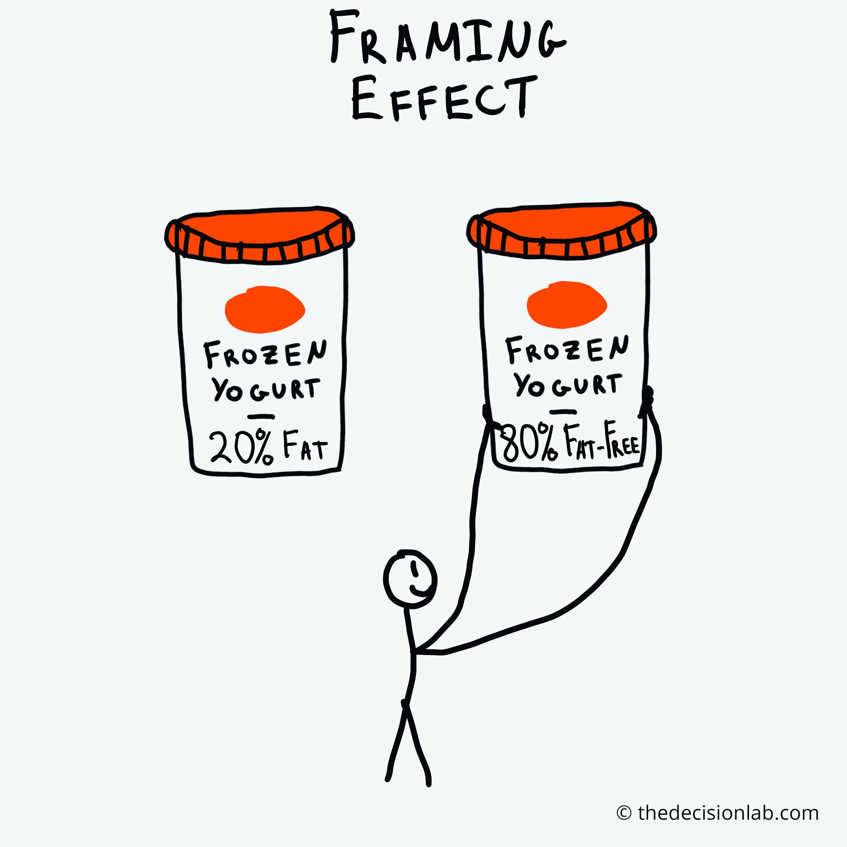
Consumers weakness at calculation:
  Consumers are not always willing to or able to make comparisons between prices and different goods.
  Information presented in a way where its difficult to make comparisons.
  May not provide enough information
Framing and Bias
Economic statements or choices can be worded in such a way as to influence the outcome.
Framing of questions in a particular way can bias the outcome.

