Slide 1
Ch 7 Demand Part1

Slide 2
Learning Objectives:
Understand the concept of demand.
Understand the relationship between price and demand.
Understand the distinction between movements along the demand curve and shift of the demand curve.
Know the factors that may cause a shift in the demand

Slide 3
Demand
Market – Buyers - demand and sellers - supply
Demand is the quantity of goods or services that will be bought at any given price over a period of time.
Eg: Monthly Demand for cars at €16000 would be 2 million units.

Slide 4
Demand and Price
Ceteris paribus, changes in price results in changes in Quantity demanded.
Increase in price, fall in Quantity demanded of a product.
Decrease in price, rise in Quantity demanded of a product.

Slide 5
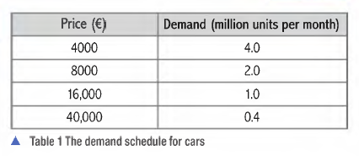
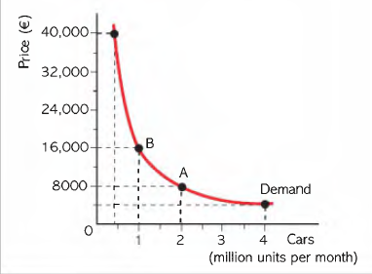
Demand curve shows the quantity that is demanded at any given prices.
Downward sloping Demand curve shows that as price falls, Quantity Demanded rises.
Inverse/ opposite relationship between price and Demand.
When prices change there is said to be a movement along the demand curve.
Extension of Demand- Quantity demanded rises.
Contraction of Demand- Quantity Demanded falls.
Demand curve shows effective demand – how much would be bought ( consumers can afford to buy and would buy) at given price and not how much they would like to buy with unlimited resources.

Slide 6
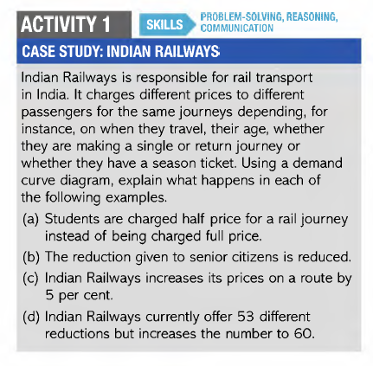

Slide 7
Conditions of Demand
Other factors that cause change in demand are called conditions of demand.
Shift the demand curve- left or right.

Slide 8
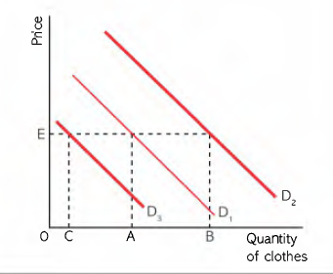
Change in income:
Normal Goods | Inferior Goods
Increase in income- Increase in demand | Increase in income- Decrease in demand
Decrease in income- Decrease in Demand | Decrease in income- Increase in Demand

Slide 9
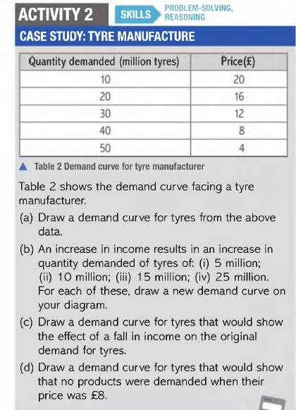

Slide 10
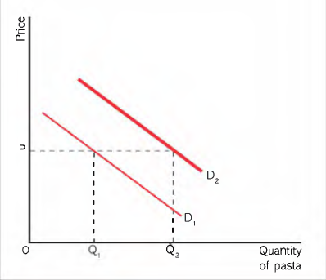
The price of other goods
Substitute Goods | Complementary Goods
Increase in price- Increase in Demand for substitute goods | Increase in price- Decrease in demand for complementary goods
Decrease in price- Decrease in demand of substitute | Decrease in price- Increase in Demand of complementary goods.

Slide 11
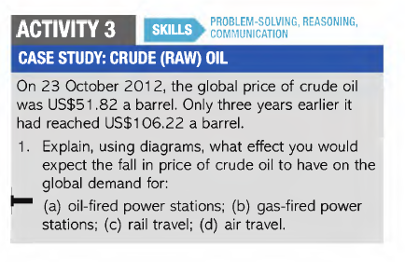

Slide 12
Other factors:
Changes in Population
Increase in population – increase in demand for goods
Changes in fashion
Change in taste and preferences in favour of product – increase in demand
Changes in legislation(Law)
Compulsion of seat belts or helmets, anti pollution equipment, ban on cigarettes
Advertising
Power influence on consumer demand that seeks to influence consumer choice

Slide 13
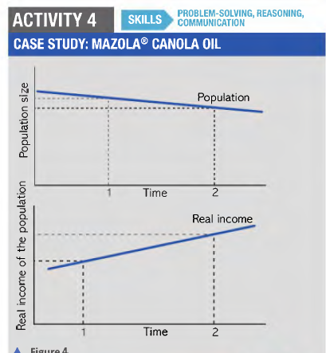
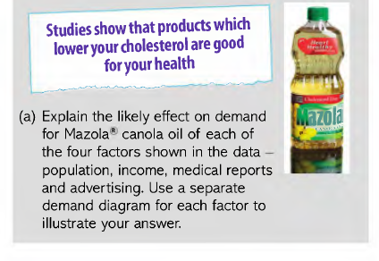

Slide 14
The law of diminishing marginal utility
Demand curve – how much buyers prepared to pay for given quantity of goods.
Price falls, consumers buy more goods.
As buyers consume more goods, they put less value on the last unit bought.
Definition:
The value or utility attached to consuming the last product bought falls as more units are consumed over a given period of time.

Slide 15
Problem of paradox of value
Consumers pay high price for unnecessary goods (Diamond), but less price for necessities(food or water).
Diminishing marginal utility explains this paradox:
Fewer goods available, higher marginal utility, consumers ready to pay high price.
Plenty of goods, lower marginal utility, consumers ready to pay lower price.
Consumers may place high value on necessities if they are short in supply.
If diamonds were as common as water or food, buyers would not pay much for last quantity bought.
Law of diminishing marginal utility explains why demand curve is downward sloping.

Slide 16
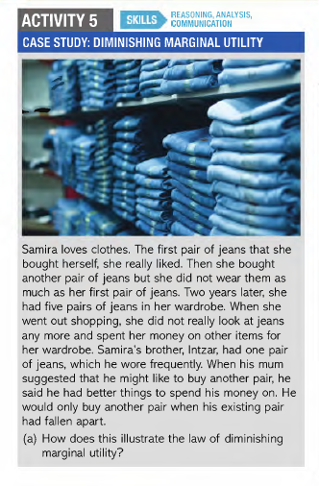

Slide 17
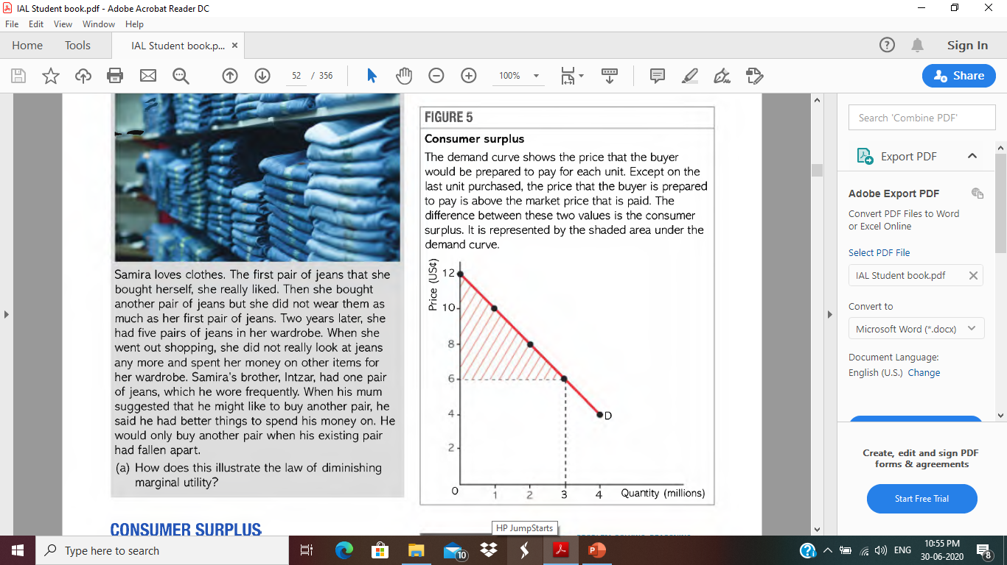
Consumer Surplus
Difference between what buyers are willing to pay and what they actually pay.
The total consumer surplus is shown by the shaded area

Slide 18
