Slide 1
Ch 8 Price Elasticity of Demand Part 1

Slide 2
The meaning of demand elasticity
Elasticity is a measure of how much the quantity demanded is affected by changes in price, income or other factors.
Different elasticities of demand measure the proportionate response of quantity demanded to a proportionate change in the variables that affect demand.
Price elasticity of demand
Income elasticity of demand
Cross elasticity of demand

Slide 3
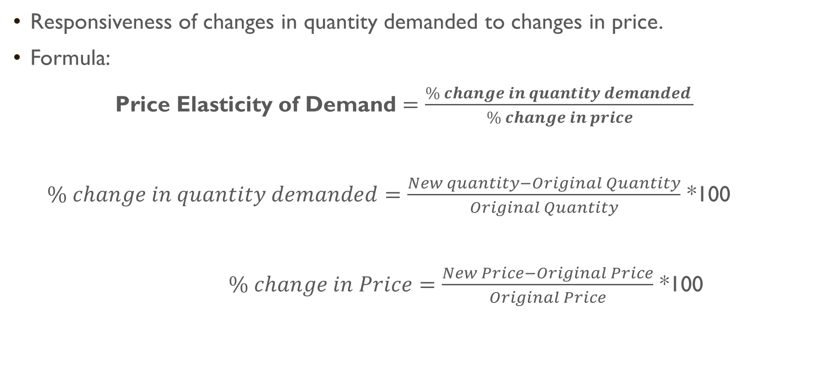
Price elasticity of demand
Responsiveness of changes in quantity demanded to changes in price.
Formula:
Price Elasticity of Demand $=\frac{\% change in quantity demanded }{\% change in price}$
$\% change in quantity demanded=\frac{New quantity−Original Quantity}{Original Quantity}$ *100
$\% change in Price=\frac{New Price−Original Price}{Original Price}$ *100

Slide 4
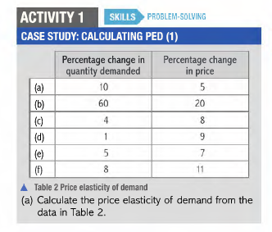


Slide 5
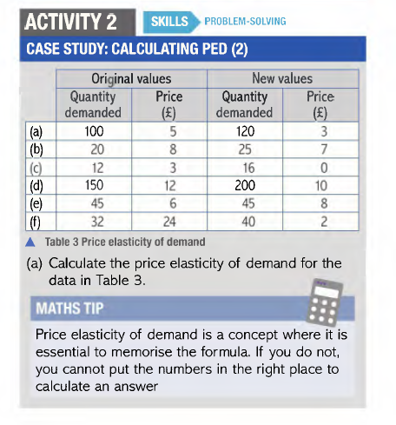

Slide 6
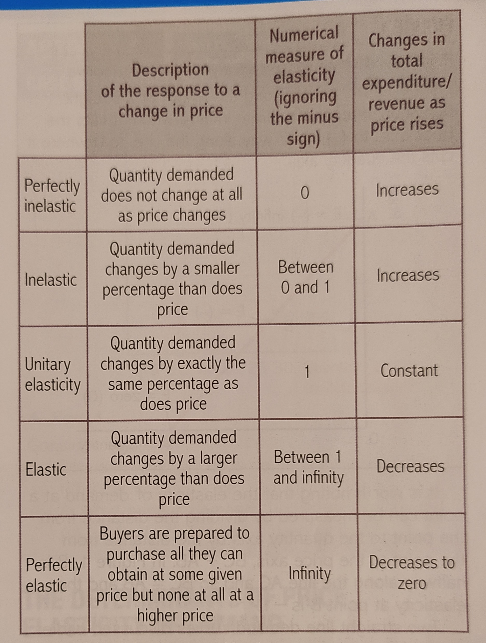
Elastic and Inelastic Demand

Slide 7
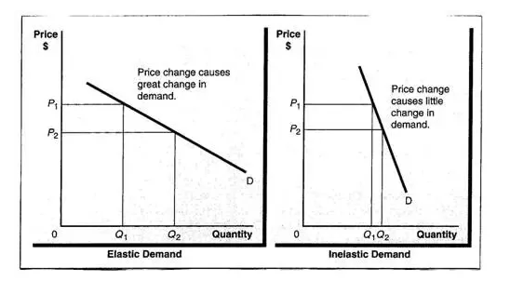
Elastic & Inelastic demand curve

Slide 8
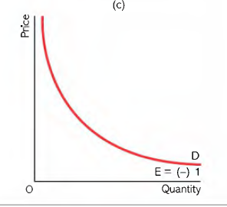
Unitary Elastic

Slide 9
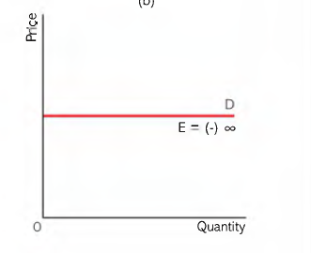

Perfectly Elastic and Perfectly Inelastic
PERFECTLY ELASTIC
PERFECTLY INELASTIC

Slide 10
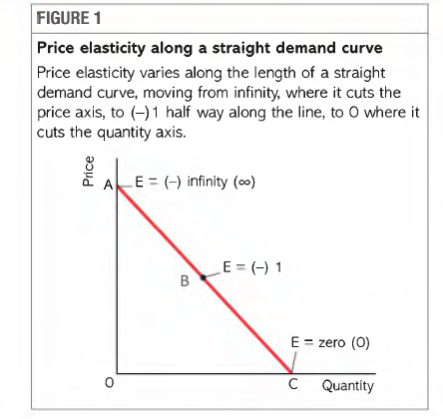
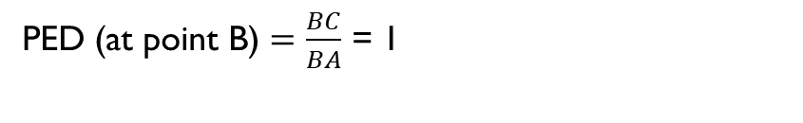
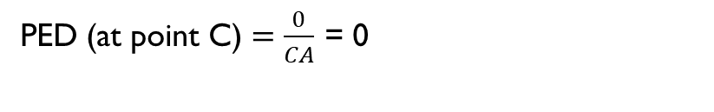

Price Elasticity along a straight Demand Curve
PED (at a point) $=\frac{Distance from a point to quantity axis}{Distance from a point to price axis}$
PED (at point A) $=\frac{AC}{0}$ = ∞
PED (at point C) $=\frac{0}{CA}$ = 0
PED (at point B) $=\frac{BC}{BA}$ = 1

Slide 11
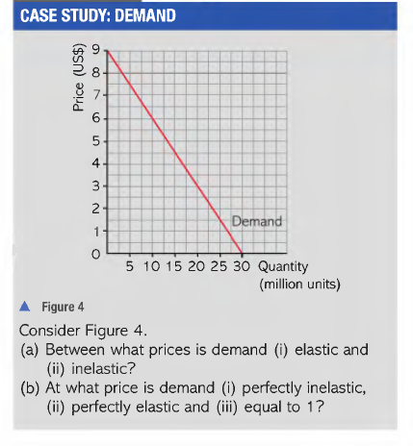

Slide 12
Determinants of PED
Availability of substitutes
More substitutes – Elastic
Less Substitutes – Inelastic
E.g. Salt - few substitutes – Increase in price – very little change in demand – Inelastic
Pasta – more substitutes (rice, noodles) - Increase in price – greater change in demand – Elastic
Width(Size of market)
Wider market – Inelastic demand
Narrow market – Elastic Elastic
Eg food – wider market – few substitute – Inelastic
Pasta – Narrow market – more substitute – Elastic
E.g. Sweets – wider market – few substitute - Inelastic
Eclairs – narrow market – more substitutes – Elastic

Slide 13
Time
Long period of time – Elastic demand
E.g Increase in oil price – Short term – few substitutes– still have to drive cars, industry use oil, business cant change from oil-fired system to gas- fired power stations – Inelastic demand in short term.
Short term – fixed budget, lack of information, durability of goods.
Types of goods:
Luxury- Elastic
Not essential for existence.
Necessity- Inelastic
Whatever the price change, have to buy
Difficult to define what is necessity and luxury.
Total Expenditure:
High TE- Elastic
Low TE- Inelastic
Eg. Grocery and rent

Slide 14
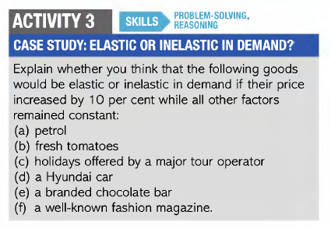

Slide 15
Price Elasticity of Demand and Total Expenditure
Inelastic Demand Total expenditure will rise with rise in price. | Elastic Demand Total expenditure will fall with rise in price | Unitary Elastic Demand Total expenditure will remain unchanged because the percentage rise in price will be equal and opposite to percentage fall in demand.

Slide 16
