Slide 1
Ch 9
Income and Cross-Elasticities

Slide 2
Learning Objectives:
Understand the concept of ‘Income and Cross-Elasticity of Demand’
Know how to use formula to calculate income and cross-elasticity of demand
Understand the interpretation of numerical values of income and cross-elasticity of demand.
Understand the difference between normal and inferior goods.
Understand the significance of income and cross-elasticity of demand for firms, consumers and the government.

Slide 3

Income Elasticity of Demand
Definition: Demand for a good will change if there is change in consumers income.
Positive IED(Normal goods) - Income increases by 5% and Demand for good increases by 20%.
Negative IED(inferior goods)- Increase in income leads to fall in demand.
Zero IED- Increase in income but no change in demand.
Formula-
  IED= $\frac{Percentage change in Quantity Demand}{Percentage change in income}$
  Percentage change in Quantity demand=$\frac{New Quantity −Original Quantity}{Original Quantity}$ * 100
  Percentage change in income=$\frac{New Income −Original Income}{Original Income}$ * 100
E.g. Highly income elastic – holidays, rent, leisure activities
  Inelastic – Washing liquid

Slide 4
Income inelastic | IED < 1 and IED > -1
Income Elastic | IED > 1 and IED <-1

Slide 5
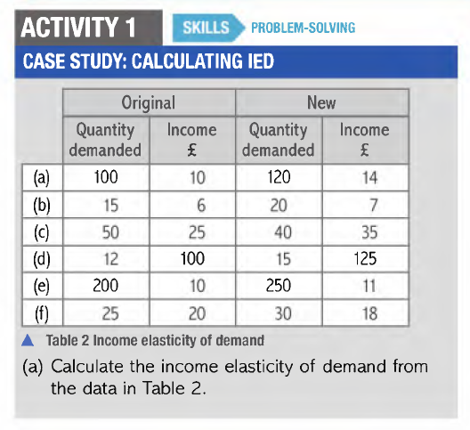

Slide 6
Normal and Inferior Goods
Normal goods- Increase in demand when there is increase in income.
    Positive IED- Quantity demanded and income either both increases or decreases.
Inferior goods- Decrease in demand when there is increase in income.
    Negative IED – Inverse relationship between quantity demanded and income.
Switching consumption from bread to meat.
Switching consumption from canned tomatoes to fresh tomatoes.
Switching consumption from public transport to private vehicles.
A good can be both a normal or inferior good depending on the level of income.
  Bread is a normal good for low income earners.
  Bread is an inferior good for high income earners.

Slide 7
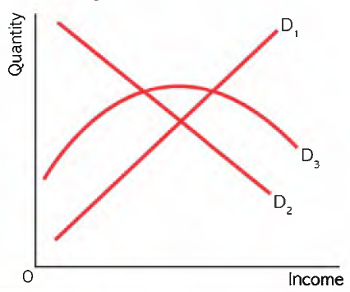
D1 – Demand curve for normal good.
It is upward sloping because demand increases as income increases.
D2 – Demand curve for inferior good.
It is downward sloping because demand decreases as income increases.
D3- Good is normal at low levels of income. Good is inferior at high levels of income.

Slide 8
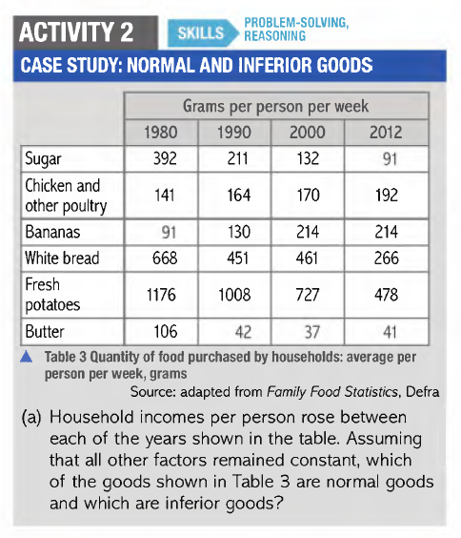

Slide 9
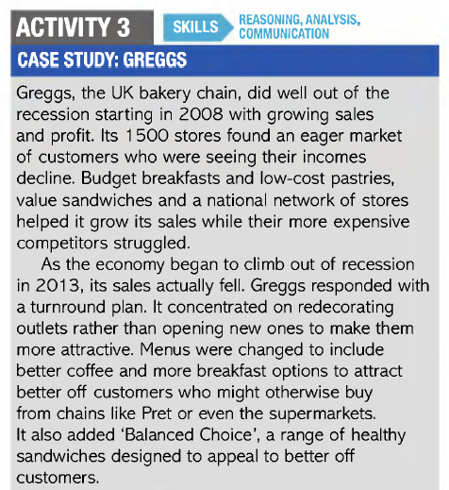
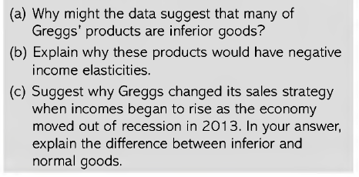

Slide 10
Necessities and Luxuries
Necessities (Basic goods) – IED is less than +1.
Luxuries (Superior goods) – IED is greater than +1.
Useful to discuss necessities and luxuries in theory but putting precise values on these in terms of IED might not be that helpful.

Slide 11

Cross – Price Elasticity of Demand
XED measures the proportionate response of quantity demanded of one good to proportionate change in price of another.
E.g. By how much demand for goat increases when the price of beef goes up.
Formula-
  XED= $\frac{Percentage change in quantity demand for X}{Percentage change in price of Y}$
XED Inelastic | XED < 1 and XED > -1
XED Elastic | XED > 1 and XED < -1

Slide 12
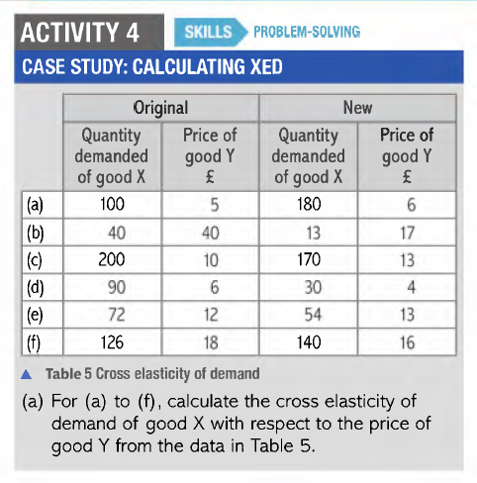

Slide 13
Substitutes and Complements
Substitutes – good that can be replaced by another good
  Positive XED
  E.g. Lamb and chicken, coke and pepsi, holiday in spain and holiday in turkey, Asian food and Mexican food, tea coffee
  Increase in price of lamb leads to increase in quantity demanded of chicken.
Complements –
  Negative XED.
  E.g. Tablets and apps, tennis racket and tennis ball, Petrol and car
  Increase in price of car leads to decrease in demand for petrol.
Unrelated goods - Zero XED
  E.g. Glue and chocolate bars
  Increase in price of glue will not have any effect on demand for chocolate bars.

