Slide 1
Ch 10
Supply and Price Elasticity of Supply

Slide 2
Learning Objectives:
1st Part
Understand the concept of supply.
Understand the distinction between movements along the supply curve and shifts of supply curve.
Understand factors the cause movement and shift of supply curve.
2nd Part
Understand the concept of ‘Producer Surplus’
Understand the concept of ‘Price Elasticity of Supply’
Understand calculation and interpretation of numerical values of PES
Understand the factors that influence PES.

Slide 3
Supply
Definition: Quantity of goods that sellers are prepared to sell at any given price over a period of time.
  E.g. Supply of milk at 26.7 pence per litre over the one month period was 1230 million litres.
Increase in price - expand production – make higher profits

Slide 4
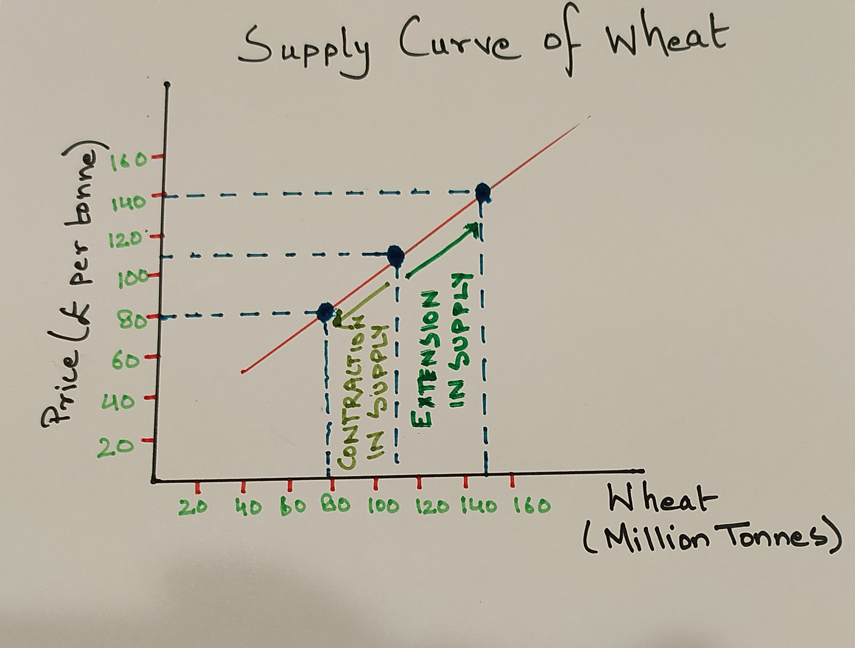
Supply and Price
Extension of supply: Quantity supplied will rise if the price of the good also rises, assuming that other variables remain constant.
Contraction of supply: Fall in price will lead to fall in quantity supplied.
Supply curve – Shows the quantity that will be supplied over a period of time at any given price.
Initially,
When price of wheat was £ 110 per tonne, quantity supplied was 110 million tonnes per year
Only most efficient farmers grow wheat
Extension of Supply:
Price of wheat rose to £ 140 per tonne, quantity supplied increased to 150 million tonnes per year.
Farmers already growing wheat increase the size of land, non-farmers start to grow wheat – make profits even if costs of production are higher
Contraction of supply:
Price of wheat fall to £ 80 per tonne, quantity supplied decreased to 80 million tonnes per year.
Lower price – profits reduced – fall in output produced, other mights stop producing completely

Slide 5
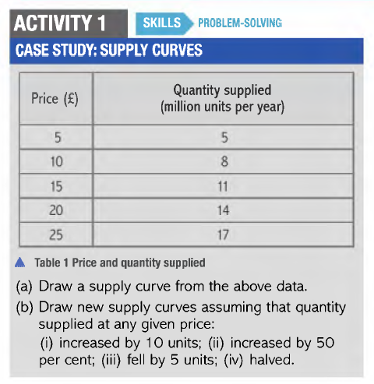

Slide 6
Conditions of supply
Changes in price will lead to changes in quantity supplied – movement along supply curve – extension or contraction
The factors other than price that cause changes in supply of a product are called conditions of supply.
Changes in other factors - shift in supply curve towards left or right.

Slide 7
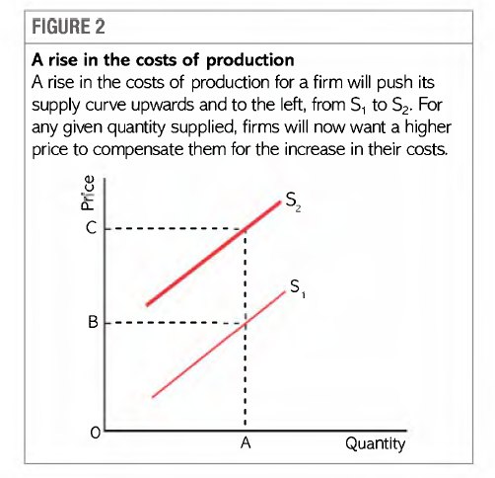
Cost of production
Rise in cost of production
firms pass on this increase in form of higher price
If can not charge higher price – fall in profits – produce less or stop producing
Fall in supply – left shift
Decrease in cost of production
Rise in profits
Increase in supply – right shift

Slide 8
TECHNOLOGY:
Introduction of new technology - fall in cost of production – higher profits – increase in supply – right shift
Increase in productive efficiency – encourage firms to produce more at same price or produce the same quantity at lower price.
Conflict or natural disaster – new technical equipment destroyed – may have to use outdated technology/ increase labour force – fall in supply – left shift
.

Slide 9
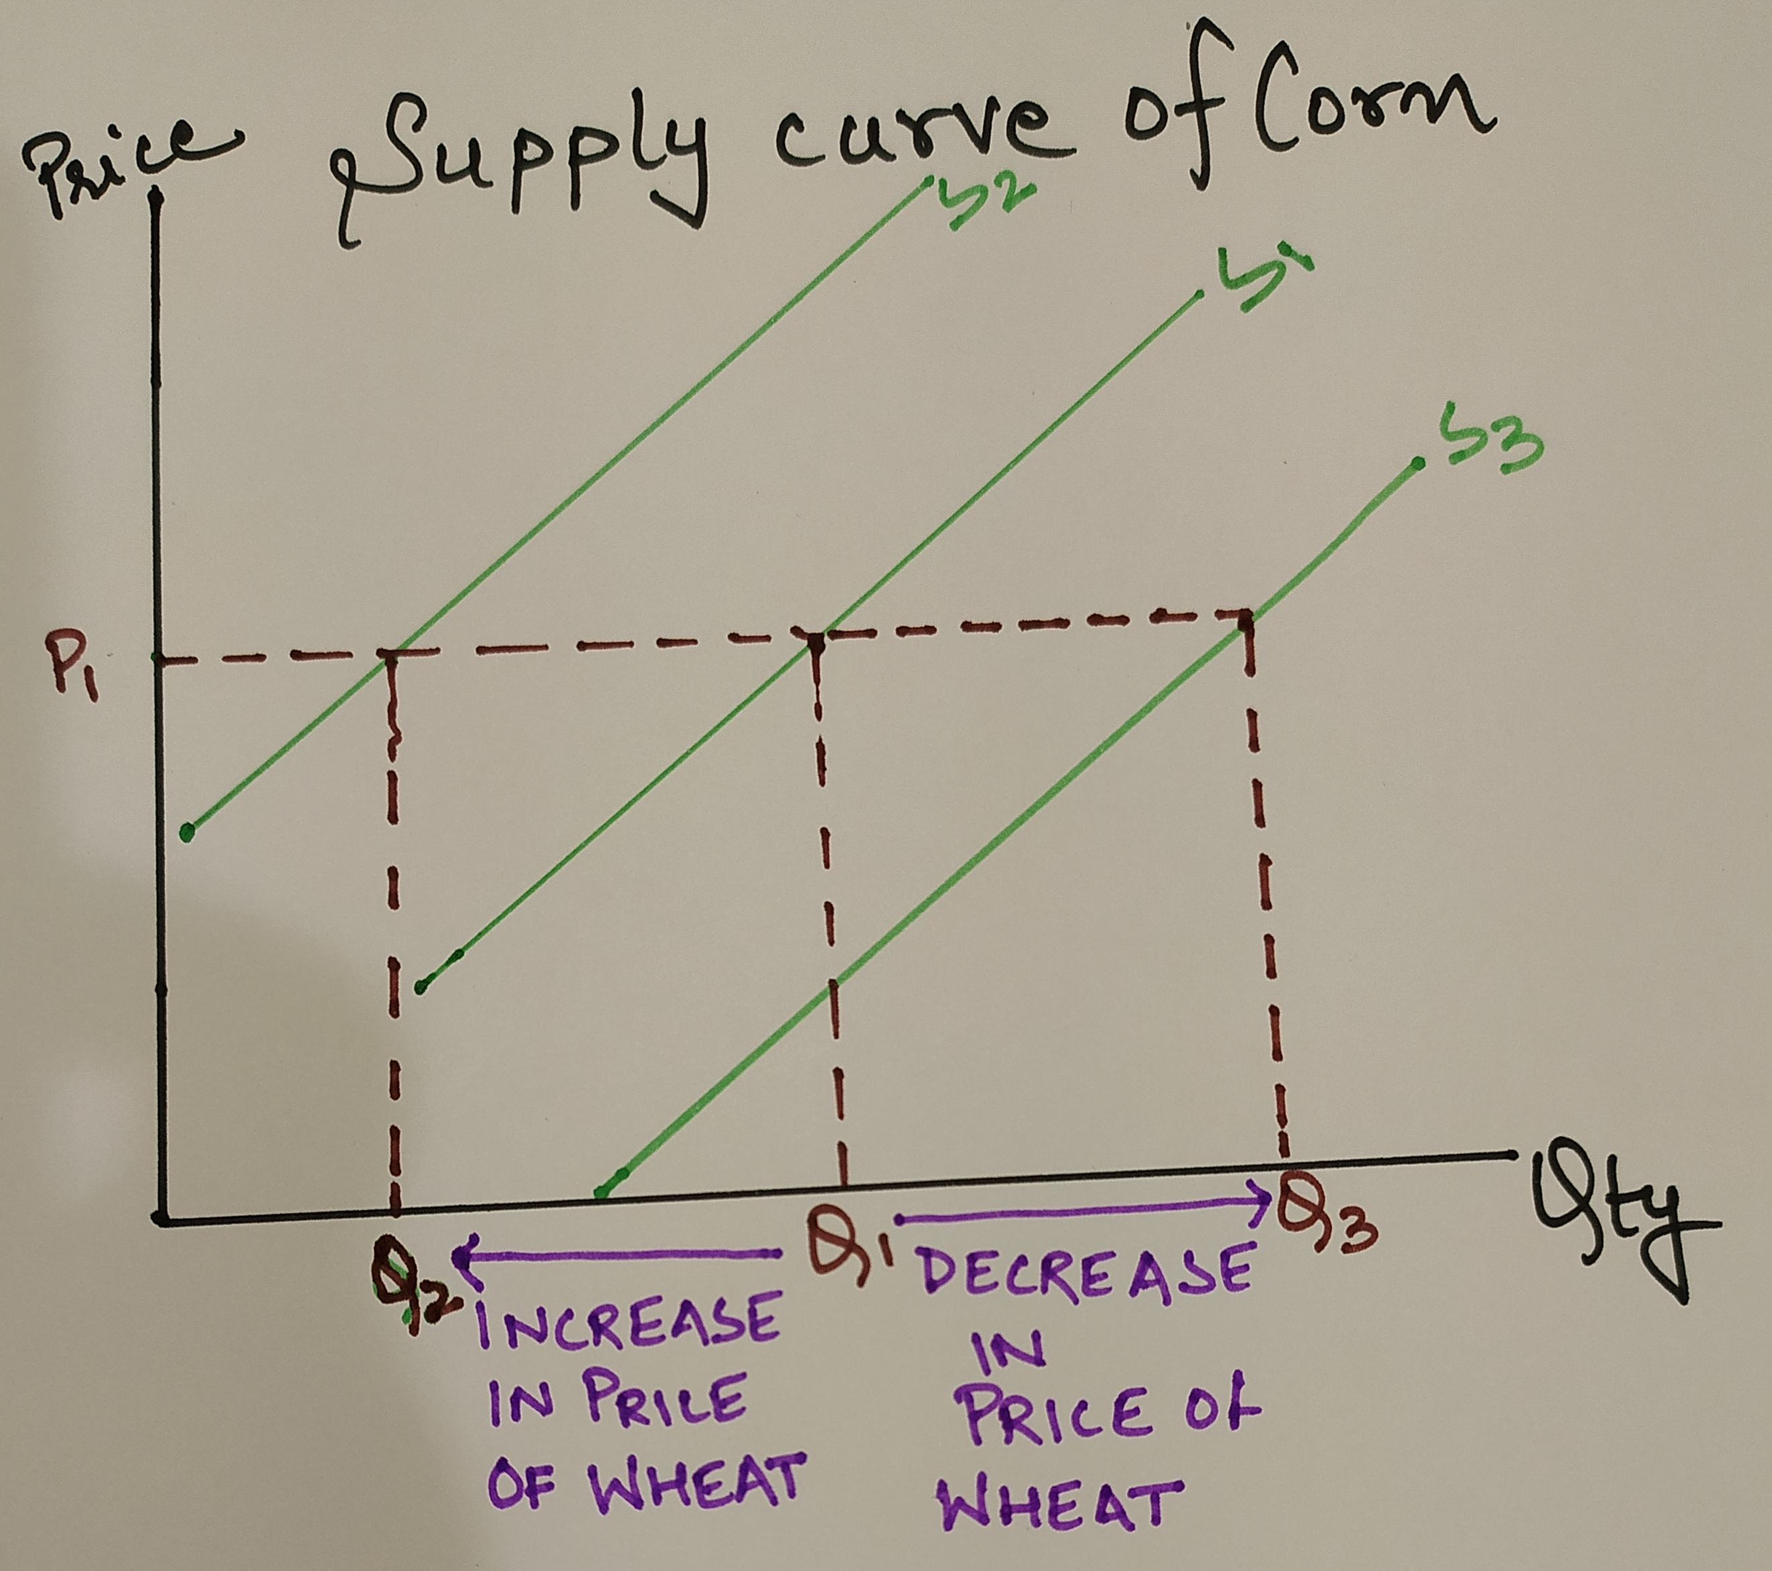
Price of other goods
Substitute goods: Wheat and corn are substitute goods
If price of wheat increases, quantity supplied of corn will decrease. Supply curve shifts left.
If price of wheat decreases, quantity supplied of corn will increase. Supply curve shifts right.

Slide 10
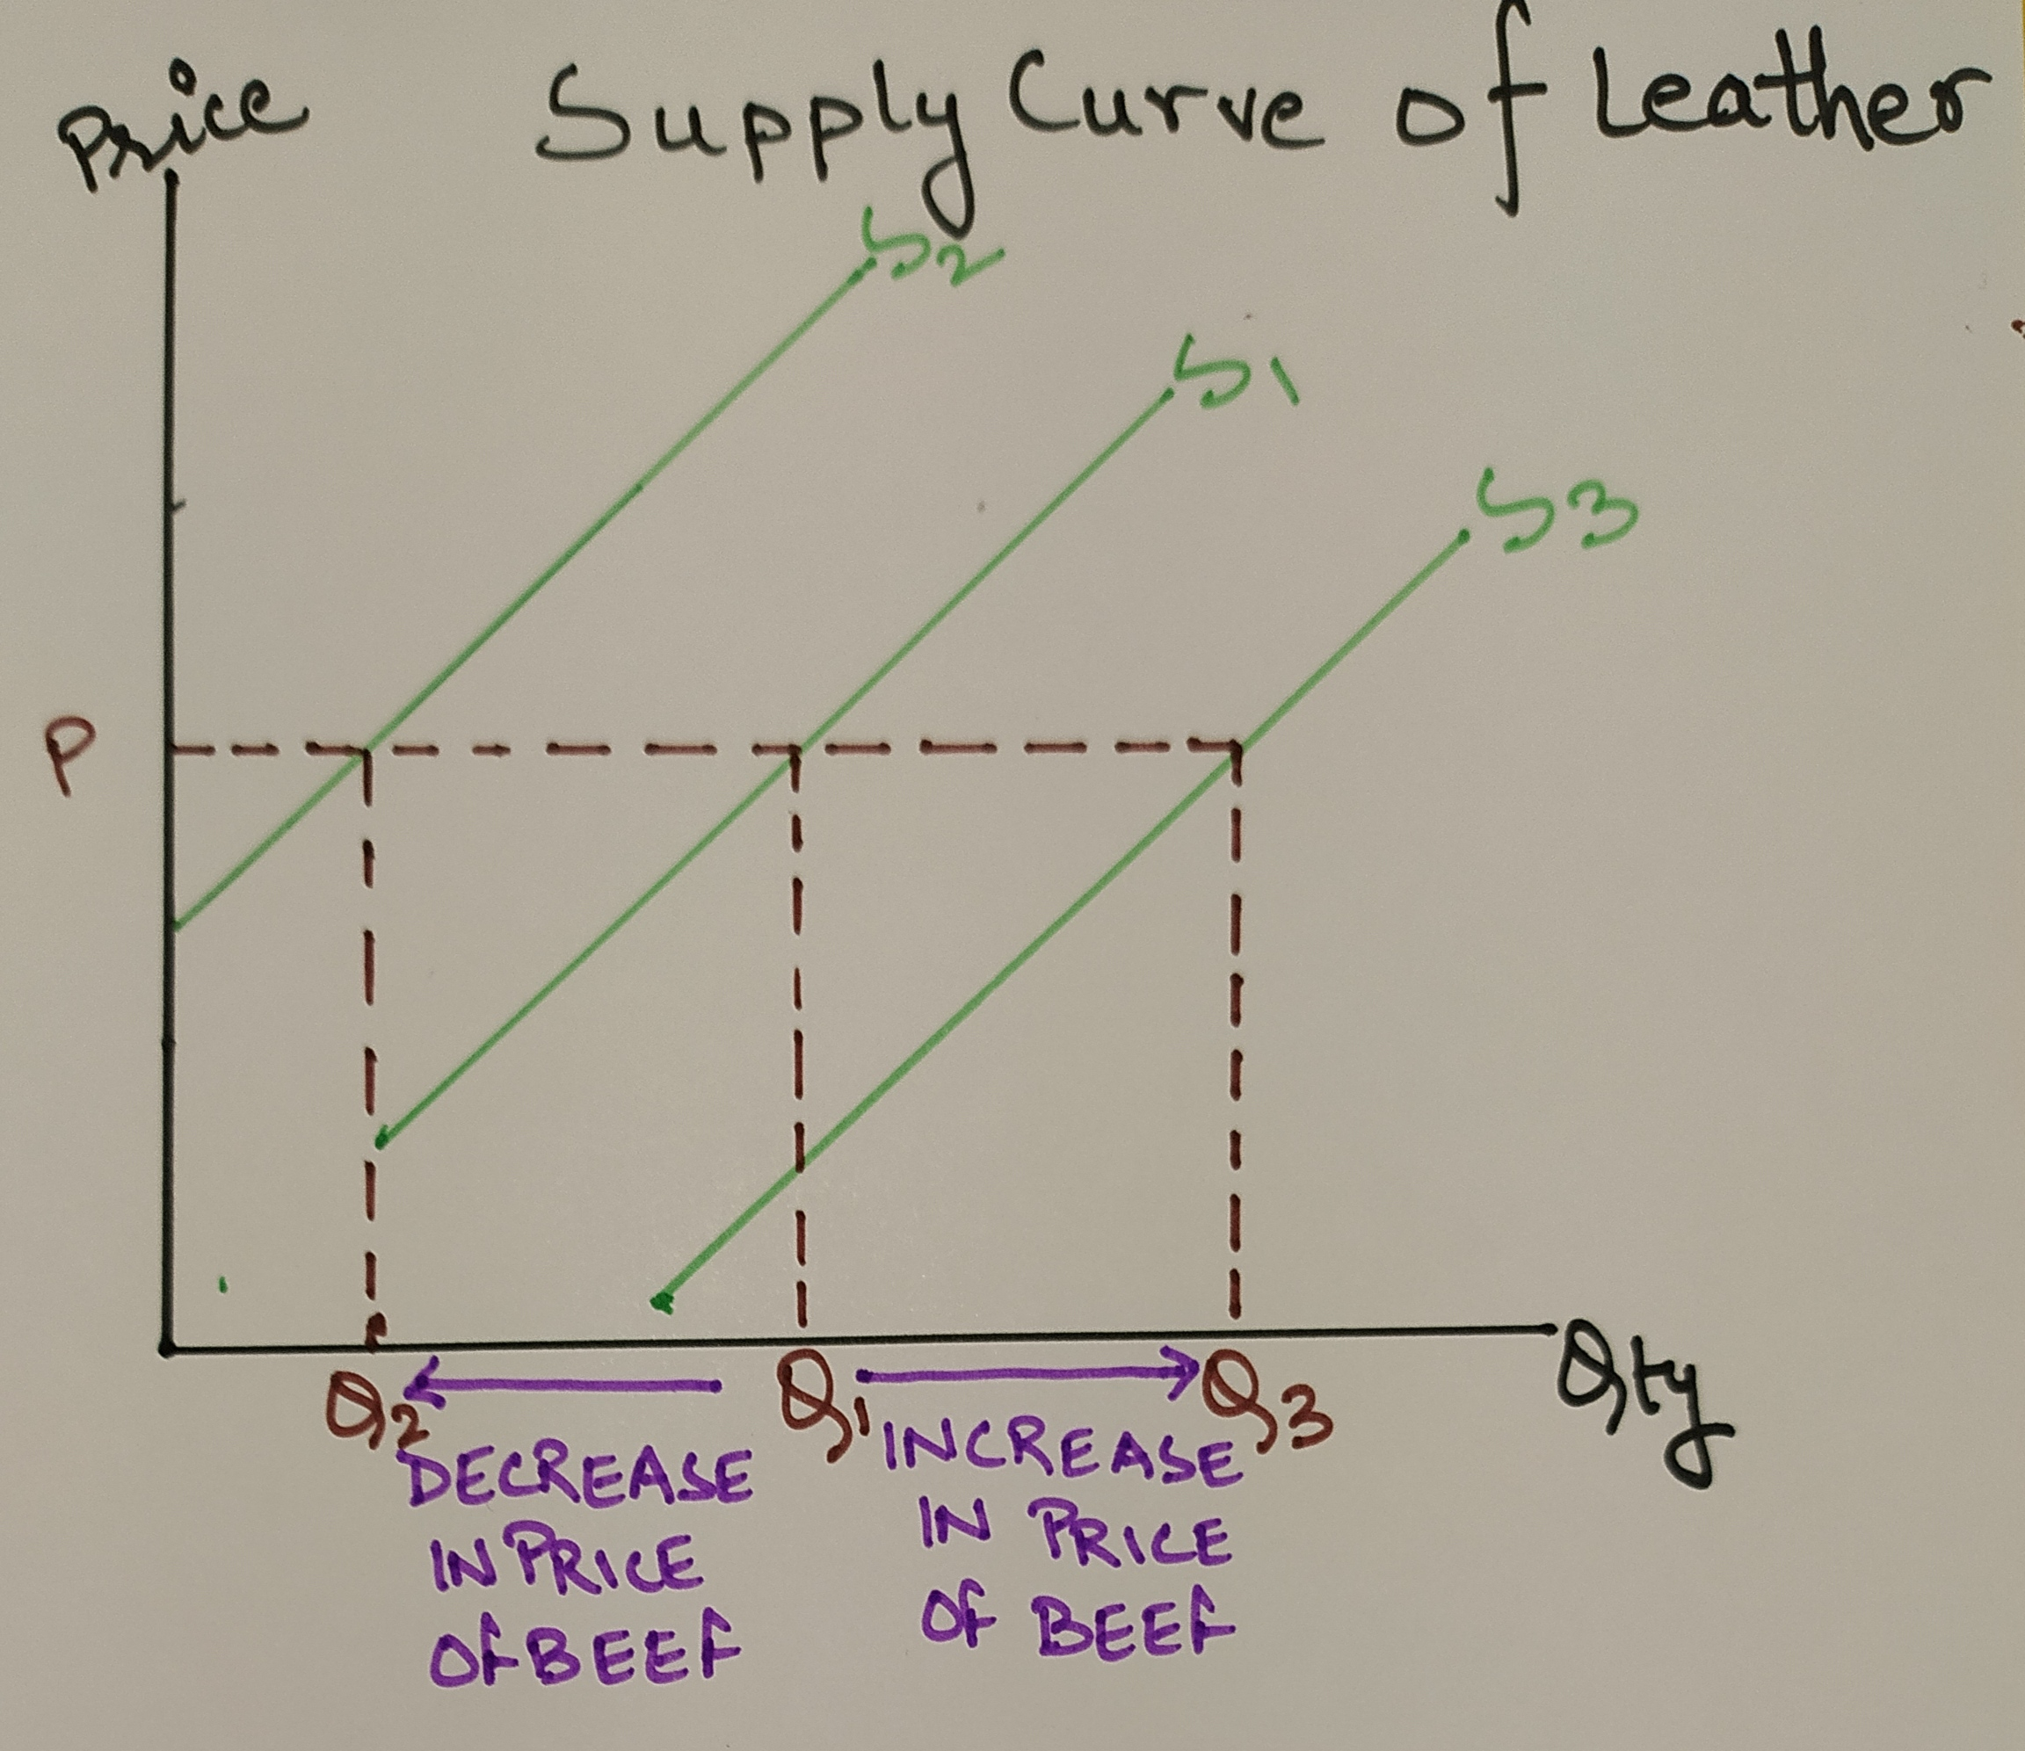
Complementary goods: Beef and leather are complementary goods.
If price of beef rises, there will be an increase in price of leather and thus quantity supplied of leather will increase. Supply curve shifts right.
If price of beef falls, there will be decrease in price of leather and thus quantity supplied of leather will decrease. Supply curve shifts left.

Slide 11
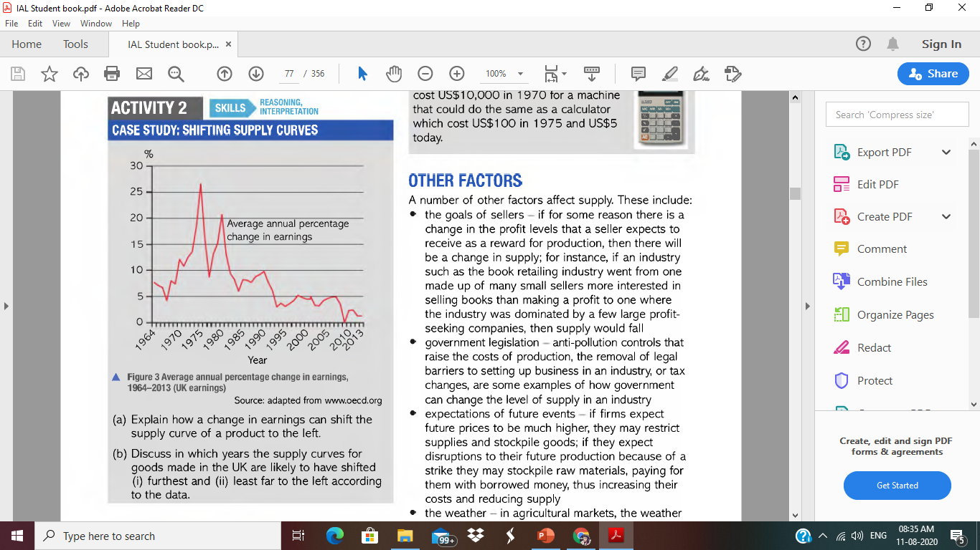

Slide 12
Other factors:
The goals of sellers: Maximising sales or maximising profits.
      If there is change in profit levels then there will be change in supply.
Government Legislation:
      Anti-pollution controls leads to reduction in supply.
      Removal of legal barriers leads to increase in supply.
Expectation of future events:
      If future price expected to rise firms restrict the supply.
      If future price expected to fall firm increase the supply.
Weather:
      Bad weather will reduce the supply.
      Good weather increase the supply.
Producer cartel – Restrict the supply which allows the, to raise the price and make more profits and revenues.

Slide 13
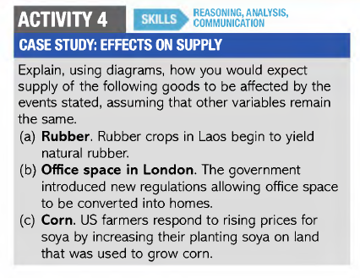

Slide 14
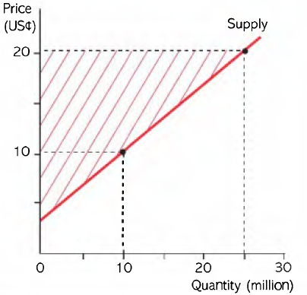
Producer Surplus
Definition: The difference between the market price and the lowest price at which a firm is prepared to supply is producer surplus.
Firms will supply 10 million units at 10 cents.
Firms will supply 25 million units at 20 cents.
Assume market price set is 20 cents.
The firms will receive more than the lowest price at which they are ready to supply.
Producer surplus area – area between the supply curve and horizontal line at market price. It is sum of producer surplus earned at each level of output.

Slide 15
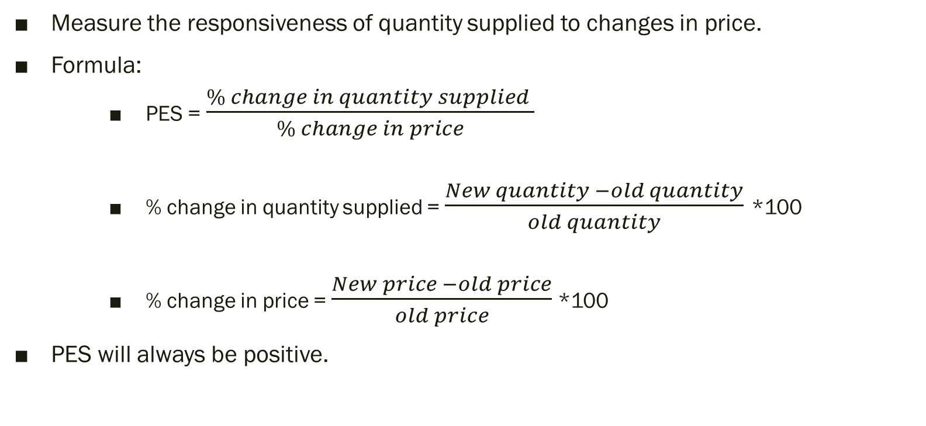
Price Elasticity of Supply
Measure the responsiveness of quantity supplied to changes in price.
Formula:
    PES = $\frac{\% change in quantity supplied }{\% change in price}$
    % change in quantity supplied = $\frac{New quantity −old quantity}{old quantity}$ *100
    % change in price = $\frac{New price −old price}{old price}$ *100
PES will always be positive.

Slide 16
Unitary Elastic (PES=1) % change in Qs = % change in price | Elastic (PES > 1 ) % change in Qs > % change in price | Inelastic (PES < 1) % change in Qs < % change in price | Perfectly Elastic (PES = ∞) Any amount of Qs at a given price | Perfectly Inelastic (PES = 0) No change Qs to change in price
Pr
Pr
Pr
Es < 1
Pr
Pr
Es = 0
Es =1
Es > 1
Es = ∞
Qty
Qty
Qty
Qty
Qty

Slide 17
Determinants of Elasticity of Supply
Availability of substitutes:
  Producer substitutes – the goods that producer can easily produce as an alternatives. Eg: Wheat and Corn
  More substitute – PES is elastic (high)
  Less substitutes – PES is inelastic (low)
Time:
  Short run – PES is low
  Long run – PES is high
Spare capacity:
  No spare capacity – PES is low
  More spare capacity – PES is high
Ease of storage:
  Perishable goods – difficult to store – PES is low
  Non perishable goods – easy to store – PES is high

Slide 18
