Slide 1
Ch 15
Positive and Negative Externalities

Slide 2
Learning Objectives:
Part 1
Understanding the difference between private benefits, social benefits and external benefits.
Understand the distinction between private cost, social cost and external cost.
Part 2
Understand the distinction between :
  External benefits of production
  External benefits of consumption
  External cost of production
  External cost of consumption
Understand the use of diagrams, using Marginal analysis, to illustrate:
  External Benefits of consumption
  External Cost of Production

Slide 3
Private & Social Cost
Private & Social Benefit
Private Cost: Cost incurred by consumer or producer
Social Cost: Total cost incurred by the society when a good is consumed or produced.
  Social Cost= Private cost + External cost(Negative externality)
Private Benefits: Benefits received by consumer or producer
Social Benefit: Total benefits accrued to the society when a good is consumed or produced
  Social Benefits= Private Benefits + External benefits(Positive externality)

Slide 4
Positive and Negative externalities
Negative externalities: Social cost > Private cost
Positive externalities: Social Benefit > Private Benefit
  Example of merit good.

Slide 5
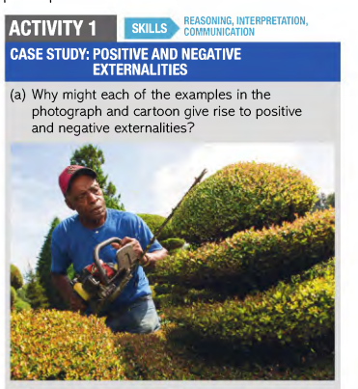
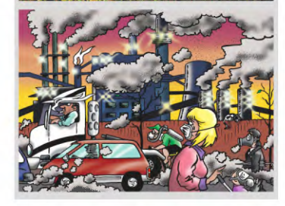

Slide 6
Externalities of production and consumption
Production Externalities arise when social cost and private cost of production are different
  Negative externalities of production: Social Costs > Private Costs
  Positive externalities of production: Social Costs < Private Costs
Consumption externalities arise when social benefits and private benefits of consumption are different
  Negative externalities of consumption: Social Benefits < Private benefits
  Positive externalities of consumption: Social Benefits > Private Benefits

Slide 7
Market Failure
Output and price is fixed where D=S which means private benefit = private cost.
Market prices do not reflect costs and benefits.
Greater the externality, larger the difference between Private costs and benefits and Social cost and benefit.
Greater externality, greater Market failure
Social Optimum Level of output : Social Cost = Social Benefits

Slide 8
Marginal Costs and Benefits
Marginal cost is the extra cost of producing an extra unit of output.
Marginal benefit is the benefit received from consuming an extra unit of output
Price
Marginal Cost
B
Marginal Benefit
O
A
Quantity

Slide 9
Welfare losses with Production and Consumption externalities
Net welfare loss is the lost welfare as a result of too much or too little production or consumption
Negative externalities of production | Positive Externalities of consumption
MSC > MPC | MSB > MPB
Price
MSC
Price
Welfare Loss Triangle
Welfare Loss Triangle
J
J
MPC=MSC=S
MPC=S
F
G
G
F
MSB
E
K
E
K
MPB=MSB=D
MPB=D
Quantity
Quantity
O
A
B
O
A
B

