Slide 1
Ch 17 Imperfect Market Information

Slide 2
Learning Objectives:
Understand the difference between symmetric and Asymmetric information.
Understand the significance of information gaps.
Understand the problem of asymmetric information with an example of second-hand cars market.
Understand how imperfect market information may lead to a misallocation of resources in various context.

Slide 3
Symmetric and Asymmetric information
Symmetric information: Buyers and sellers have potential access to the same information.
Imperfect information: Buyers and seller do not have the information they need to take welfare maximising decision.
Asymmetric information: Information gaps occur when either the buyer or the seller has more information than the other.

Slide 4
Diagram
Price
S with perfect information
F
E
D with imperfect information
D with perfect information
O
A
B
Quantity
Too much bought

Slide 5
The Market for second-hand cars
George Akerlof was the first to outline the problem of Asymmetric Information.
Example of second-hand cars.
Model assumed, buyers do not have information about the quality of cars.
They offer average price for the cars.
High quality car owners not ready to sell at lower price and leave the market.
Buyers start offering more lower prices.
Final outcome was disappearance of the market for second-hand cars.
Asymmetric information has led to collapse of market.

Slide 6
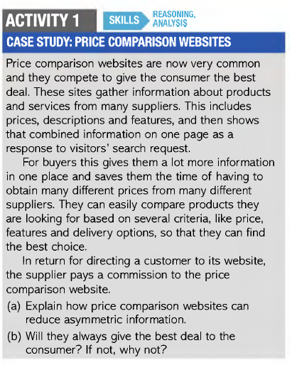

Slide 7
Market Examples
Education:
Example of principal-agent problem.
Principal- An individual or organization that benefits or loses from a set of economic decisions.
Agent- An individual or organization that makes decision on behalf of the Principal
Principal- student, agent- Parents, guardians, government, school.
A child suffers from asymmetric information.
Principal-agent problem occurs when parents and guardians along with the child try to avoid education.
State has an incentive to see all the children reach their full potential.

Slide 8
Pension:
Young workers pay too little into pension because of asymmetric information.
They ignore the loss of welfare of that will come from having low income at 70.
Government forces workers to save for their retirement through national pension scheme or pensions tied to work.

Slide 9
Financial services:
Financial institutions and their employees mistreated their customers leading to financial crisis of 2008.
Bank employees were selling mortgages to low income households.
They knew these customers won’t be able to repay those mortgages.
In 2008 households started defaulting on their debts in large numbers.
There was information failure and moral hazard.
Moral Hazard occurs when an economic agent like a bank or banker, makes decisions in their own best interest knowing that there are potential negative risks and if problem result, the cost will be partly paid by the other economic agents.

Slide 10
Advertising:
Advertisements increase information for buyers.
Persuasive advertisements- designed to change the attitude on the part of buyer.

