Slide 1
Ch 18 Moral Hazard, Speculation and Market Bubbles

Slide 2
Learning Objectives:
Understand how moral hazard can occur.
Understand the impact of moral hazard on economic agents.
Understand how market bubbles may arise.
Understand the impact of market bubble on economic agents.

Slide 3
Moral Hazard
Moral Hazard is a situation where an individual or organization is protected from the consequences of their actions.
It arises because of asymmetric information.
Main cause of 2008 financial crises was sub-prime mortgages.
Why government comes for rescue when banks fail?
Banks are regarded as ‘too big to fail’.
Government also impose heavy regulations on modern banking system to protect the depositors.

Slide 4
Speculation and Market Bubble
Speculation means an economic agent buys or sells something in the expectation of future price change in the hope of generating a profit.
Speculation creates market bubble.
Market Bubble occurs when rising demand, drives prices beyond the level that might be normally expected

Slide 5
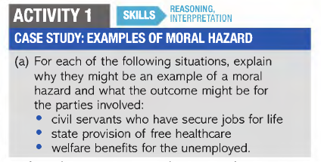

Slide 6
