Slide 1
Chapter 4
Revenue

Slide 2
Learning Objectives
Calculate Total Revenue (TR), Average Revenue (AR), Marginal Revenue (Mr)
Relationship between tr, ar and mr
PED has an effect on revenue
Calculate changes in revenue with different PED

Slide 3
Tr,ar and mr
Revenue – receipts of money from sale of goods and services over a period of time
Tr – total amount of money received from the sale of any given level of output
  Tr = q * p
AR – average amount received per unit sold
  ar = tr/Q
  Ar = p
Mr – additional amount received from selling an extra unit of output
  Difference between tr at different level
    Mr = trn – TRn-1
    MR = ∆TR/ ∆Q

Slide 4
REVENUE CURVES
Different assumptions about price – shape of revenue curve will be different
First Assumption - firms receive same price for each good sold
Q | P | TR = P * Q | AR = TR/Q | MR = TRn – TRn-1
1 | 5 | 5 | 5 | -
2 | 5 | 10 | 5 | 5
3 | 5 | 15 | 5 | 5
4 | 5 | 20 | 5 | 5
5 | 5 | 25 | 5 | 5
If price is same, AR = MR
TR increase as output increases

Slide 5
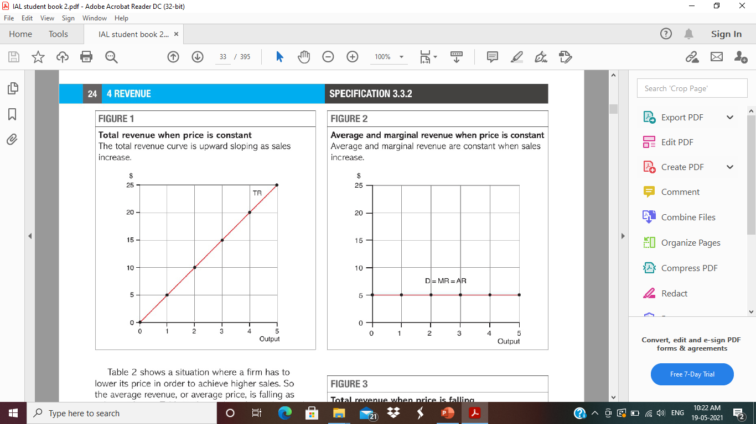

Slide 6
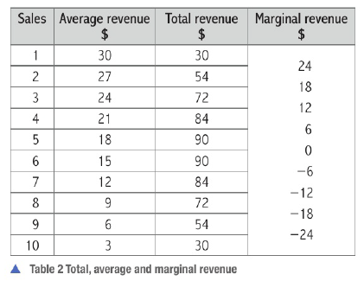
Second Assumption - In order to increase sale firms charge lower price
Price is lower – AR falls as output increases
Loss in revenue due to lower price > gain in revenue from extra output sold
means MR becomes negative – each extra unit sold brings in negative extra revenue means less revenue than previous unit sold

Slide 7
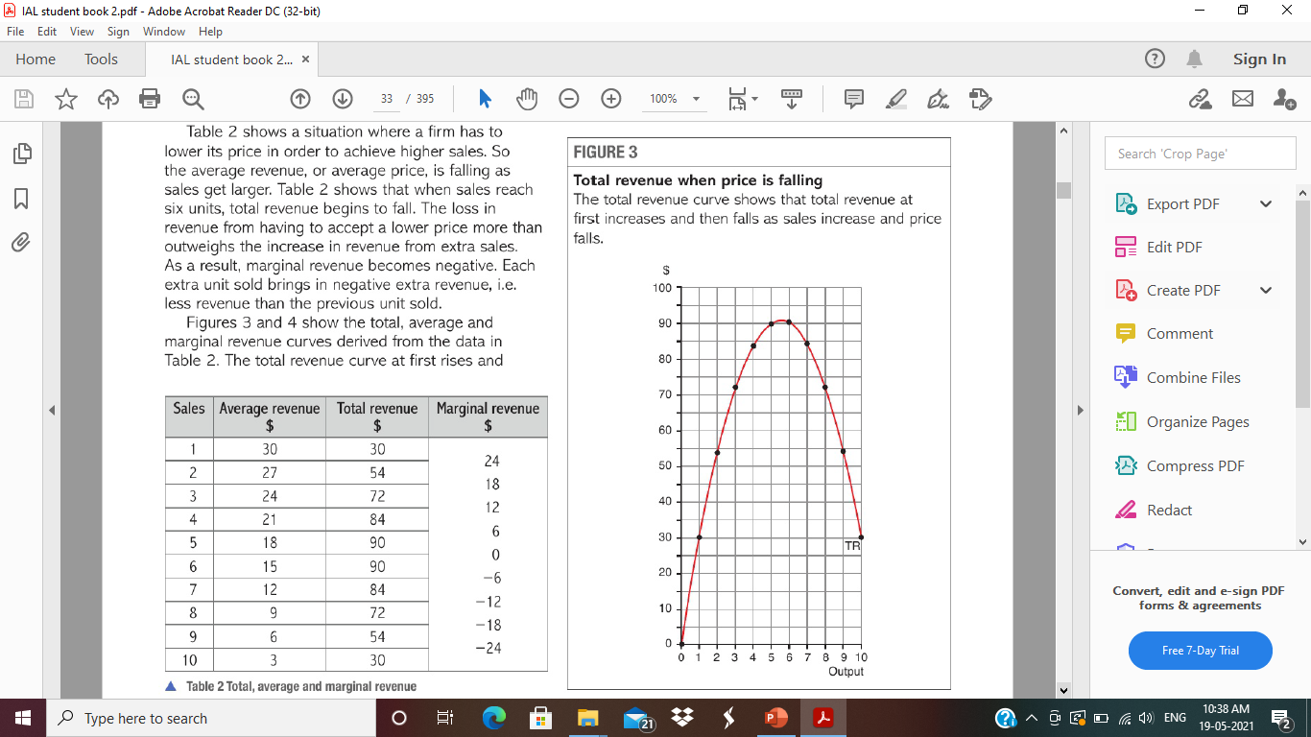
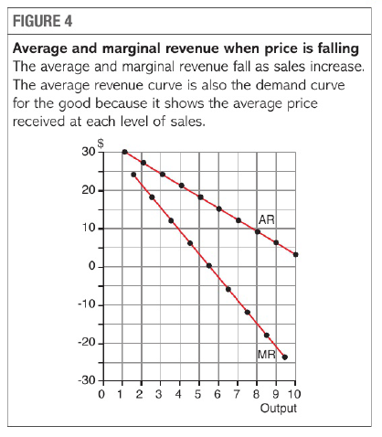

Slide 8
Revenue and Price Elasticity of Demand
First assumption – same price – ar =mr =D – horizontal – perfectly Elastic, infinite quantities can be sold at given price
Second assumption – lower price – change in PED – change in TR
Price inelastic (small fall in demand when price Rise) – increase in TR with Rise in Price
Price Inelastic (Small rise in demand when price fall) – Fall in TR with fall in price
Price Elastic (greater fall in demand when price rise) – fall in Tr with rise in price
Price Elastic (Greater Rise in Demand when price fall) – Rise in TR with fall in price
MR positive – PED Elastic since TR is increasing
MR Negative – PED inelastic since TR starts falling
PED is unitary (1) – TR is maximised and MR is zero

