Slide 1
Chapter 5
Costs

Slide 2
Learning Objectives
SR cost curves are derived from the assumption diminishing marginal productivity
Law of diminishing marginal returns
Calculate TC, TFC,TVC,AC, AFC,AVC,MC and their relationship
Relationship between Marginal Product(MP) and Marginal Cost(MC)
Relationship between Average Product(AP) and Average Cost(AC)
Relationship between Total Product and Total Cost
Relationship between SR and LR cost

Slide 3
The SR and LR
SR – At least one factor input is fixed.
LR – All factor inputs are variable
Very LR – State of Technology can change
SR/LR – No standard length of time.

Slide 4
Law of Diminishing returns - SR
Law of diminishing marginal productivity/ law of diminishing marginal returns
TP –Quantity of output produced by given number of input over a period of time.
    E.g. 1000 workers produce 3000 cars.
AP – Quantity of output per unit input
    AP = TP/Input Quantity (labour)
      = 3000/1000
      =30 cars
MP – Additional output produced by extra unit of input.
  MP = TPn – TPn-1
      = ∆TP/ ∆ Qty of input
  Extra worker – Output raised to 3004
  MP = 3004 – 3000
    = 4

Slide 5
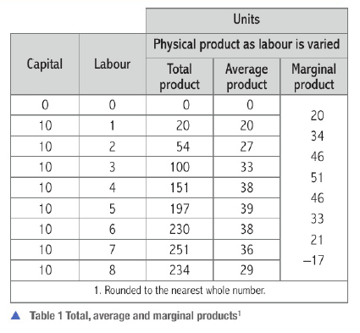
MP rises till 4th worker and falls at 5th worker, 5th worker produces less than 4th worker.
Therefore Diminishing marginal returns when employing 5th worker
AP rises till 5th worker and falls at 6th worker. AP falling later than MP
Diminishing Average return sets in at 6th worker

Slide 6
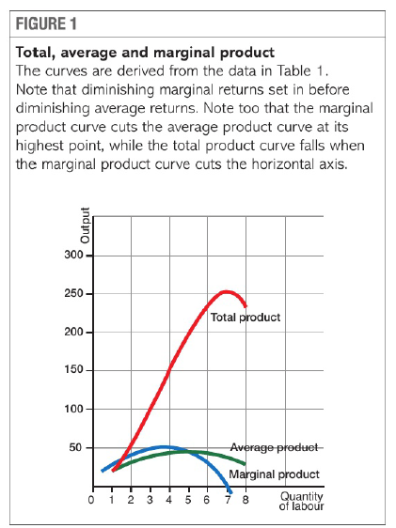
Law of diminishing returns
When quantities of variable input combined with fixed input MP of variable input of declines and then AP of variable input also decline later.
Law of diminishing returns explains the behaviour of cost curves in SR

Slide 7
Returns to scale - LR
Increasing returns to scale – Equal % increase in inputs – more than proportional increase in output
  E.g. all inputs increase by 100%, output increase by 200%
Constant returns to scale - Equal % increase in inputs – same proportional increase in output
  E.g. all inputs increase by 100%, output increase by 100%
Decreasing returns to scale – Equal % increase in inputs – less than proportional increase in output
  E.g. all inputs increase by 100%, output increase by 50%

Slide 8
The Definition of Economic Costs
Economic cost – opportunity cost of a resource/factor
Hidden costs/ imputed costs/ implicit costs – Resources have opportunity cost but no payments made
  Labour
  Financial capital
  Depreciation
  Goodwill

Slide 9
Fixed and Variable cost
Fixed cost/ indirect cost/ overhead cost –
  Does not change with change in output
  E.g. Rent of building, cost on capital good, salaries of permanent staff, advertising cost,
Variable cost/ direct / prime cost-
  Changes with change in output
  E.g. Cost of raw material
  Labour – neither fixed nor variable cost, it is semi variable cost.
    Labour includes both permanent and temporary staff.
    Firm adjust staff with change in output but adjustments are slow
    Hence, labour is semi-variable cost.
SR- some factors fixed, some variable, hence both fixed and variable cost incurred.
LR- All factors are variable, hence only variable cost incurred.

Slide 10
TC, AC, MC
TC – Cost of producing given level of output
  E.g. Cost of producing 100 units is $1 million
  TC = $1 million
  To increase output, more factor inputs used, leads to rise in TC

Slide 11
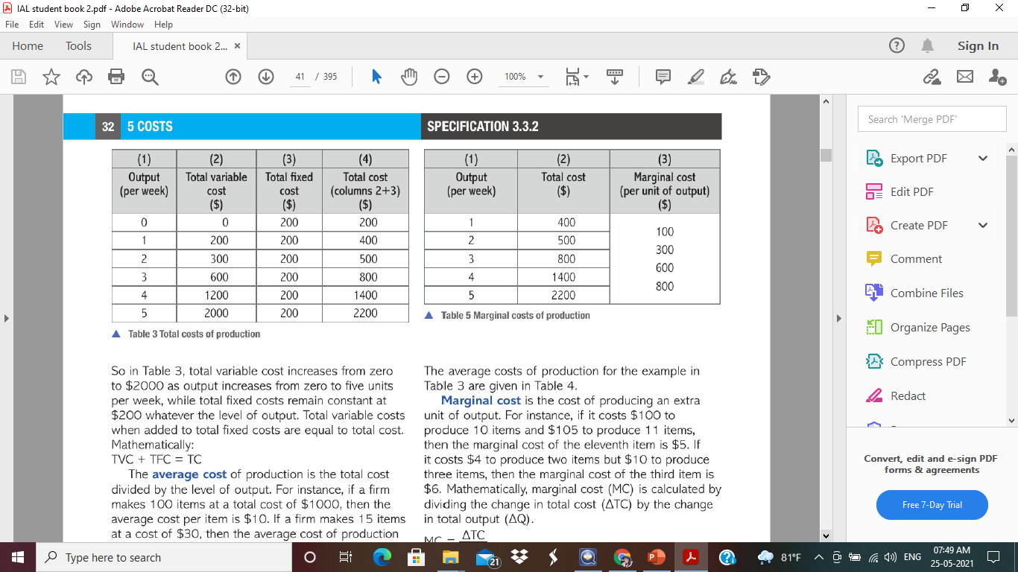
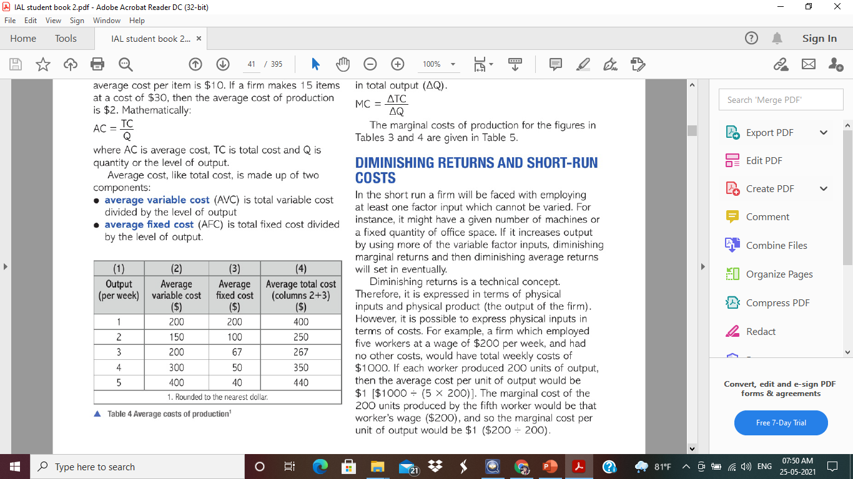
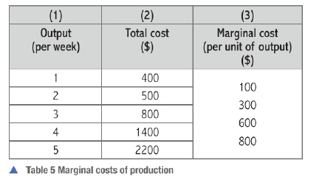
MC – Additional cost of producing extra unit of output
MC = TCn – TCn-1
= ∆TC/ ∆ Qty of output
AC – total divided by level of output
AC= TC/Qty of output

Slide 12
Diminishing Marginal returns and
SR costs
Diminishing marginal returns – increasing quantities of variable inputs combined with fixed inputs, MP starts to decline and afterwards AP also declines
Diminishing returns is expressed in terms of physical input and physical output.
Physical inputs can be expressed in terms of costs
E.g.
5 workers at wage $200/week
TC (assume no other costs) = 5*$200 = $1000
Each worker produced 200 units of output
TP or total output = 5 * 200 = 1000 units
AC = TC/Qty of output
= $1000/1000 = $1
Labour Wages = $200 | Output (units) | TC ($) | AC | MC
1 | 200 | 200 | 1 | -
2 | 400 | 400 | 1 | 1
3 | 600 | 600 | 1 | 1
4 | 800 | 800 | 1 | 1
5 | 1000 | 1000 | 1 | 1

Slide 13
SR COST SCHEDULES
Price of capital $ 100 per unit
Price of labour $200 per unit – Supply of perfectly elastic
UNITS |  |  |  |  | $
Capital | Labour | TP (Output) | AP | MP | Total Cost |  |  | Average Cost |  |  | MC
 |  |  |  |  | TVC | TFC | TC | AVC | AFC | AC | MC
10 | 0 | 0 | 0 | - | 0 | 1000 | 1000 | 0 | - | - | -
10 | 1 | 20 | 20 | 20 | 200 | 1000 | 1200 | 10 | 50 | 60 | 10
10 | 2 | 54 | 27 | 34 | 400 | 1000 | 1400 | 7.4 | 18.5 | 25.9 | 5.9
10 | 3 | 100 | 33.3 | 46 | 600 | 1000 | 1600 | 6 | 10 | 16 | 4.3
10 | 4 | 151 | 37.8 | 51 | 800 | 1000 | 1800 | 5.3 | 6.6 | 11.9 | 3.9
10 | 5 | 197 | 39.4 | 46 | 1000 | 1000 | 2000 | 5.1 | 5.1 | 10.2 | 4.3
10 | 6 | 230 | 38.3 | 33 | 1200 | 1000 | 2200 | 5.2 | 4.3 | 9.6 | 6.1
10 | 7 | 251 | 35.9 | 21 | 1400 | 1000 | 2400 | 5.6 | 4.0 | 9.6 | 9.5
10 | 8 | 260 | 32.5 | 9 | 1600 | 1000 | 2600 | 6.2 | 3.8 | 10 | 22.2

Slide 14
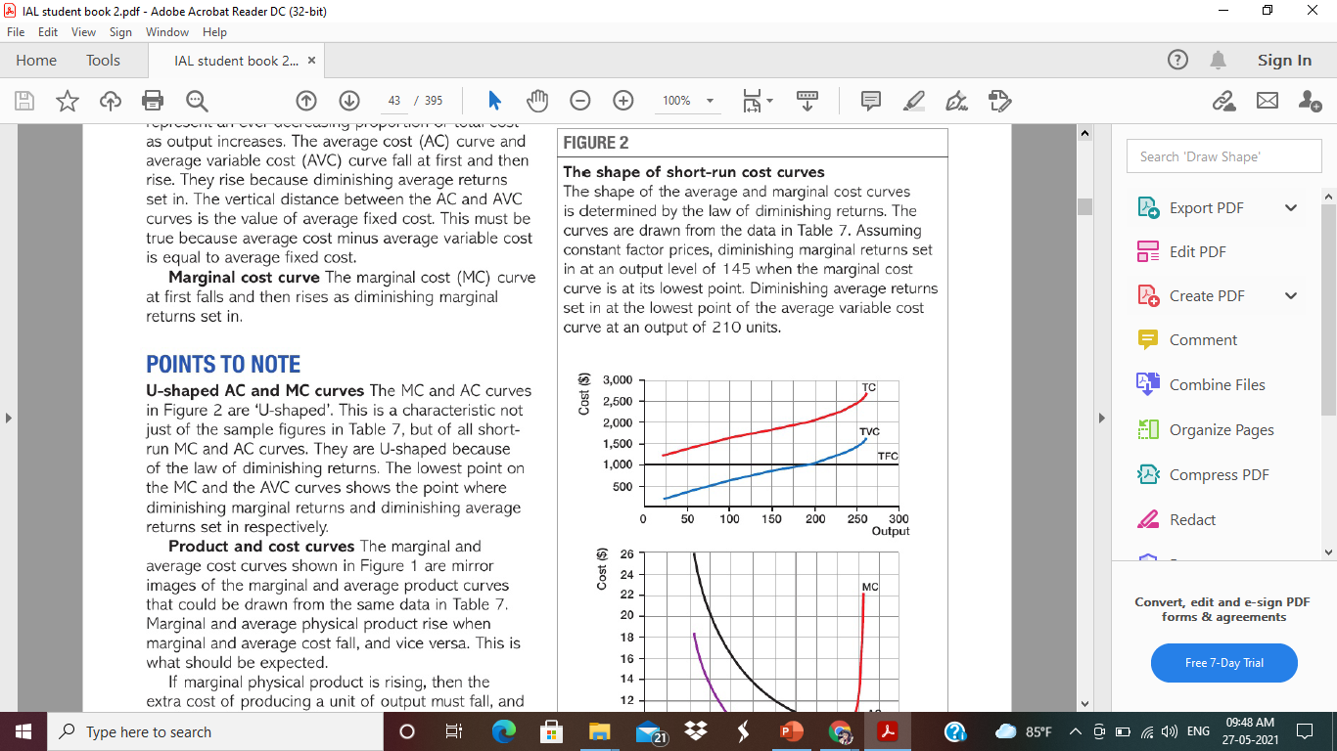
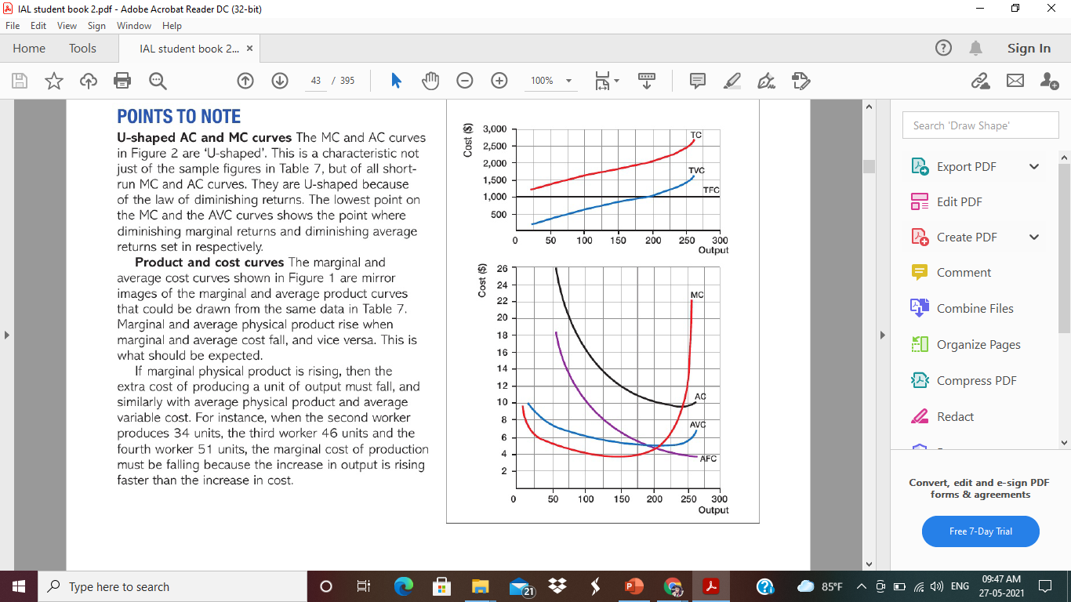


Slide 15
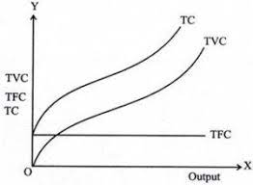
TOTAL COST CURVES
TFC – Horizontal line – shows TFC is constant at different levels of output
TVC & TC – Upward sloping – first increasing marginal returns then diminishing marginal returns.
TVC and TC curves are parallel to each other
The vertical distance between the two curves is because of TFC.

Slide 16
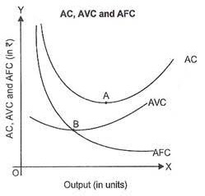
AVERAGE COST CURVES
AFC – Downward sloping – AFC falls as output rises
AVC and AC – first downward then upward sloping
They rise because diminishing average returns sets in.
Vertical distance between the two is because of AFC
AFC declining – distance between AVC and AC reduced.
Lowest Point of AVC – B
Lowest point of AC – A
Lowest point of AVC reaches before lowest point of AC
Shape – U shaped because of diminishing average returns
Lowest point on AC shows diminishing returns sets in.

Slide 17
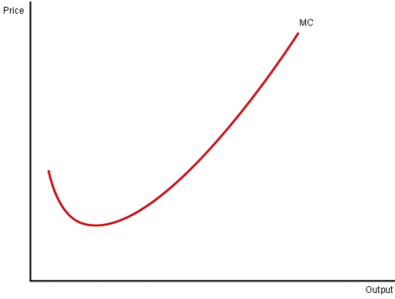
MARGINAL COST CURVE
MC – first downward the upward sloping – first falls then rises as diminishing marginal returns sets in.
Shape - U Shaped because of diminishing marginal returns
Lowest point of MC shows diminishing marginal returns sets in

Slide 18
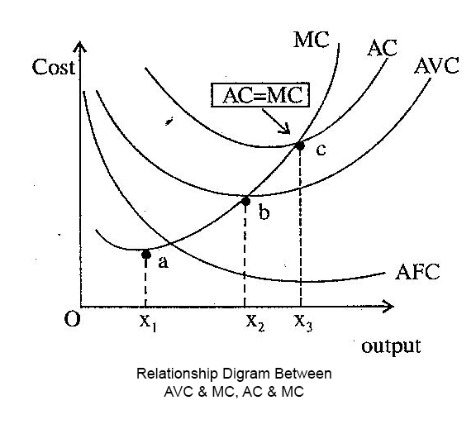
MC curve cuts AVC and AC curves at their lowest point
E.g.
5 students – total height is 10 meters
Average height of group = 2 meters
New student (additional student) joins – if height is 1 meters
6 students – total height is 11 meters
Average height of group = 1.83 meters
i.e. Average height falls
Since Marginal height < Average height
New student joins – if height is 2 meters
6 students – total height is 12 meters
Average height of group = 2 meters
i.e. Average height remains same
Since Marginal height = Average height
New student joins - if height is 3 meters
6 students – total height is 13 metres
Average height of group = 2.2 meters
i.e. Average height rise
Since Marginal height > Average height
When AC fall, MC < AC
When AC is constant, MC = AC
When AC rise, MC > AC
MC cuts AC at its lowest point

Slide 19
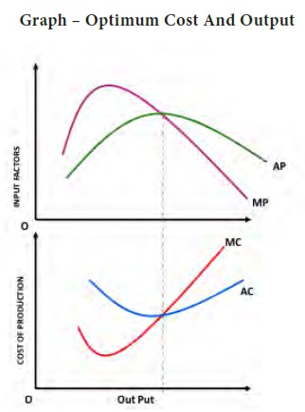
MP & AP curves are mirror image of MC and MC curves
Constant factor cost per unit, therefore Product curves and cost curves are mirror images
If unit cost of labor is increased as more workers are employed, then cost and product curves will not be mirror images of each other

