Slide 1
Chapter 6 Economies and Diseconomies of scale

Slide 2
Learning Objectives
Relationship between LR cost curves and economies/diseconomies of scale
Minimum efficient scale
Difference between internal and external economies of scale
Six sources of internal economies of scale
Three sources of external economies of scale
Three sources of diseconomies of scale

Slide 3
Economies of scale and LRAC
Economies of scale – Firms expand in size and output, LRAC falls
Diseconomies of scale – Firms become too large, LRAC rise
Output (millions) | TC (million $) | AC ($)
10 | 10 | 1
40 | 20 | 0.5
Output (millions) | TC ($) | AC ($)
10 | 10 | 1
40 | 80 | 2

Slide 4
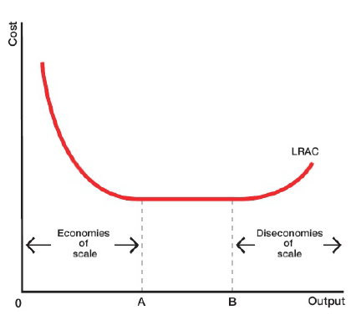
Assumption – input prices are constant
Economies of scale - At output level OA, LRAC Falls
Between Output level OA and OB – LRAC constant
Diseconomies of scale – At output level beyond OB, LRAC rise
Constant
Returns to scale

Slide 5
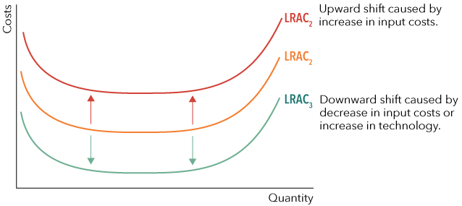
IF INPUT PRICE CHANGE – SHIFT IN LRAC

Slide 6

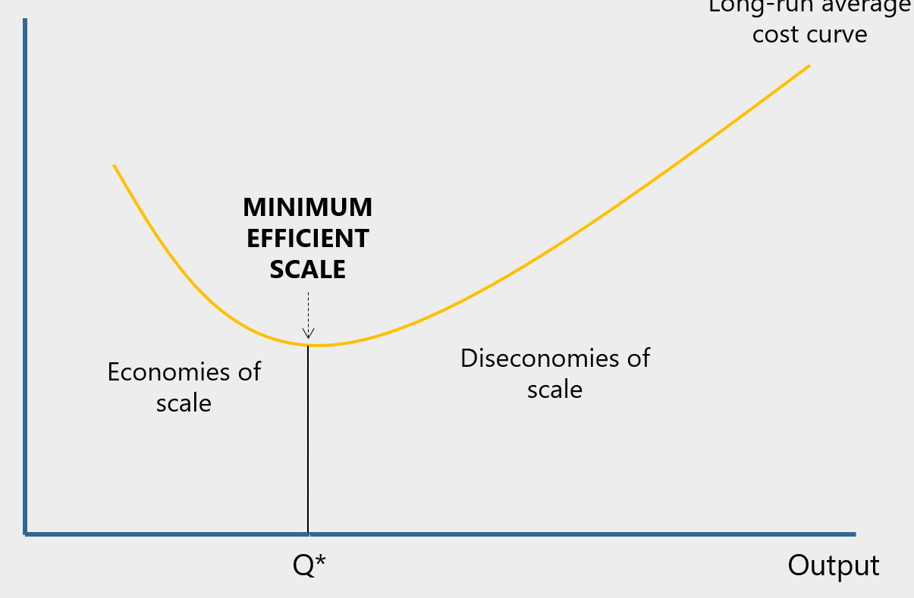
Productive efficiency – when
production takes place at lowest AC
Productive efficiency occur at the bottom of the curve
Between A and B – constant returns to scale
Optimal level of output – Output range over which AC are at its minimum
Minimum efficient scale – Output level at which lowest cost production starts
Pt A is MES
To the right of MES (Pt A) – if constant returns to scale occur, AC is constant
If diseconomies of scale occur, AC rise

Slide 7
Sources of internal economies of scale
Internal economies of scale – growth in output of the firm
Sources:
Financial economies
Technical economies
Managerial economies
Marketing economies
Purchasing economies
Risk bearing economies

Slide 8
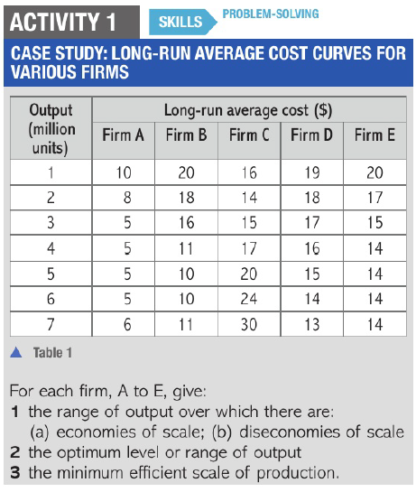

Slide 9
Internal Diseconomies of Scale
Arise due to management problem – difficult to control activities of organisation
Solution:
Individual person – tight control of all major decisions
Centralise operations – Small team controlling all activities
Decentralise operations – Small subsidiary companies making decisions about their part & head office makes decisions of whole group
Hundreds of workers – Difficult controlling organisation – no management team could prevent average costs from rising

Slide 10
Sources of Diseconomies of Scale
Communication problem
Difficult to maintain effective communication
Information not received accurately Instruction not carried out correctly less efficient
AC starts rising
Instruction arrive too late due to organisation’s hierarchy Business opportunity lost
Founder Director/manager HOD Team Leader Employees

Slide 11
Coordination problem
Large firm difficult to ensure departments working effectively with each other
Increase AC Inefficiency
Operation department can’t produce more than 800 units
Sales Department targets to sell 1000 units
Sales department too large (many employees) employees won’t work hard
Increase AC Inefficiency
X- Inefficiency – firms fail to minimise cost

Slide 12
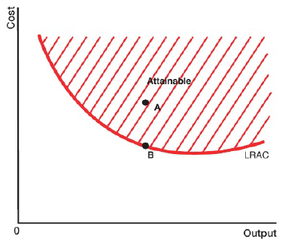
Movement Along and Shift in LRAC
LRAC – boundary
Shows minimum level of AC achievable at given level of output
Points below LRAC are unachievable
Firm can produce above LRAC not using most efficient method
Firm producing at A less efficient than firm producing at B
Movement along LRAC – Increase in output leads to fall in AC
Q

Slide 13
LRAC drawn on assumptions:
Input costs are constant
State of technology remains constant
Upward shift
Increase in input costs – increase in price of raw material
External diseconomies of scale
Downward shift
Decrease in input cost – fall in wages
Change in technology
New technology, more efficiency, reduce AC
External Economies of scale

Slide 14
External Economies of scale
Internal economies of scale | External economies of scale
Growth in output of a firm | Growth in size of industry in which firm operates

Slide 15
Sources of external economies of scale
Growth of Particular industry in an Area
Construction of better local road network
less time spent on travel or road Transport of goods quicker
less payment to driver reduces cost of individual firm
Skilled labour available in area lower training cost
Government can provide free training facilities
Sharing knowledge firms benefits being in same area & help each other
Share research and development facilities results shared with all firms lower AC
Set up Vocational colleges easy access to training & education of workers
reduced AC efficiency of workers increase

Slide 16
External Diseconomies of scale
Occur when industry expands
Competition increases between individual firms
Shortage in supply of factor inputs
Increase in price of factor inputs
Rise in AC
LRAC shifts upwards

Slide 17
Relationship between SR and LR AC
Costs
SRAC1
SRAC8
SRAC7
I
SRAC2
SRAC6
A
SRAC3
SRAC4
SRAC5
H
G
B
F
C
E
D
Output
O
Q1
Q2
Q3
Q4
Q5
Q6
Q7
Q8

Slide 18
Costs
SRAC1
SRAC8
LRAC
SRAC7
SRAC6
SRAC2
SRAC4
SRAC5
A
SRAC3
H
G
B
F
C
E
D
Output
Q1
Q2
Q3
Q4
Q5
Q6
Q7
Q8

Slide 19
Costs
SRAC1
SRAC8
LRAC
SRAC7
SRAC6
SRAC2
SRAC4
SRAC5
A
SRAC3
H
G
B
F
C
E
D
Output
Q1
Q2
Q3
Q4
Q5
Q6
Q7
Q8

Slide 20
Costs
SRAC1
SRAC8
LRAC
SRAC7
SRAC6
SRAC2
SRAC4
SRAC5
A
SRAC3
H
G
B
F
C
E
D
Output
Q1
Q2
Q3
Q4
Q5
Q6
Q7
Q8

Slide 21
Costs
SRAC1
SRAC8
LRAC
SRAC7
SRAC6
SRAC2
SRAC4
SRAC5
A
SRAC3
H
G
B
F
Diseconomies of scale – Rising LRAC
C
E
Economies of scale – Falling LRAC
D
Output
Q1
Q2
Q3
Q4
Q5
Q6
Q7
Q8
Increasing returns to scale
Decreasing returns to scale

