Slide 1
Ch 8 Efficiency

Slide 2
Learning Objectives
Understand the concept of allocative efficiency, productive efficiency, dynamic efficiency, X-efficiency.
Understand efficiency and inefficiency in different market structures

Slide 3
Efficiency
How well resources(time, talent or material) are used to produce an end result.
Relationship between scarce inputs and outputs

Slide 4
Allocative Efficiency
Resources are allocated to goods and services demanded by consumers
Basic economic problem- resources are scarce and wants are infinite
Scarce resources are used to produce goods that satisfies consumer preferences and maximises their welfare
Allocative efficiency achieved → MB = MC
Marginal Benefit(MB) → price consumers willing to pay for the last good consumed.
Shown by demand curve
Marginal Cost(MC) → price producers willing to receive for the last good produced.
Shown by supply curve

Slide 5
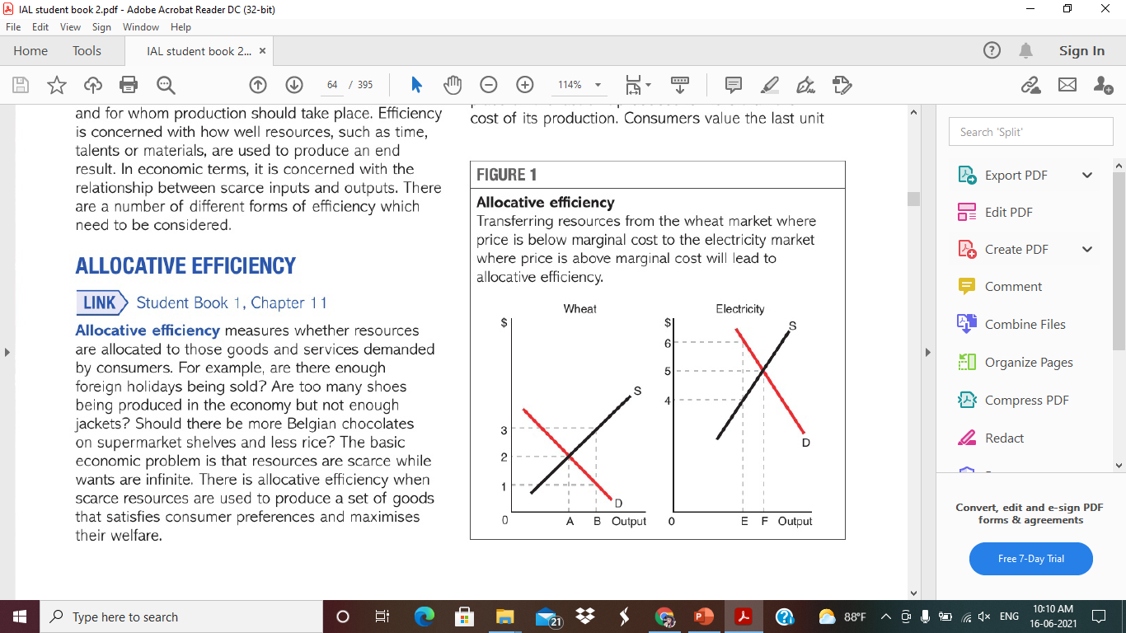
Wheat market
Current output – OB
Price that consumers willing to pay for OB output - $1 (P=D= MB)
Price that farmers willing to receive for OB output - $3 (MC)
(MB(P)<MC)
Value that consumers place on the product < cost of producing the product
Consumers value the last unit (OB) at $1
Cost of producing last unit (OB) is $3
Scarce resources would be efficiently allocated if less wheat were produced

Slide 6
Electricity market
Current output is OE
Price consumers willing to pay - $6 (P= MB)
Suppliers receive price - $4 (MC)
(MB(P)>MC)
Value that consumers place on product > cost of producing the product
Consumers value the last unit (OE) at $6
Cost of last unit (OE) is $4
Scarce resources were more efficiently allocated if more electricity is produced

Slide 7
Allocative efficiency exists – when MB(P) = MC
Consumers value the last unit consumed as much as its cost of production
Allocative efficiency does not mean incomes are distributed equally.

Slide 8
Productive Efficiency
Productive efficiency - When production is achieved at lowest average cost
Productive inefficiency – when cost of production is above the minimum possible cost
E.g. Firm which produces one million units at a cost of $10000, but it could produce same output at $8000- the firm is productively inefficient

Slide 9
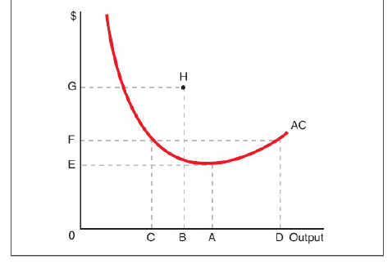
Output OA – productively efficient – lowest average cost OE
Output OD – average cost OF – productively inefficient – too much production
Output OC – average cost OF – productively inefficient –
At point H – output produced OB – average cost is OG – productively inefficient
Output OA is productively efficient level of output whether AC is LR or SR

Slide 10
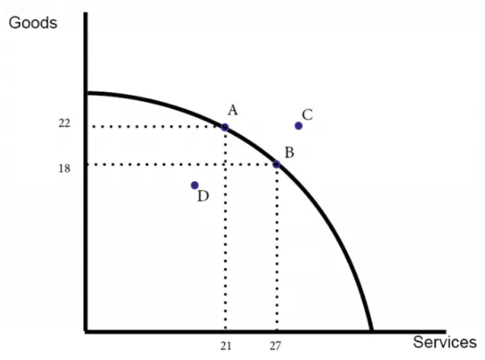
Productive efficiency in economy – occurs when it is producing on its PPF curve
If all firms produce at lowest average cost economy will be producing at PPF

Slide 11
Dynamic efficiency
When resources are allocated efficiently overtime
Productive & allocative efficiency – static efficiency – at a point of time
E.g.
Rate of investment
Firms invest - to cut costs or to make new products
Investment in – R&D, Machinery/building, training workers
Determinant of rate of investment – Demand of consumers, interest rate, past profits

Slide 12
Dynamic inefficiency – firms fail to take into account all the future costs and benefits of investment
R&D – takes long time before investment is repaid
Underinvestment in R&D
Reduce the pace of innovation
Training of workers – firms attract trained workers from other firms
Underinvestment in training of workers.

Slide 13
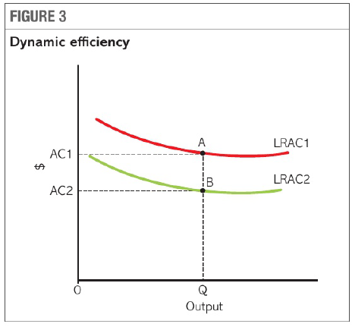
LRAC1 (2010)
LRAC2 (2018)
When firms are dynamically efficient LRAC falls

Slide 14
X - Inefficiency
Organizational slack
Type of productive inefficiency
Firm is not producing at the lowest possible cost for a given level output
Firm operating within boundary but not on the boundary
Difference between actual average cost and possible cost

Slide 15
Output OB – AC is OG – X- inefficient
Operating within the boundary
Output OC – AC is OF – productive inefficiency but not X – inefficiency
Productive efficiency – production at output OA – AC is OE
J
I
I

Slide 16
Reasons for X – inefficiency (not producing at lowest possible AC)
Management poor at controlling costs
Not paying cheapest possible price to suppliers
Employ too many workers/ production sites
Not employing most efficient and profitable equipment.
Stakeholders extract higher benefits
Trade unions negotiate higher rate of pay
Environmental groups pressurize to adopt stricter environment standards

Slide 17
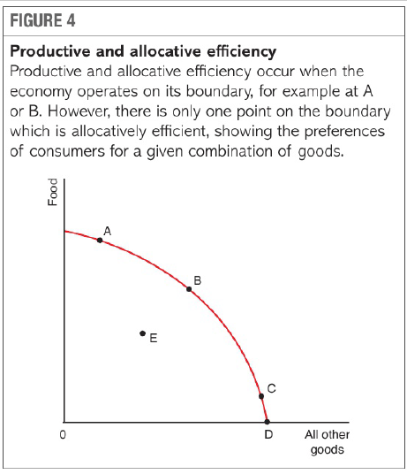
Efficiency and PPF
PPF – shows combinations of goods produced if all resources fully utilized ( full employment )
All points on boundary are productively efficient (A, B, C, D)
Inefficiency – produce within PPF
Only one point on boundary is productively efficient
Preferences/ utility of consumers is maximized

Slide 18
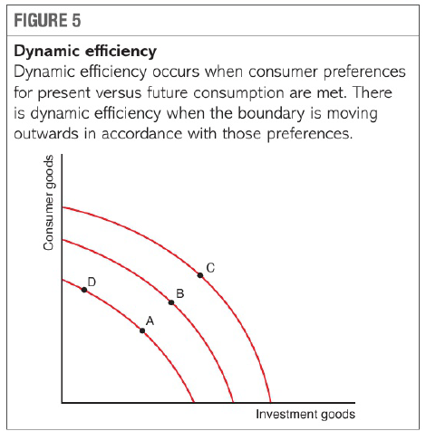
Shown by movement of PPF to right
Preferences of present and future consumers are realized
Best outcome depends on the value that consumers put on present and future consumption

Slide 19
Organisation slack
Arise because a firm fails to minimise its average costs at given level of output
Because of lack of competition in the market, management of firm do not feel threatened by other firms
Managers not focus on keeping costs down
Managers not worry to buy raw materials at lowest cost as long as cost is reasonable and quality of material is suitable.

Slide 20
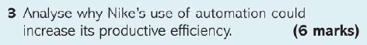
Productive efficiency – when production is operating at lowest average cost
Automation enables Nike to produce running shoes using less labour and fewer materials than the production of most running shoes. Nike can produce these shoes at a lower unit cost than previously.
The position on AC curve, will move towards lowest point on AC curve
Move whole AC curve down, due to lower labour cost by 50% because fewer employees are needed.
Variable cost decrease by 20 %, as less material needed to produce each shoe
AC and VC will be lower and so unit costs reduced at all levels of output leading to output being produced at more productive efficient level.

Slide 21

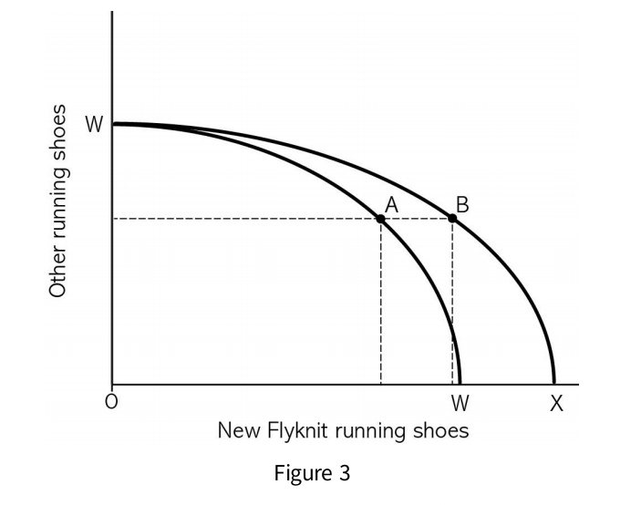
Allocative Efficiency – when scarce resources are used to produce goods that satisfy consumer preference and maximise welfare.
Dynamic efficiency – when resources are allocated efficiently overtime.
Innovation leads to improvement in range and performance of products
Pt A – shows the original combination of flyknit and all other running shoes demanded by consumers
It reflects the demand in competitive market. If Pt A most satisfies consumers wants then it is allocatively efficient.

Slide 22
Overtime production techniques used by Nike and Adidas have speed up the supply of shoes to meet rapidly changing consumers need for running shoes
Automation in Nike factories, using new automated processes, improved allocative efficiency as the flyknit shoes being produced meet consumer needs as shown by growing demand for these products and high price consumers are willing to pay,
App- $130 instead of $75 without the flyknit uppers
Pt B shows PPF curve moved outwards for Nike shoes as it has innovative automated production technique that have allowed output and consumption to be at B
Adidas will be able to produce customer made shoes on the spot to meet the individual needs of consumer
Development with use of 3D printing will bring further innovation to meet changing customer needs quickly

Slide 23
Evaluation
Many consumers may not be willing to pay the higher prices charged for personally designed shoes
If market is not competitive and does not reflect consumer demand then allocative efficiency may not occur.
Producing a new shoe in five hours instead of several weeks may not benefit consumers much. Fast change in fashion may become less important for consumers.
Automation reduce employment
Conclusion
Extent to which consumers benefits by automation depends on competitiveness in sports shoes market and whether cost saving is passed to consumers.
Shareholders benefits from automation as it results in huge cost savings and increased profits.
Extent to which dynamic efficiency is improved depends on whether the new innovations produce designs that meet changing consumer needs

