Slide 1
Ch 9 Market structures and Concentration ratios

Slide 2
Learning Objectives
Understanding the Characteristics that distinguish different market structures
Understanding the significance of concentration ratios
Know how to calculate an n – firm concentration ratio

Slide 3
Market structure
Characteristics of market that determines firms behaviour

Slide 4
1. No. of firms in market and relative size
Firms in the industry – one or many
Pure monopoly – only supplier in the market
Oligopoly – market dominated by few large producers
Large number of firms, most are small and less important
Few large firm produce most of the output of the industry
Perfect competition or monopolistic competition
Large no. of small suppliers, not large enough to dominate the market

Slide 5
2. Ease or difficulty in entering/leaving the market
Barriers to entry or exit

Slide 6
3. Similar/ differentiated goods
Indentical – homogenous goods
Same products whichever firm produces it
E.g. Coal steel, rice
Quality/type may be different but no producer has monopoly of any quality/ type
Differentiated – Non homogenous goods
Easier for firms to control market
Product differentiation
Creating brands – builds brand loyalty
Elasticity of demand reduced (relatively inelastic Demand)

Slide 7
4. Knowledge shared by the firms
Perfect knowledge – of prices, output and products
Only one price in market
Firms has access to all the information available
Perfect knowledge does not imply:
All firms in the industry will posses all information.
All firms know everything about their industry and future
Perfect knowledge only means that all firms have the same access to the information.
Imperfect knowledge –
Firms have imperfect knowledge when there are industrial secrets
Market share, unaware of new technology/ new products launched by rival firms
Info. Can be a barrier to entry

Slide 8
5. Actions of one firms affect another firm
Independent
Actions of any firm will have no significant impact on any other single firm
Interdependent
Actions of one firm will have an impact on other firms
Few firms in the industry
Uncertainty

Slide 9
Competition and Market structures
Perfect competition
Large number of firms compete in the industry
Produce homogenous goods
None of the firm large enough to have direct impact on any other firm or market price of the good
Freedom of exit and entry to the industry

Slide 10
Monopolistic competition
Large number of firms
Each produce differentiated goods
Firms have some control over the price
Freedom of entry or exit
Oligopoly
Many firms but few large firms dominate and produce majority of output
Interdependent – make decisions depending on behaviour of competitors
Monopoly
Only one firm in the industry
High barriers to entry

Slide 11
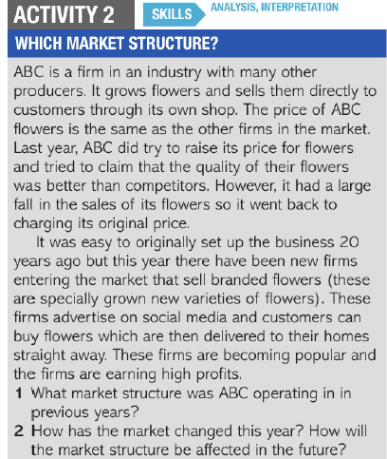

Slide 12


