Slide 1
Costs

Slide 2
Short run and long run
Short run: defined as a time period in which at least one factor of production (land, labour, capital, or entrepreneurship) is fixed.
it cannot be changed even if there is a change in demand.,
In short run output can be increased only by adding more variable factors.
Long run: defined as a time period in which all the factors of production are variable.

Slide 3
Types of costs
Total cost
Total Cost incurred
TC=FC+VC
Variable cost
Cost that varies as output changes
Fixed cost
Cost that remain unchanged
FC=TC-VC
VC=TC-FC

Slide 4
Average cost
Cost per output
AC=TC/Q
Marginal cost
Additional cost of producing one extra unit of output
MC=TC2-TC1 OR Changes in TC/Changes in Q

Slide 5
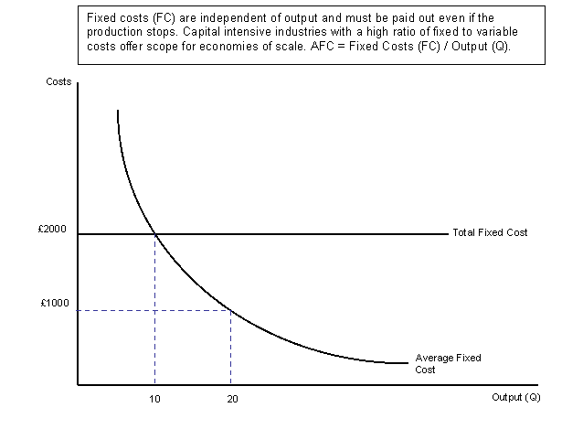

Slide 6
Calculate TC, AC, MC and Draw the curves
Output (Q) | Total Fixed Cost | Total Variable Cost | Total Cost | Average Cost | Marginal Cost | AverageFixed Cost | AverageVariable Cost
0 | 30 | 0 | 30 | 0 | 0
1 | 30 | 22 | 52 | 52 | 22
2 | 30 | 38
3 | 30 | 48
4 | 30 | 61
5 | 30 | 79
6 | 30 | 102
7 | 30 | 131
8 | 30 | 166
9 | 30 | 207
10 | 30 | 255

Slide 7
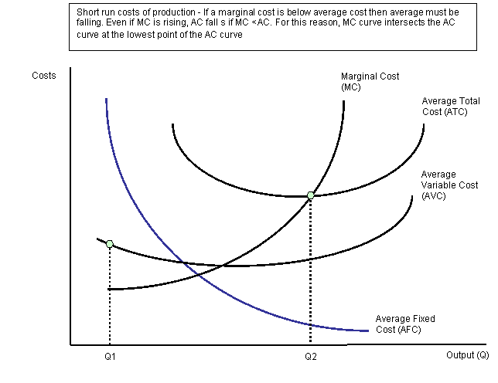

Slide 8
Long run production - returns to scale
In the long run, all factors of production are variable.
How the output of a business responds to a change in factor inputs is called returns to scale.
Increasing returns to scale occur when the % change in output > % change in inputs
Decreasing returns to scale occur when the % change in output < % change in inputs
Constant returns to scale occur when the % change in output = % change in inputs

Slide 9
The law of Diminishing Returns
Total product
Total output of goods produced
Average product
Output per worker
AP=TP/No.of labours
Marginal Product
Additional output produced when an extra worker is added
MP=TP2-TP1

Slide 10
In the short run, the law of diminishing returns states that as we add more units of a variable input (i.e. labour or raw materials) to fixed amounts of land and capital, the change in total output will at first rise and then fall.
Diminishing returns to labour occurs when marginal product of labour starts to fall.

Slide 11
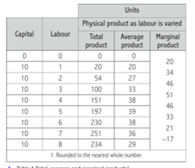

Slide 12
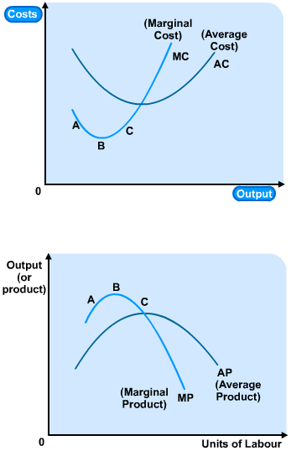
Cost Curves and Product Curves
At point A on the bottom diagram, we have a situation where each worker adds more to total output than the last.
But each worker is paid the same wage, so each marginal unit that this new worker produces will cost less, on average, than the units produced by the last worker (given that we are assuming that the only variable cost is labour).
Hence, the marginal cost curve must be falling (see point A on the top diagram).

Slide 13
At point B on the bottom diagram, we have a situation where each worker adds the same amount to total output than the last.
Each worker is paid the same wage, so each marginal unit that this new worker produces will cost the same, on average, than the units produced by the last worker.
Hence, the marginal cost curve must be constant, or flat (see point B on the top diagram).

Slide 14
At point C on the bottom diagram, we have a situation where each worker adds fewer units to total output than the last (diminishing marginal returns have set in).
But each worker is still paid the same wage, so each marginal unit that this new worker produces will cost more, on average, than the units produced by the last worker.
Hence, the marginal cost curve must be rising (see point C on the top diagram).

Slide 15
So the marginal cost and average cost curves come from the product curves, which are, in turn, derived from the law of diminishing marginal returns.
The average variable cost curve comes from the product curves in exactly the same way.
Do worked examples.

Slide 16
Some key points about the curves
the average fixed cost curve is continually falling, because a fixed number is being divided by an ever-increasing number of output.
the marginal cost curve cuts the average cost and average variable cost curves at their minimum points, where they are temporarily flat.
this can be explained using marginal analysis.

Slide 17
If the average height of a group of people is 6 feet, then if we add some people who are 5 feet tall, the average will fall.
This is because of the marginal height, in other words, the height of next person added is less than the average.
Therefore, if the marginal unit is below the average, the average will fall.
If the net added person is more than 6 feet, average will increase.

Slide 18
If the marginal cost is greater than the average cost, the average must be rising.
The only time that the average is not falling or rising is when the marginal cost is equal to the average cost and the average has stopped falling and it yet has to start rising.

Slide 19
AC is declining whenever MC is below AC, and rising whenever MC is above AC.
MC curve cuts the AC at the minimum point of the AC curve.
In other words, at the point where output is produced at lowest unit cost.

