Slide 1
Economic Efficiencies
Objectives:
Describe different economic efficiencies
Identify the efficiencies that are achieved in perfect competition and monopoly

Slide 2
Efficiencies
Productive efficiency
Dynamic efficiency
Economies of scale
Allocative efficiency
X-inefficiency

Slide 3
Productive efficiency
This exists when production is achieved at the lowest average cost.
Allocative efficiency
This measures if the resources are allocated to those goods demanded by the consumers.
This can be achieved where AR(P)=MC
X-inefficiency
This occurs when the firm is not producing at the lowest possible output
It can be illustrated when AC=MC

Slide 4
Dynamic efficiency
This is achieved ,when a firm invests abnormal profit on R&D
Economies of scale
This is achieved when there is a fall in LRAC due to an increase in size.

Slide 5
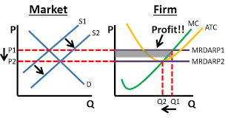
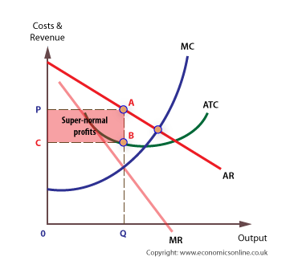
Productive efficiency(AC=MC)
In a Perfectly competitive firm, it is achieved in LR
In a monopoly ,productive efficiency is not achieved as AC is not equal to MC at profit maximising output

Slide 6
Allocative efficiency(AR=MC)
In a Perfectly competitive firm, allocative efficiency is achieved in both SR and LR as AR=MC
In a monopoly ,allocative efficiency is not achieved as AR> MC at profit maximising output

Slide 7
X-inefficiency
in a perfectly competitive firm there is an absence of X-inefficiency as they have greater incentives to reduce costs and the firms are price takers
In a monopoly,firm would be X-inefficient as they don’t bother about reducing the cost as they are price makers

Slide 8
Dynamic efficiency
In a Perfectly competitive firm, there is lack of dynamic efficiency because:
1. they don’t get abnormal profit in LR no investment on R&D
2.They deal with homogenous products
However In a monopoly ,they enjoy dynamic efficiency as huge amount of abnormal profit is invested on innovation and R&D

Slide 9
Economies of scale
A Perfectly competitive firm doesn't enjoy economies of scale as they are small in size
But monopoly firm enjoys economies of scale as they are larger in Size

