Slide 1


Slide 2
Objectives:
Identify five different market structures
Explain perfect competition with it’s characteristics
Illustrate diagrammatic analysis of SR and LR in perfect competition

Slide 3
Market structures
Perfect competition
Monopolistic competition
Oligopoly
Monopoly
Monopsony

Slide 4
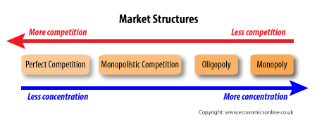

Slide 5


Perfect competition
A market structure in which there are many buyers and sellers dealing with identical products

Slide 6
Perfect competition
Perfect knowledge
Many buyers and sellers
Identical products
Price takers
No barriers to entry and exit
Abnormal profit in SR and normal profit in LR
Notes:
from

Slide 7
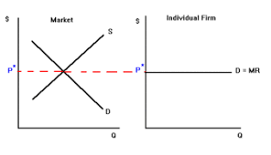
PricPrice taker graph
In a marker price is determined by the the market forces demand and supply and the same price is taken by the individual firm. In PC, there would be a perfectly elastic demand curve.M e.g. different systems in place, employee dissatisfaction
• Takeover bid process is lengthy and expensive - needs approval from many countries and international organisations (e.g. EU)
• Having to contend with bureaucracy – paperwork etc.
• The bid may be blocked by one or more competition authorities
Notes:
from

Slide 8
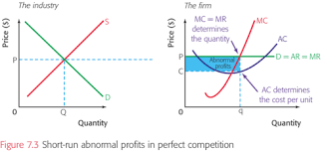
Short run Abnormal profit
Abnormal profit: when AR>AC at the profit maximising output where MR=MC
Revenue is determined from AR curve
Cost is determined from AC curve

Slide 9
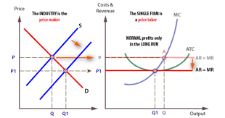
Normal profit in LR
Perfectly competitive firm enjoys a normal profit in LR as there is freedom of entry and exit
Normal profit is when AR=AC at profit maximising output where MC=MR

Slide 10
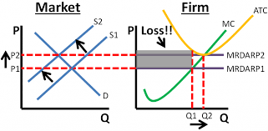
Loss in PC
Loss is when AR< AC at profit maximising output where MR=MC
Shutdown is when AVC >AR at a loss

