Slide 1
Monopolistic Competition and Monopoly
Objectives:
Identify different characteristics of a monopolistic competition and monopoly
Diagrammatic illustration of Short run and long run

Slide 2
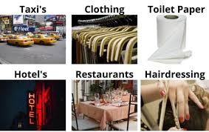
Monopolistic Competition
A market structure in which there are many suppliers dealing with differentiated products

Slide 3
Characteristics
Many sellers
Differentiated products
Firms are independent
Some control over the price
Low barriers to entry
Imperfect knowledge
Profit maximisers

Slide 4
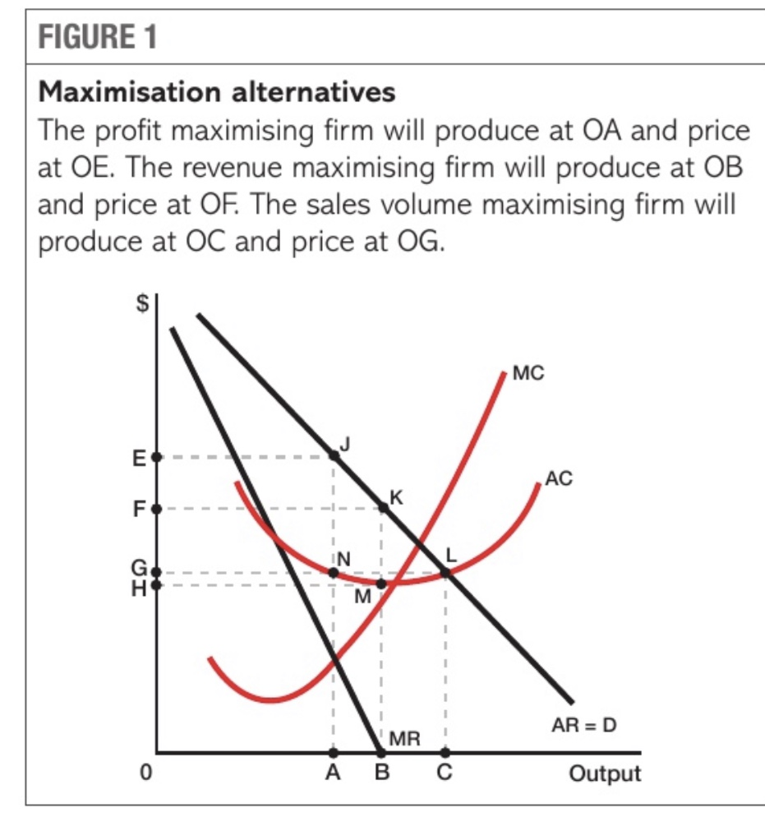
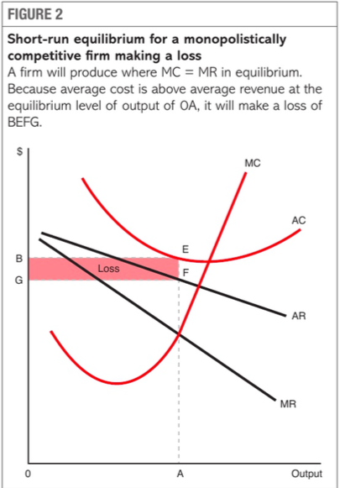

Slide 5

A market structure in which there is a single supplier dealing with a good which has no substitute.

Slide 6
Monopoly
Sole supplier
Imperfect knowledge
High barriers to entry and exit
No substitute
Price maker

Slide 7
Advantages to firms
Increase in supernormal profit due to high barriers to entry
Increases dynamic efficiency
Increases in technology increases efficiency
Enjoys economies of scale
Disadvantages to firms
It may lead to X-inefficiency
Government might impose high tax on monopolist

Slide 8
Advantages to consumers
Cheaper prices due to economies of scale increases consumer surplus
High quality of goods due to dynamic efficiency
Disadvantages to consumers
Poor level of goods and services
X-inefficiency hence no cost saving leading to higher price.
Some consumers might be better off due to price discrimination

Slide 9
Stay safe

