Slide 1
Objectives of firms
A business objective is a result that a firm aims to achieve. There are four major objectives

Slide 2
Profit maximization
This occurs at the output where the MR=MC
Marginal Revenue: additional revenue earned by selling an extra unit
Marginal cost: additional cost incurred due to an increase in production

Slide 3
2.Revenue maximisation
Revenue maximization: When the marginal revenue is equal to Zero.
This concept reflects the situation of the Divorce of ownership

Slide 4
3.Sales maximization
When the Average cost of the firm is equal to Average revenue
4. Profit Satisficing

Slide 5
Objectives in brief
Profit
MR=MC
Revenue
MR=0
Sales
AC=AR

Slide 6
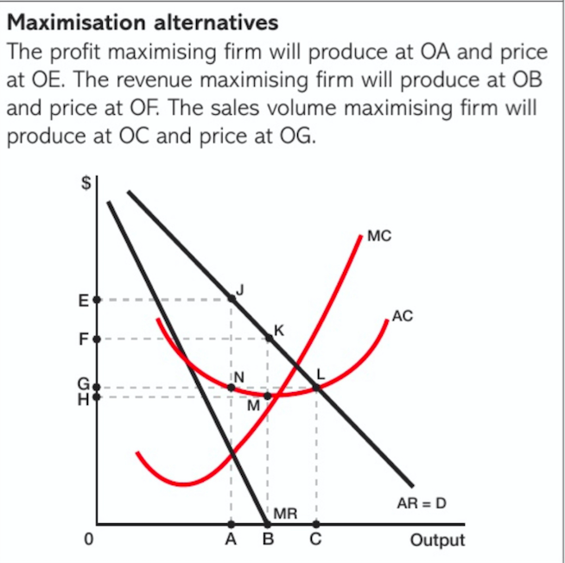

Slide 7
Revenue
Total revenue(TR)
Amount of money earned by selling a product(P*Q)
Average revenue(P/AR)
Revenue per unit sold(TR/Q)
Marginal revenue(MR)
Additional revenue from sale of an extra unit(MR2-MR1)

Slide 8
Calculations
Sales | Average Revenue (Price) $ | Total Revenue $ | Marginal revenue $
1 | 5 | 5
2 | 5 | 10 | 5
3 | 5 | 15 | 5
4 | 5 | 20 | 5
5 | 5 | 25 | 5

Slide 9
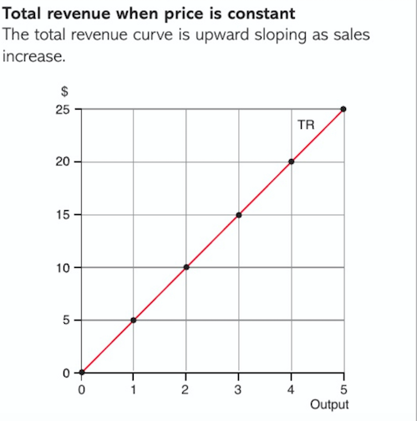

Slide 10
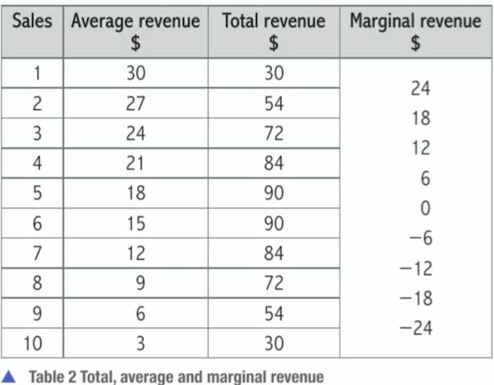

Slide 11
