Slide 1
PRICE DISCRIMINATION
Objectives:
Describe the conditions applied for price discrimination
Explain the advantages and disadvantages of price discrimination

Slide 2
Price Discrimination:
Charging different prices for the same good/service from different customers

Slide 3
1st degree
This is where the firm charges the maximum price that a consumer is willing to pay. This is very difficult in practise.
2nd degree
This is when consumers are charged different prices according to how much they consume. For example, units of electricity become cheaper after higher levels of consumption.
3rd degree
This is when consumers are grouped into two or more independent markets. For example, train companies offer discounts for people over 65 or people travelling off-peak.

Slide 4
Conditions applied
The firm should be a price maker
There must be a different elasticity of demand for the different market sections
The firm must be able to separate the market into different sections and prevent resale

Slide 5
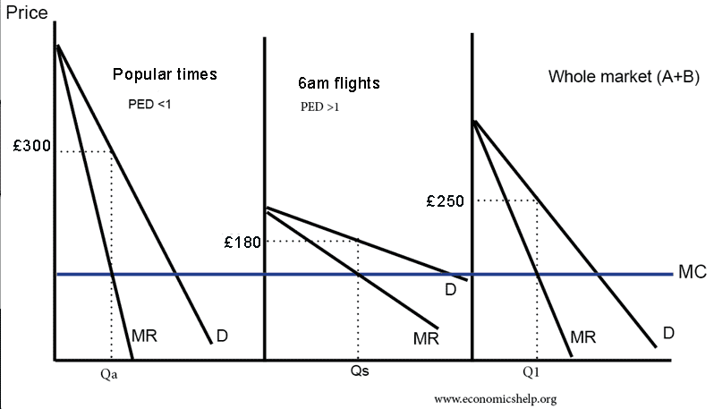
Third degree price discrimination

Slide 6
Advantages
Firm will be able to increase revenue.
Increased revenue can be used for research and development.
Some consumers will benefit from lower fares; e.g. pensioners can take advantage of cheaper fares on trains.

Slide 7
Disadvantages
Some consumers will face higher prices leading to allocative inefficient and a loss of consumer surplus.
Often those who benefit from lower prices may not be the poorest. For example, some old people may be quite rich, but the unemployed will have to pay the full adult fare.
There may be administration costs involved in separating the markets.
Profits from price discrimination can be used to cross subsidise
predatory pricing.

