Slide 1
Pricing strategies of oligopolies
Oligopolists may use predatory pricing to force rivals out of the market. This means keeping price artificially low, and often below the full cost of production.
They may also operate a limit-pricing strategy to deter entrants, which is also called entry forestalling price.
Oligopolists may collude with rivals and raise price together, but this may attract new entrants.

Slide 2
Cost-plus pricing is a straightforward pricing method, where a firm sets a price by calculating average production costs and then adding a fixed mark-up to achieve a desired profit level. Cost-plus pricing is also called rule of thumb pricing.
There are different versions of cost-plus pricing, including full cost pricing, where all costs - that is, fixed and variable costs - are calculated, plus a mark up for profits, and contribution pricing, where only variable costs are calculated with precision and the mark-up is a contribution to both fixed costs and profits.

Slide 3
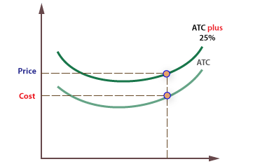

Slide 4
Evaluation of oligopolies
Oligopolies can be criticised on a number of obvious grounds, including:
High concentration reduces consumer choice.
Cartel-like behaviour reduces competition and can lead to higher prices and reduced output.
Firms can be prevented from entering a market because of deliberate barriers to entry.
There is a potential loss of economic welfare.
Oligopolists may be allocatively and productively inefficient.

Slide 5
oligopolies may provide the following benefits
Oligopolies may adopt a highly competitive strategy, in which case they can generate similar benefits to more competitive market structures, such as lower prices. Even though there are a few firms, making the market uncompetitive, their behaviour may be highly competitive.
Oligopolists may be dynamically efficient in terms of innovation and new product and process development. The super-normal profits they generate may be used to innovate, in which case the consumer may gain.
Price stability may bring advantages to consumers and the macro-economy because it helps consumers plan ahead and stabilises their expenditure, which may help stabilise the trade cycle.

Slide 6
Collusive oligopolies
Another key feature of oligopolistic markets is that firms may attempt to collude, rather than compete.
If colluding, participants act like a monopoly and can enjoy the benefits of higher profits over the long term.

Slide 7
Types of collusion
Overt: Overt collusion occurs when there is no attempt to hide agreements, such as when firms form trade associations like the Association of Petrol Retailers.
Covert: Covert collusion occurs when firms try to hide the results of their collusion, usually to avoid detection by regulators, such as when fixing prices.

Slide 8
Tacit
Tacit collusion arises when firms act together, called acting in concert, but where there is no formal or even informal agreement.
For example, it may be accepted that a particular firm is the price leader in an industry, and other firms simply follow the lead of this firm.
All firms may ‘understand’ this, but no agreement or record exists to prove it. If firms do collude, and their behaviour can be proven to result in reduced competition, they are likely to be subject to regulation.
In many cases, tacit collusion is difficult or impossible to prove, though regulators are becoming increasingly sophisticated in developing new methods of detection.

Slide 9
The Prisoner’s Dilemma
The Prisoner's Dilemma is a simple game which illustrates the choices facing oligopolies.
The scenario: Robin and Tom are prisoners
They have been arrested for a petty crime, of which there is good evidence of their guilt – if found guilty they will receive a 2 year sentence.
During the interview the police officer becomes suspicious that the two prisoners are also guilty of a serious crime, but is not sure he has any evidence.

Slide 10
Robin and Tom are placed in separate rooms and cannot communicate with each other. The police officer tries to get them to confess to the serious crime by offering them some options, with possible pay-offs.
The options
Each is told that if they both confess to the serious crime they will receive a sentence of 3 years. However, each is also told that if he confesses and his partner does not, then he will get a light sentence of 1 year, and his partner will get 10 years. They know that if they both deny the serious offence they are certain to be found guilty of the lesser offence, and will get a 2 year sentence.

Slide 11
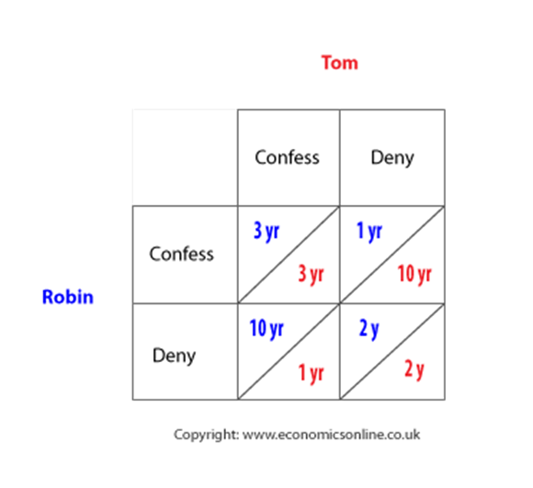
The pay-off matrix

Slide 12
The dilemma is that their own 'pay-off' is wholly dependent on the behaviour of the other prisoner.
To avoid the worse-case scenario (10 years), the safest option is to confess and get 3 years.
If collusion is possible they can both agree to deny (and get 2 years), but there is a very strong incentive to cheat because, if one denies and the other confesses, the best outcome of all is possible - that is 1 year.
Fearing that the other may cheat, the safest option is to confess.

Slide 13
Types of strategy
Maximax: A maximax strategy is one where the player attempts to earn the maximum possible benefit available. This means they will prefer the alternative which includes the chance of achieving the best possible outcome – even if a highly unfavourable outcome is possible.
This strategy, often referred to as the best of the best is often seen as ‘naive’ and overly optimistic strategy, in that it assumes a highly favourable environment for decision making.
The best pay-off for Robin from confessing is 1 year (with Tom denying), and the best pay-off from denying is 2 years (with Tom denying) - so the best of the best is to confess (I year).
Maximin: A maximin strategy is where a player chooses the best of the worst pay-off. This is commonly chosen when a player cannot rely on the other party to keep any agreement that has been made - for example, to deny. In the Prisoner's Dilemma, the worst pay-off to Robin from confessing is to get 3 years (with Tom confessing), and the worst pay-off from denying is 10 years (with Tom confessing) - therefore the best of the worst is to confess.
In this case, both the maximin and maximax strategies would be to confess. When this occurs, it is said to be the dominant strategy.

Slide 14
Dominant strategy: A dominant strategy is the best outcome irrespective of what the other player chooses, in this case it is for each player to confess - both the optimistic maximax and pessimistic maximin lead to the same decision being taken.

Slide 15
Non pricing strategies
Advertising. This creates product differentiation and brand loyalty. Advertising can also be used as a barrier to entry.
Product Development. This could be an effort to improve the quality of the product such as mobile phones with more features.
Loyalty cards. A reason for customers to come back.
Quality of service. Increasing loyalty through better quality.
Location. Better location for firms can let the firm have a competitive advantage over rivals.

