Slide 1
PROTECTIONISM

Slide 2
What is Protectionism?
Protectionism means the policies used by countries to put up barriers to trade
  Example, tariff and quota.

Slide 3
Methods of Protection
Tariffs (import duties)
  This is a tax imposed on imported goods.
  The main advantage is due to tariff it can increase government tax revenue
  The disadvantage is it can create shortages
Quotas
  These are restrictions on the quantity of imports into a country. For example, in Maldives we have a quota placed on the import of Motor Cycle and Cars.
  The main disadvantage of quota is it doesn’t increase any tax revenue.

Slide 4
Non-tariff barriers
  These are barriers which don’t involve taxing imports.
  They reduce imports because it makes it more complicated for an exporter to get their goods into another country e.g., bureaucracy, setting technical standards
Subsidies to home producers
  This means giving grants to domestic producers to lower their production costs. E.g. the Common Agricultural Policy (CAP) of the EU

Slide 5
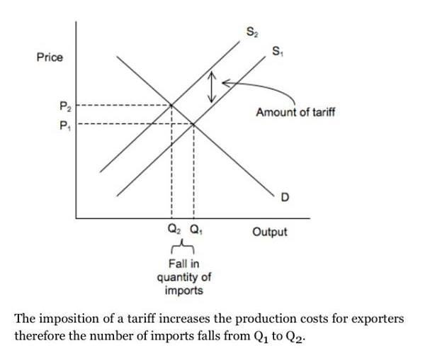
Simple graph - Tariff

Slide 6
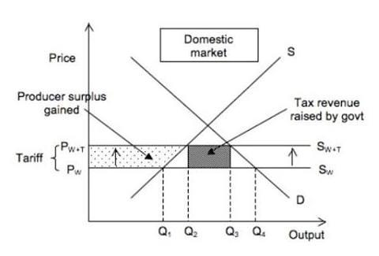
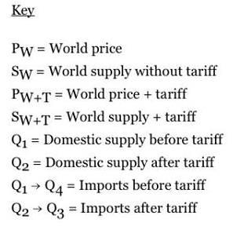
Complicated Graph - Tariff
Initially domestic supply is Q1. Volume of imports Q1 to Q4
After tariff: domestic production increase to Q2 and imports fall to Q2 to Q3
Net result:
- domestic producers protected Q1 to Q2
- consumer lose as consumer surplus fall

Slide 7
Arguments for Protectionism
To protect infant industries: some business can be of long term benefit to the economy providing jobs, growth and exports, if they are not protected in the early stages the businesses may die.
To protect jobs: there may be a lot of pressure on the government in certain industries to protect jobs. Protectionism can also be used to ease the pain of structural unemployment.

Slide 8
To prevent dumping: dumping can cause unemployment and damage the long-term health of an industry, hence protectionism prevents other countries from dumping their surpluses on your country.
To avoid over specialization: protectionism can ensure a country has a better spread of industries. This means it is better able to survive changes in world demand.

Slide 9
Strategic reasons: protectionism can mean a country has minimum level of production in strategically important goods like food, energy…etc.
Economies of scale: local producers can take advantage of the protection to expand output and get the advantage of economies of scale.
To reduce a balance payment deficit: protectionism reduces imports, therefore it reduces a balance of payment deficit.

Slide 10
Arguments against Protectionism
Lack of competition and build up of monopolies: protectionism reduces competition, this means that domestic businesses may build up monopoly positions.
Reduced consumer choice: lack of competition from imports means reduced consumer choice.
Higher prices: without competition, businesses can raise prices more easily. This means higher prices for consumers and can result in inflation.

Slide 11
Retaliation: if one country impose trade barriers, others usually retaliate. If this happens there may be a drop in world trade and nobody benefits.
Unfair competition: protectionism means that a country has an unfair advantage. Eg, subsidies to home producers.

Slide 12
Impact of protectionism on world trade – a practical example
A good example of protectionism is the Common Agricultural Policy (CAP)
This uses a combination of tariffs, subsidies and guaranteed minimum prices to protect EU farmers.
The impact is as follows:
  Surplus and dumping: guaranteed minimum price and export subsidy has made EU farmers to over produce and dump their surpluses creating unemployment and fall in income in other countries.

Slide 13
Inefficient use of resources: inefficient farmers in the EU have stayed in business due to protectionism and consumers have been paying too much for their food.
Trade conflicts: arguments about CAP and dumping have led to retaliation from other countries and a fall in trade with other countries.
Trade diversion: protectionism has given the EU countries an incentive to do more food trade with each other. This has diverted food trade away from their old trading partners.

