Slide 1
What is poverty and inequality in developed and developing countries?

Slide 2
Absolute poverty and Relative poverty
Absolute poverty: this means an individual does not have the basic necessities of life, i.e, food, water, shelter, that is when their income falls below the minimum level (poverty line)
The World Bank has set international poverty line at $1.90 (extreme poverty) and $2.16 (moderate poverty) per day at 2017 GDP PPP
One of the key Millennium Development Goals is to halve the number of people living in absolute poverty by 2015

Slide 3
Measuring Absolute poverty
The Multi Dimensional Poverty Index(MPI)
This is developed by the Oxford Poverty & Human Development Initiative (OPHI) in 2010.
This index uses various factors to determine the poverty beyond income based list.
MPI measures the percentage of the population that is multidimensionally poor.This uses data for health ,education and standard of living to provide an index.

Slide 4
Indicators of poverty
Education in terms of years of schooling and child attendance data
Health indicator in terms of child mortality rate and nutrition data
Standard of living is measured by the availability of electricity, improved toilet facilities ,safe drinking water to house holds, whether or not the floor of house is made of dirt, sand or dung, cooking fuel used and assets owned such as telephone, radio or fridge

Slide 5
Relative Poverty:
This means people living below a certain threshold income in a particular country.
It may be measured by calculating the percentage of the population living below 50% of median income. Therefore, the concept of relative poverty is:
  Highly subjective
  Subject to change over time
  Not comparable between countries. (eg, someone deemed relatively poor in the USA would be regarded as being incredibly rich in Malawi)

Slide 6
All countries will have some people living in relative poverty because incomes are unevenly distributed.
However, it is possible to have no one living in absolute poverty because this is defined in terms of an internationally agreed measure.
Relative poverty arises from inequality.

Slide 7
Difference between INCOME and WEALTH
Income: is a flow concept. People gain income either through paid employment or through the returns on assets eg, interest on savings, dividends or shares.
Wealth is a stock concept. Its measured by the amount of assets a person has

Slide 8
Measurements of Inequality
Factors influencing inequality:
Education and training
Wage rate
Inheritance
Ownership of assets
Pension rights
Unemployment
Social benefits
The tax system

Slide 9
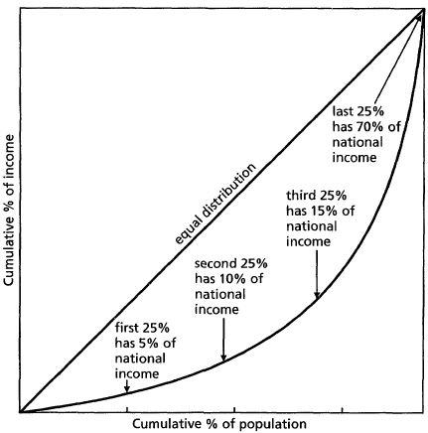
The Lorenz Curve
A
The degree of inequality can be
measured using a Lorenz curve.
B
It plots the cumulative percentage of total income.
The 45° line represents perfect equality such that the poorest 10% of the population would receive 10% of the income.
The curved line represents an unequal distribution of income. The area A and B are used in the calculation of Gini-coefficient.

Slide 10
Gini-coefficient
This is a measure of the degree of inequality in a country. It is calculated as follows:
G = A
  A +B
where A represents the area between the diagonal line and the Lorenz curve
B represents the area under the Lorenz curve.
The Gini-coefficient will have a value between 0 and 1
  0 representing absolute equality
  1 representing absolutely inequality

Slide 11
Causes of income inequality within countries
Impact of globalization; developed countries experienced an increased in inequality within the countries as the wages of skilled workers are affected due to the abundance of unskilled worker in developing countries.

Slide 12
Causes of poverty
Unemployment
Lack of education and training
Old age
Health problems
Dependency on benefits
Inheritance/cycle of poverty
Physical and intellectual capital of the country

Slide 13
Consequences of poverty
Low savings ratio: this effects firms ability to invest and expand
Balance of payment problems: those on high incomes may spend it on large volumes of imports
Lack of entrepreneurship: the poor will have no capital to start their own business
Absolute poverty could remain high: because of a lack of spending power in the economy and the lack of job creation.

