Slide 1
Chapter 1
Types of Business

Slide 2
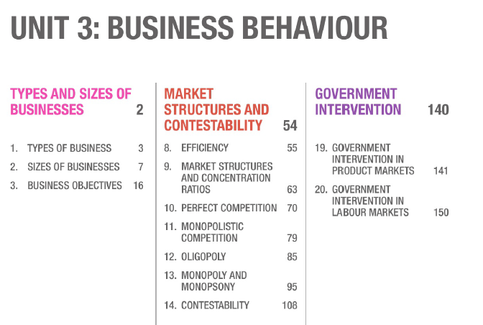

Slide 3
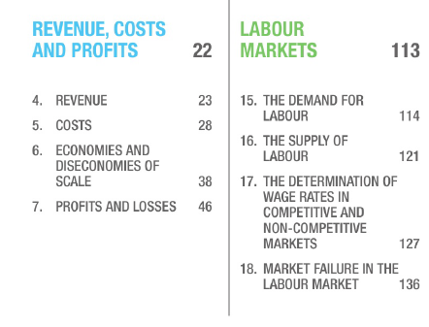

Slide 4
Structure of Unit 3 Question Paper
Section A
  Six Multiple choice questions (6 marks)
Section B
  Five Part question, data provided (34 marks)
  (a) 2 marks, (b) 4 marks, (c) 8 marks, (d) 6 marks, (e) 14 marks
Section C
  Two 20-mark essay questions from a choice of three (40 marks)

Slide 5
Objectives of Lesson
To understand different types of business
  Private sector
  Public sector
  Joint Venture

Slide 6
Private sector Organisation
Owned by individuals or companies and not by state.
Different objectives of businesses:
  Small business – self-employed businessman - Maximise profits
  Large companies – Shareholders(owners of the company), maximise profits
    Directors and managers – make decisions and run the operations – maximise their rewards
Types of private sector organisations:
  Sole trader/ sole proprietor
  Partnership
  Limited companies
  Cooperative
  Not for profit organisation

Slide 7
Sole Trader/ Sole Proprietor
One person owns and controls the business
Advantages:
  Easy to set up - little capital requirement, few legal requirement.
  Owner has full control and keeps all profits
  May or may not employ workers
Disadvantages:
  Unlimited liability: Owner and business are one and same
  Debts of business are debts of owner, to pay any business debts owners personal possession may be taken away

Slide 8
Partnership
Two or more people are partners
Partners own and control the business
Capital, risks and responsibilities are shared between partners
Advantages:
  Partners have full control of business and keeps all profits
Disadvantages:
  Unlimited liability
  Partners liable for actions of other partner

Slide 9
Limited Companies
Registered through legal formalities with government.
Limited liability: company and owners(shareholders) are separate entities.
  If the company has debts, Shareholders only lose the amount of capital invested as share capital, personal possessions are protected.
  If profits made, shareholders receive the share of profits in form of dividends

Slide 10
Private limited companies | Public limited companies
Shareholders have to agree who can buy the shares. Shares only sold to friends or family. Restriction on number of shares held by shareholders ‘Ltd’ or ‘Pvt Ltd’ | Share traded freely on stock exchange in own country or in foreign stock exchange ‘Plc’ or ‘Ltd’ or nothing added to the name

Slide 11
Cooperatives
Owned by members and each members has one vote on major business decisions
Profits shared equally among members
Limited liability
Aim: to provide service rather than to earn profits
Types of cooperatives
  Consumer cooperatives
    Owned by consumers who buy goods or services from their cooperatives.
  Producer cooperatives
    Owned by producers of commodities/crafts, work together to process and market their goods.
  Worker cooperatives
    Owned and democratically governed by employees who become co-op members.

Slide 12
Not for profit Organisations
Aim: not to earn profits rather to work for welfare
Use profits to support their aims
E.g. : Charities, community organisations, social enterprises.
There are regulators for charities to ensure they are operated correctly.

Slide 13
State owned/ Public Sector organisation
Large organisations
Created by country’s government to carry out commercial activities.
Fully or partially owned by state.
State will have significant control over business
Separate legal identity.
Profits paid to government
E.g. Airlines

Slide 14
Joint Ventures
Separate business entity created by two or more parties
Shares ownership, returns and risk
Set up so both parties can benefit
Agreement for specific project
  Share resources to develop a new product
  Share ideas
E.g.
  University sets up partnership with universities in other countries

Slide 15
Setup between global business and local business
  Global Business wants to expand into new market, local business has knowledge of that market.
  Global business – little understanding of the culture of new market,
  Forming joint venture, global business successfully enter into new markets.
  Local business gains knowledge to improve its efficiency by working with global company.
  Governments only allow foreign companies to set up in their country through joint ventures.
    To prevent exploitation of resources and employees
    To ensure transfer of knowledge
    Improve distribution of income and wealth – profits earned by domestic country.

