Slide 1
Ch 7
Profits & losses

Slide 2
Learning Objectives
Understanding the difference between normal profits, supernormal profits and losses
Know the difference between LR and SR shut down points

Slide 3
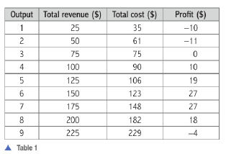
Profit
Difference between revenue and costs
Maximum profit – when difference between TR and TC is greatest

Slide 4
Normal and Supernormal Profits
Profits = TR – TC
Economic profit considers implicit and explicit cost
Accounting profit considers only explicit cost
 | Company A | Company B | Company C
Laptop | $100,000 | $110,000 | $90,000 | Accounting profit
Tablet | $100,000 | $100,000 | $100,000
Economic Profit | $0 | $10,000 | - $10,000
 | Normal Profit | Super normal Profit | Loss
When a firm makes normal profit, we say the economic profits are zero.

Slide 5
Normal profit – profit that resources used in the firm could have made in their next best alternative.
Normal profit is a situation where a firm makes sufficient revenue to cover its total costs and remain competitive in the industry.
In measuring normal profits, we include opportunity cost(implicit costs).
If a firm fails to earn normal profits, it would stop producing in the LR.
Firms resources would be put to better use for producing other goods and services where normal profits could be earned.
Normal profits must be earned to keep FOP in present use.
It is the minimum return an entrepreneur would be willing to accept to remain in the business

Slide 6
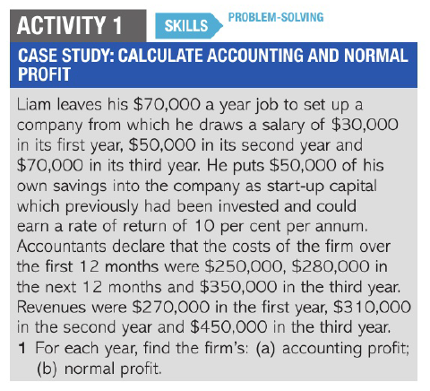
Supernormal Profits/ Pure Profits/ Abnormal Profits
Profits over and above normal profits
Normal Profit TR = TC
Supernormal Profits TR > TC

Slide 7
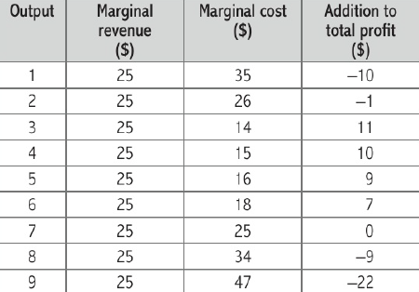
Profit Maximisation Rule – MC= MR
MC and MR – used to find profit maximisation level of output
MC – additional cost of extra unit of output produced
MR – additional revenue from extra unit of sales
Marginal profit – extra profit made from producing extra unit of output
Marginal profit = MR – MC
So long as firm can make additional profit by producing extra unit of output it will carry on expanding
When producing extra unit yields a loss (Marginal profit is negative) firm will stop production
Profits will be maximised at output level where MC=MR

Slide 8
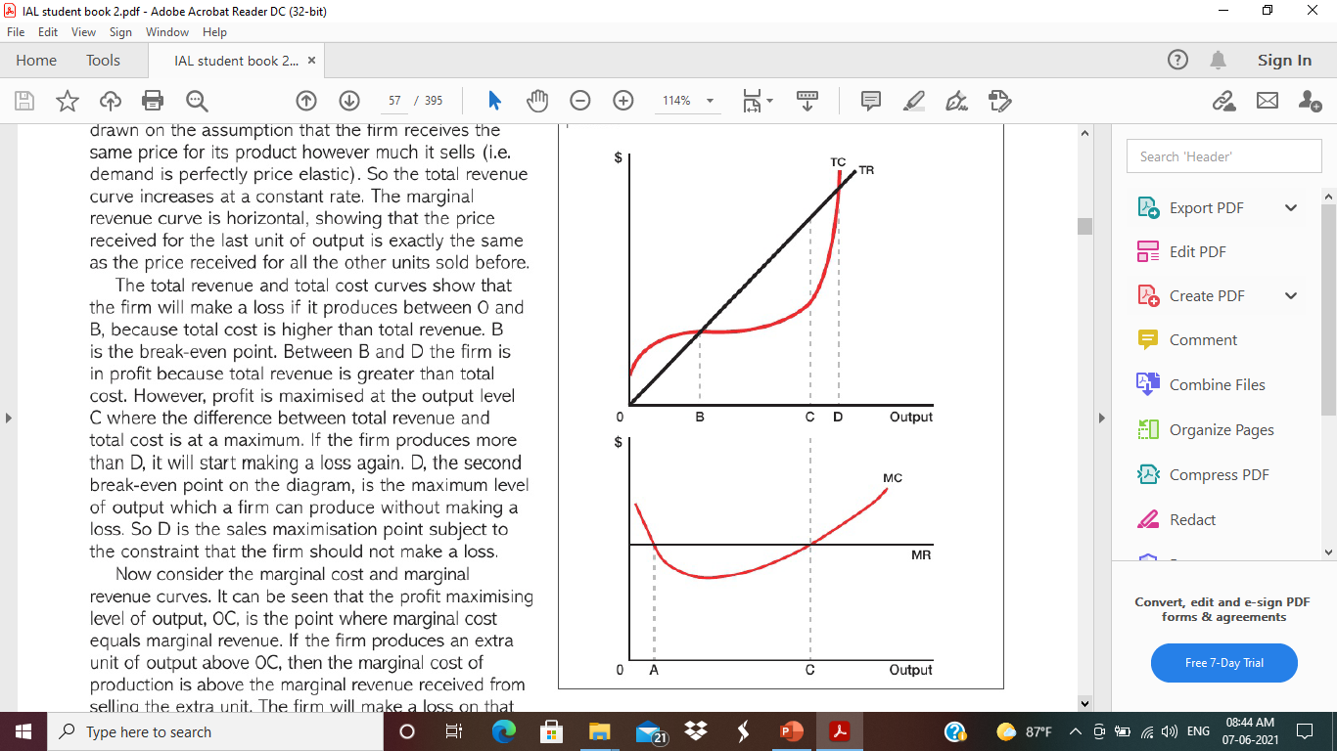
Cost and Revenue curves
TR and TC curves
Assumption – Firm receives same price (Demand is perfectly elastic)
i.e. D = AR = MR
TR curve increases at constant rate
Between O and B – TC > TR – Loss
At B (first break even point) – TR=TC – Normal profit
Between B and D – TR > TC – Super-normal profits
At C – Difference between TR and TC is greatest – Profit maximisation
Beyond C – profits will start to decline
At D (second break even point) – TR = TC – maximum level of output firm can produce without making a loss
D is sales maximisation point

Slide 9
MC and MR curves
OC – Profit maximisation level of output – MC=MR
Right of OC – MC > MR – firm makes loss on extra unit produced, total profit starts falling, output reduced
Left of OC – MC < MR – firm makes profit on extra unit produced, expand output
At A also, MC=MR
Not always MC starts above MR at initial level of output
If it happens first intersection point of two curves (MC= MR) is not profit maximisation point
For profit maximisation two conditions to fulfil:
MC is rising
MC = MR

Slide 10
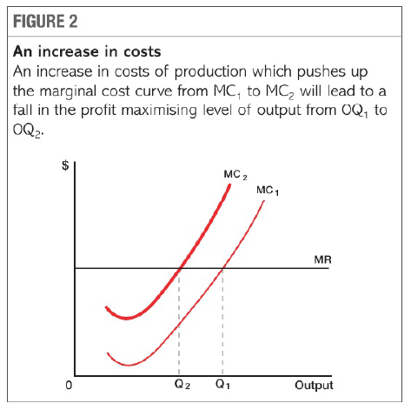
Shift in Cost and Revenue curves
Impact of shift in cost and revenue curves on output
Assumption - cost/ price of raw material increase
MC at every level of output will be higher
MC shift upwards
Profit maximisation level of output falls from OQ1 to OQ2
Rise in costs will lead to fall in output

Slide 11
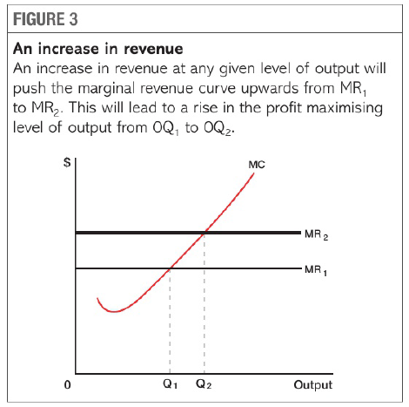
Assumption – increase in income/ good becomes fashionable to purchase
Revenue increase at every given level of output
MR curve pushed upwards
Profit maximisation level of output rise from OQ1 to OQ2
Rise in revenue will increase output

Slide 12
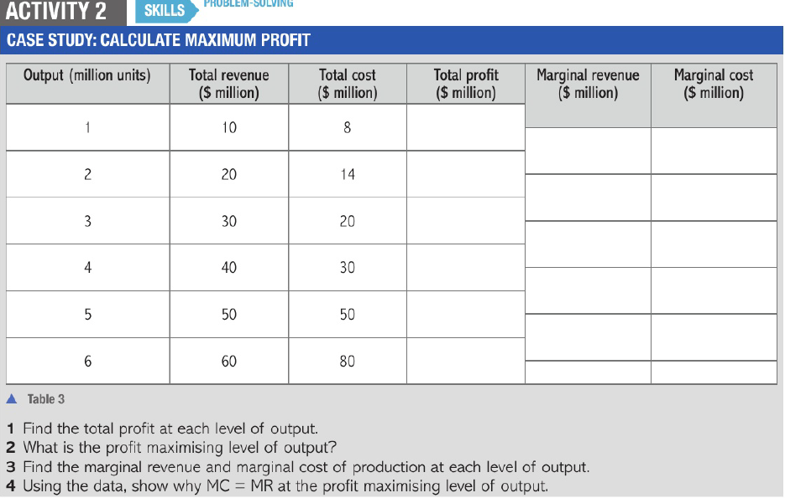

Slide 13
Shutdown points in SR and LR
Firms makes profits and losses
Different approaches to study economics
Neo-Classical economics – firms will continue production in SR so long as they can cover their variable costs
Classical Economics | Neo-Classical Economics
Focuses on what makes economy expand or contract | Focuses on how individuals operate within the economy
Emphasizes on production of goods and services | Emphasizes on exchange of goods and services
Explains how economic systems grow and contract | Explains the behaviour of individual/ companies within the whole system

Slide 14
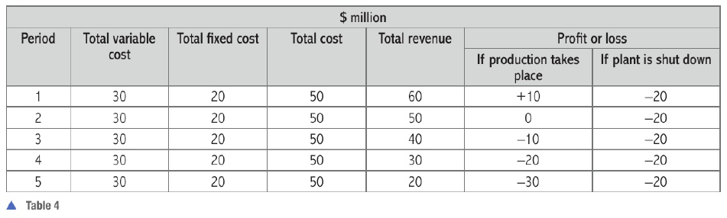
1st period – TR > TC (AR>ATC) – If production takes place, Economic profit is $10 million, Supernormal profits
2nd period – TR = TC (AR = ATC) – If production takes place, Economic profit is 0, normal profit
3rd period – TR < TC (AR<ATC)/ (AR>AVC) – if production takes place loss of $10 million,
if firm shuts down the production loss of $20 million
continue production
4th period – TR<TC (AR<ATC)/ (AR= AVC) – if production takes place loss of $20 million
if shuts down loss of $20 million
produce or not to produce (choice)
5th period – TR<TC (AR<ATC)/ (AR < AVC) - if production takes place loss of $30 million
if shuts down loss of $20 million, Firm decides to shut down

Slide 15
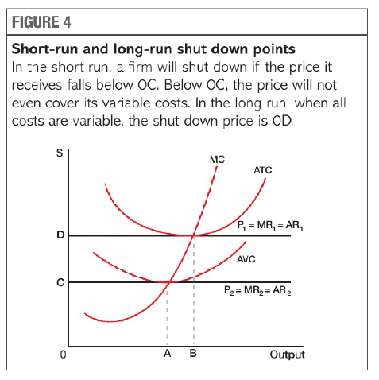
Profit maximisation level of output – MC = MR
At price OE, AR>ATC, Supernormal profits
At price OD, AR=ATC, Normal profits
At price OG, AR<ATC/AR>AVC
At price OC, AR = AVC
Price OC/ output OA – SR shutdown point
Price OD/ output OB – LR shutdown point
E
P0=MR0=AR0
G
P3=MR3=AR3
I
P4=MR4=AR4
J
H
F

Slide 16
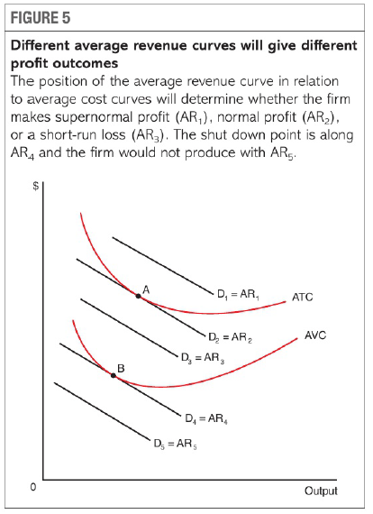
Profit maximisation level of output – MC = MR
At price OE, AR>ATC, Supernormal profits
At price OD, AR=ATC, Normal profits
At price OG, AR<ATC/AR>AVC
At price OC, AR = AVC
Price OC/ output OB – SR shutdown point
Price OD/ output OA – LR shutdown point
MC
E
D
G
C
I
J
B
H
A
F

Slide 17
Difference between TR and TC
E.g.
TR earned from selling products to customers
Total Costs incurred to buy products, employ labour, pay taxes
When TR > TC (AR>AC) – Supernormal profits
When TR = TC (AR = AC) – Normal profits
When TR< TC (AR < AC) - Losses

Slide 18
US retail firm has variety of costs in SR – fixed costs and variable costs
Variable costs – costs that vary with output
E.g. buying products(clothing items) to sell in stores, overtime of staff
Fixed costs – costs that do not vary with output
E.g. Rent of stores, maintenance of stores, interest payment on loans
Decision to keep stores open depends on whether revenues exceed variable costs in SR.
E.g. TVC - $20 million, TFC = $5 million, TR - $21 million, keep stores open even after losses
E.g. TVC - $22 million, TFC = $5 million, TR - $21 million, shut down because can’t cover variable costs

Slide 19

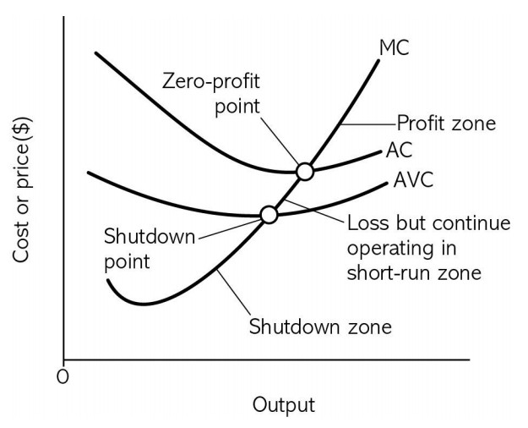
SR – retailers will close their stores if they fail to cover variable costs
By 2018, number of stores had been closed due to fall in demand – application from extract

Slide 20
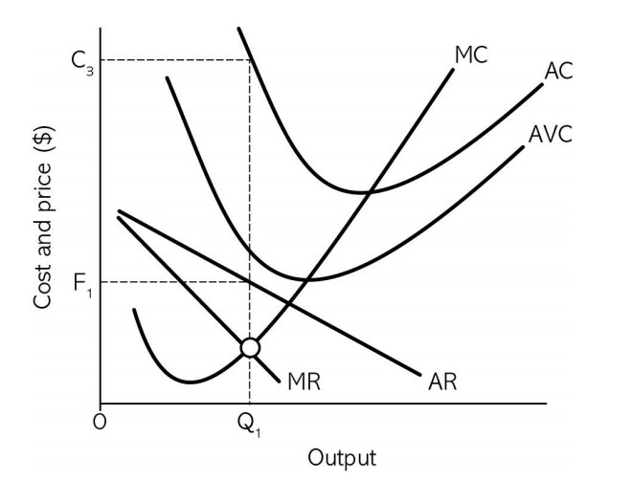
Fall in demand - more customers use ecommerce to make purchases instead of physical stores.
Fall in demand – demand curve moves down – revenue from sales in the stores had fallen
Fall in demand pushes down the price, both MR and AR reduces

Slide 21
Evaluation
Demand may not fall if better services provided
Increased revenue from online sales, recover demand in stores with click and collect service, AR and MR curves increase
Earlier closures of stores – if increases efficiency and costs saving – could lower AC
Reduce inventory costs, AVC, AC and MC reduced
Conclusions
Online sales are growing trend in retailing in America , difficult that demand could be increased,
Only way to avoid closure of stores is to bring down the costs

