Slide 1
Chapter 15
Demand of labour

Slide 2
Introduction
Demand for labour – derived demand
Increase in demand for goods – increase in demand for labour
Decrease in demand for goods – decrease in demand for labour
Demand curve of labour – how many workers will be hired at given wage rate

Slide 3
Short-run demand for labour
SR – at least one factor is fixed
Assumption – All factors fixed except labour
Law of diminishing returns – Marginal/ additional output starts to decline as more and more units of variable factors combined with fixed factors

Slide 4
Per week
1 | 2 | 3 | 4 | 5 | 6 | 7
Labour input (Workers) | Total output (Units) | Marginal physical product/ Marginal output (Units) | Price of product ($) | Marginal revenue product (MPP * Price) ($) | Wage rate per worker ($) | Total profits/ losses (MRP – Wage rate) ($)
1 | 8 |  | 10 |  | 70
2 | 17 |  | 10 |  | 70
3 | 25 |  | 10 |  | 70
4 | 32 |  | 10 |  | 70
5 | 38 |  | 10 |  | 70
6 | 43 |  | 10 |  | 70
 |  |  | 10 |  | 70
Marginal revenue product theory suggests that firms will employ a maximum of four workers because this number maximises profits.
At lower wages - more workers employed

Slide 5
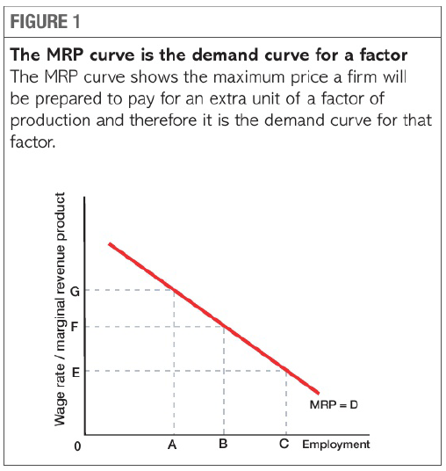
Downward sloping demand curve
Demand curve – MRP curve of labour
Shows number of workers firm will employ at given wage rate
Downward slope shows a negative relation
Fall MRP/ Wage rate – Rise in Quantity of labour
At lower wages – firms will employ more labour

Slide 6

Shifts in Demand for Labour
Change in marginal revenue product(MRP) – demand curve of labour shifts
  Productivity of labour –
    Change in physical productivity (physical output per worker)
    Increase in marginal physical product – increase in marginal revenue product (Right shift in demand of labour)
    Employers are ready to pay more to workers who are more productive
  Price of product –
    Increase in demand for goods – increase in price of goods – increase in MRP (Right shift in demand of labour)
    Increase in demands for goods – increase in demand for labour – increase in wage rate

Slide 7
Demand curve of Labour in SR & LR
Rise in wage rate( PL) – less labour firms will hire(Fall in DL)
LR – All FOP vary
  Rise in wage rate – firms substitute capital for labour – Fall in DL
SR – Assuming all FOP fixed except labour
  Diminishing returns occur (Marginal output(MPP) falls)
  Fall marginal output – fall in wage rate – Rise in DL
  Lower wages encourage employers to employ an extra worker
DL – downward sloping in SR and LR

Slide 8
Wage rate relative to price of labour
Change in wage rate relative to price of capital – Shifts the DL
Rise in wage rate relative to price of capital – capital cheaper than labour – firms replace labour with capital – Fall in DL
LR- all FOP variable – complete freedom to choose techniques of production.
Developing countries – labour is cheaper than capital – Labour intensive technique
  Agriculture sector – more use of labour
Developed countries – capital is cheaper than labour – capital intensive technique
  Agriculture sector – more tractors and machinery used

Slide 9
Perfect and Imperfect competition
Assumption – Perfectly competitive market
  Any quantity of goods supplied at same price
  Demand curve of product – perfectly elastic (Horizontal)
  MRP/DL – Downward sloping – Law of diminishing returns
Imperfectly competitive market
  Demand curve of product – More output supplied at lower prices – Downward sloping
  Fall in price of product – fall in MRP/DL
  MRP/DL – downward sloping – Law of diminishing returns & fall in price of product

Slide 10
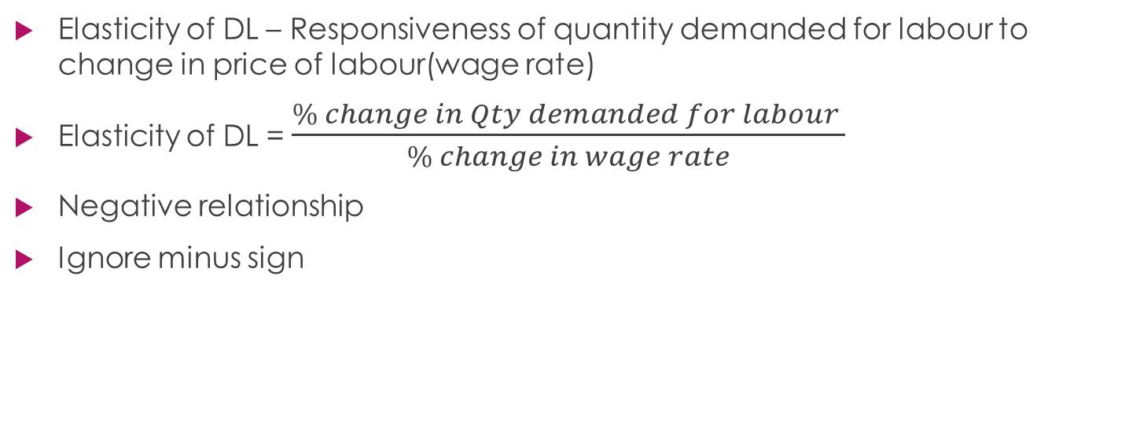
Elasticity of DL
Elasticity of DL – Responsiveness of quantity demanded for labour to change in price of labour(wage rate)
Elasticity of DL = $\frac{\% change in Qty demanded for labour }{\% change in wage rate}$
Negative relationship
Ignore minus sign

Slide 11
Factors/reasons that change Elasticity of DL
Time
  Long time period – firms can increase its capital stock - Easy to substitute labour for other FOP (More elastic)
  Short time period – Little choice of substitution – employ same no. of workers at higher wage rate (Less elastic)
  Contract of employment – higher penalties for making workers redundant (Less elastic)

