Slide 1
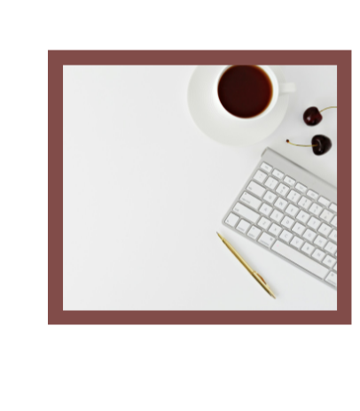
Informal email writing

Slide 2
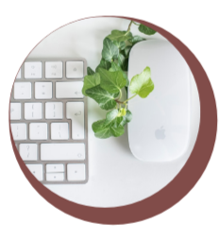
Purpose
To share information with the reader, usually to give news about what happened in our personal lives.
The audience of the informal email is someone we know quite well, usually a friend.
This means that the language and tone of the email tends to be informal and often includes examples of spoken English including contractions, phrasal verbs and idioms.

Slide 3
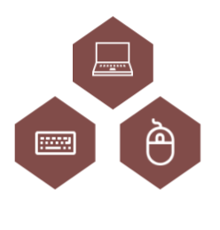
Content
Content covers:
• Task fulfilment (i.e. whether the piece fulfills the task, how relevant the content is and an awareness of style, register, purpose and audience).
• Development of ideas (i.e. the level of detail provided).
Language
Language covers:
• Range (i.e. the complexity of grammatical and lexical structures).
• Accuracy (i.e. the level of grammatical and lexical accuracy, the type of errors and whether these impede communication).
• Organisation (i.e. whether ideas are organised and sequenced effectively, the range of linking words/phrases and other cohesive devices).

Slide 4
Language
• think about the suitable vocabulary for this text type to ensure the tone of your email is appropriately informal
• to make your email sounds informal, you can also use appropriate phrasal verbs (e.g. give up), idioms (e.g. out of the blue) and contractions (e.g. I’ve, it’s been, you’ll) instead of full forms
• include a range of topic related vocabulary (e.g. judges, audience, the first prize, compete in)
• to ensure your email is communicated skillfully and reads well, try to include clauses that begin with ‘which’, ‘when’ ‘if’, etc.
• when you finish writing your email, read it through and check for missing words (e.g. prepositions and articles) and your grammar and spelling.

Slide 5

Organisation
Your email should be divided into clear paragraphs.
• Brief opening paragraph 1 – you can ask how your friend is / apologise for something / state the reason for writing the email.
• Paragraph 2 – your response to the idea in bullet point 1.
• Paragraph 3 – your response to the idea in bullet point 2.
• Paragraph 4 - your response to the idea in bullet point 3.
• Brief closing paragraph 5 – this paragraph can include questions you have for your friend / a future invitation / a suggestion/recommendation for your friend.

Slide 6
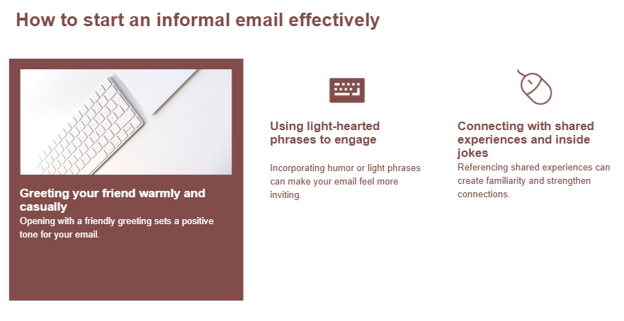

Slide 7
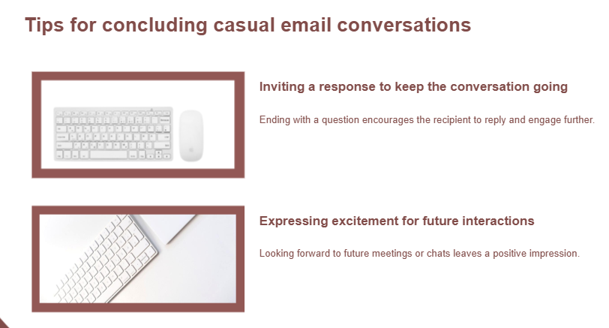

Slide 8
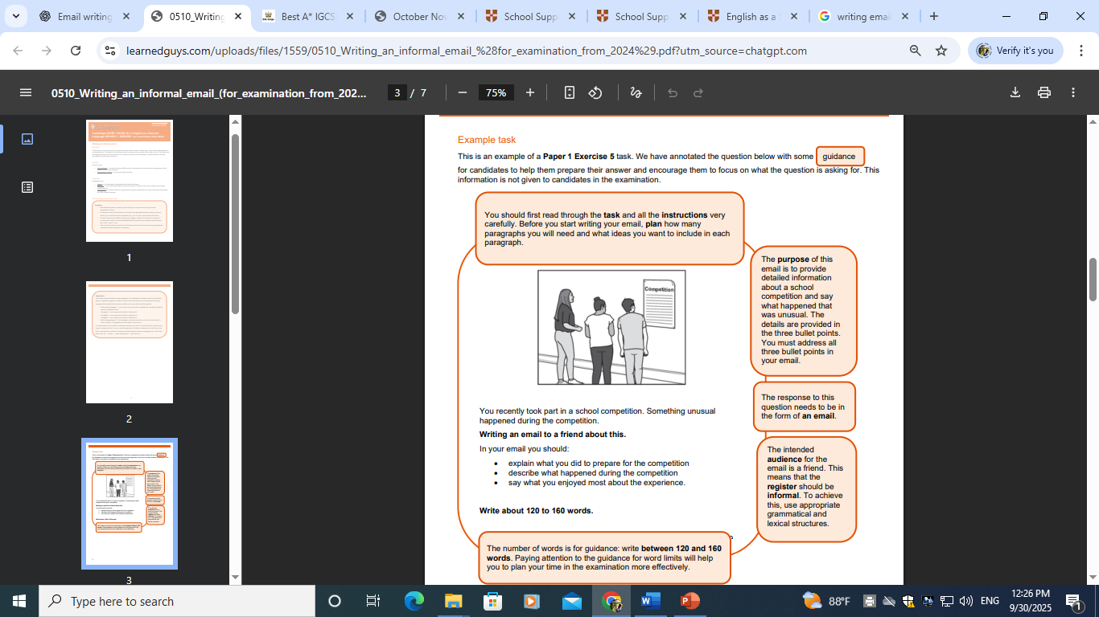


Slide 9
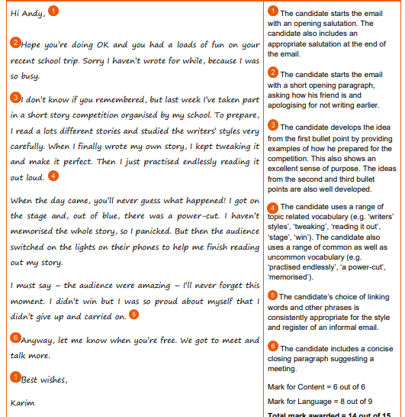
Despite this being a successful response, the level of accuracy isn’t always maintained throughout the email.
The candidate has made several errors and that is the reason why this response didn’t achieve full marks for language. However, these errors do not impede communication.
The weaker areas include tenses, verb forms, the wrong use of prepositions, the wrong use of definite and indefinite articles and omission of words, mainly prepositions and articles.

Slide 10


Task
You are planning a special party, and want some help from your friend. Write an email to your friend about the party. In your email, you should:
• say what the party is for
• suggest some activities that could happen at the party.
• explain how your friend can help you
The pictures above may give you some ideas, and you should try to use some ideas of your own. Your email should be between 120 and 160 words long.
You will receive up to 6 marks for the content of your email, and up to 9 marks for the style and accuracy of your language

